Slide 1
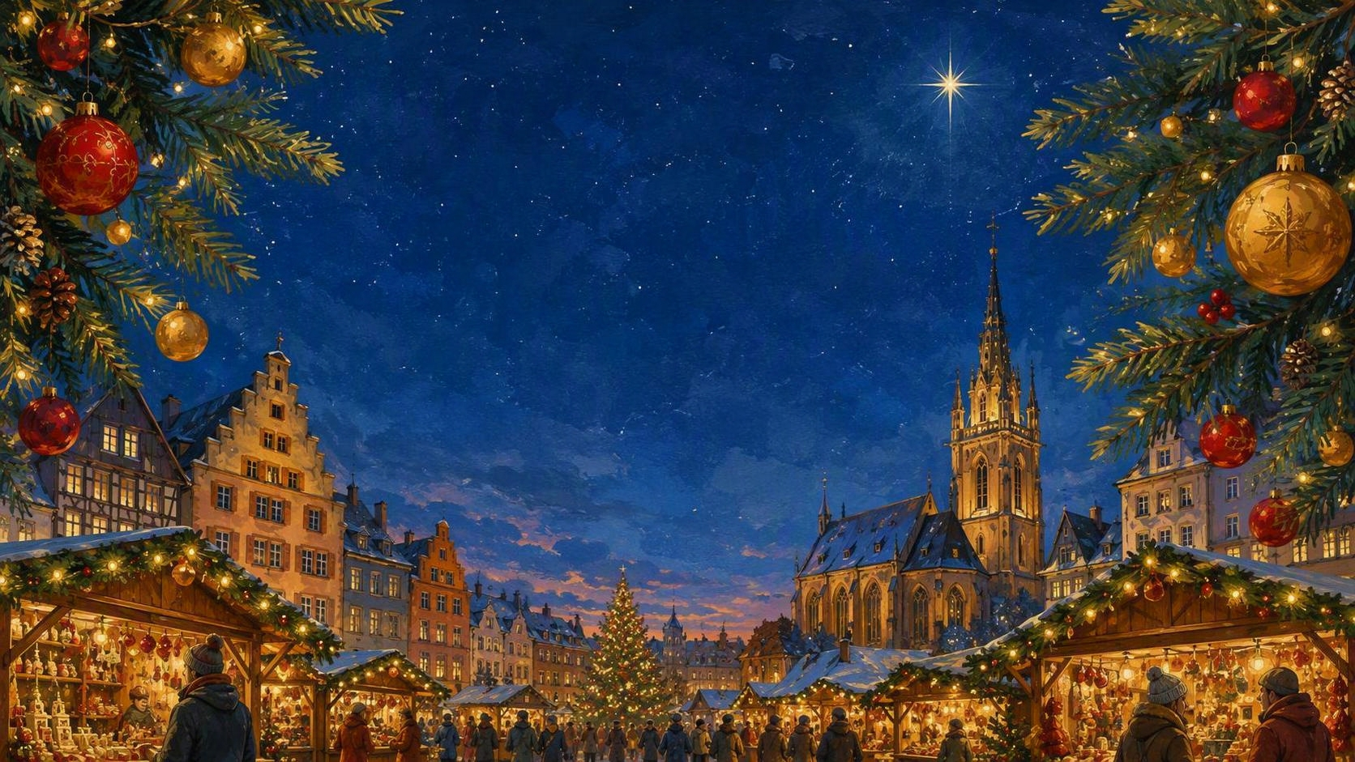
Christmas Markets
with a Danube River Cruise
Pilgrimage
December 5 – December 13

Slide 2
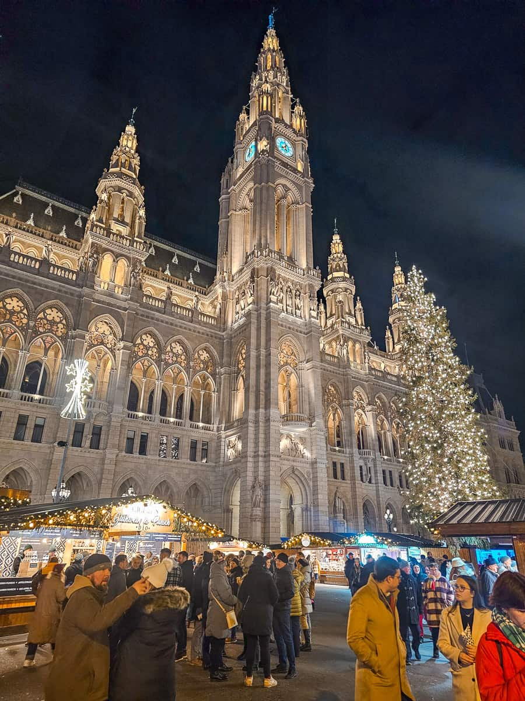
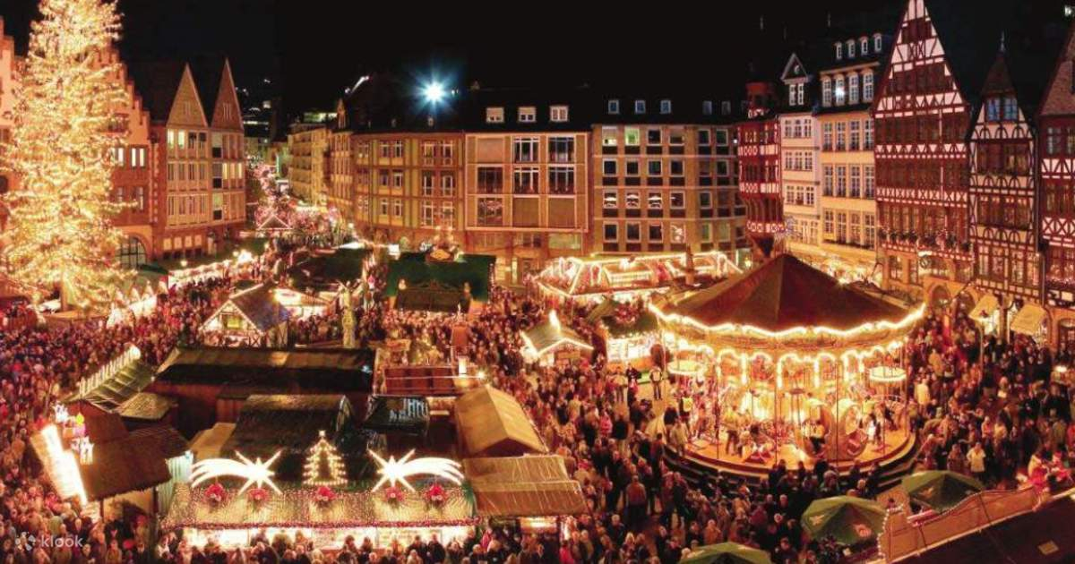
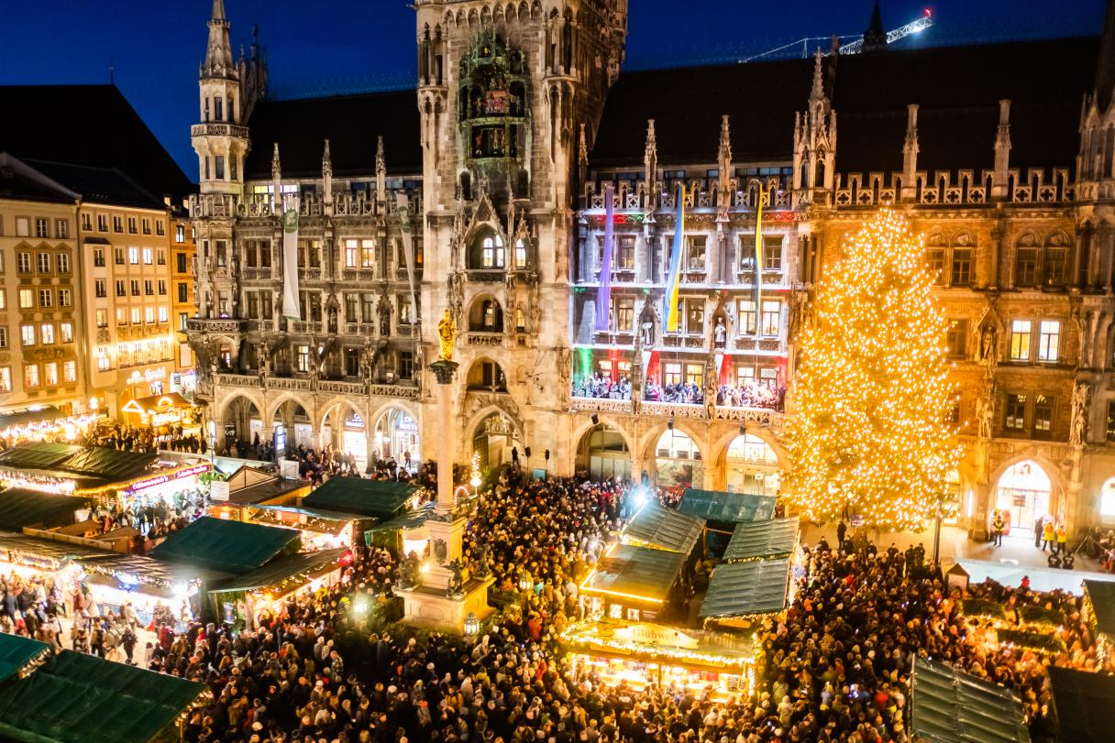
Christmas Markets with a Danube River Cruise Pilgrimage
Austria, Budapest, Slovakia, and Germany
Vienna Market
Munich Market
Deacon Kevin Bagley, D. Min.
9 Days
December 5 – 13, 2026

Slide 3
Pilgrims Prayer
Dear God,
We ask your blessing when we travel.
Guide our minds as we celebrate the places
and the pilgrims who came before us.
Give us a hunger to seek your face in our paths
and recognize you along the way.
Bless us on our travels as we experience holy places and sacred images.
Nurture our fellowship, so we see each other
as brothers and sisters on our pilgrimage together,
as we all journey to your blessed kingdom
where you live and reign, forever and ever. Amen

Slide 4
Land & Group Air vs Land Only
Land & Group Air
Land Only
Airline tickets are purchased for you
Once ticketed, you can contact the airline to change/upgrade your seat
We travel as a group on the airplane
You purchase your own airline tickets
You are responsible for getting to,
Vienna, Austria Airport
Baggage claim
December 6th at 5:35 p.m.
Once on the bus, there is no difference!

Slide 5
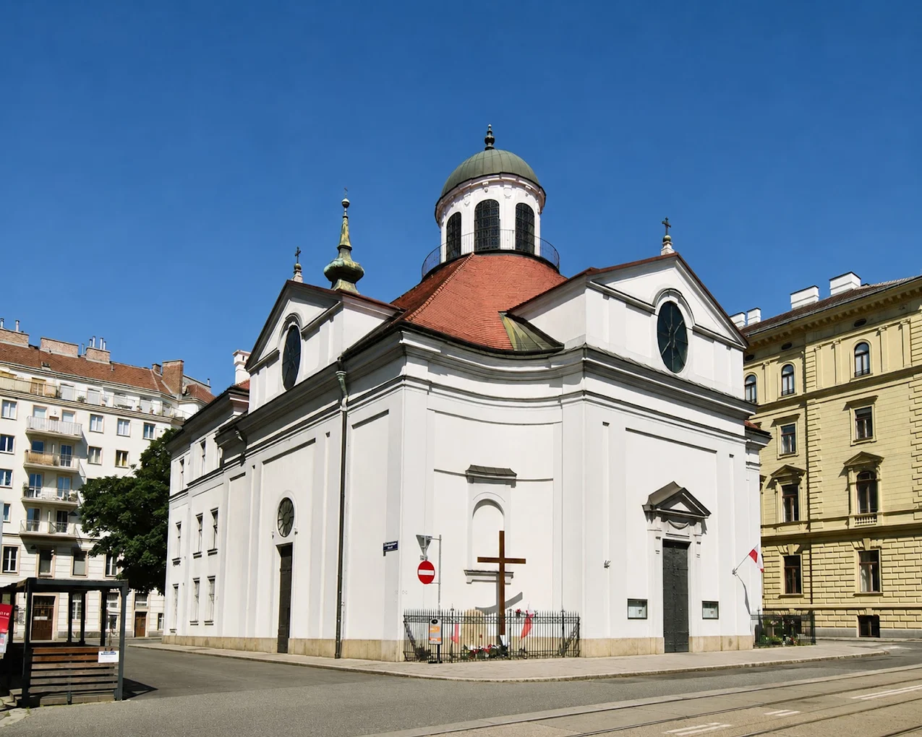
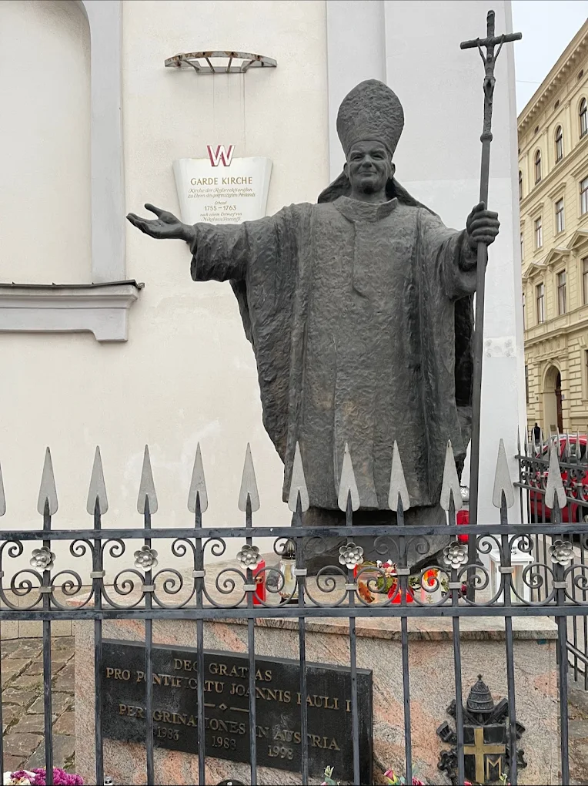
What is a pilgrimage?
A pilgrimage is a journey religious people take to a holy place or a place of religious significance.
Pilgrimage can be a physical journey, but it can also represent an individual's journey of faith
Catholics may visit sites linked to famous or important saints to help them connect with their faith's history
The primary Polish Catholic community in Vienna centers around the Kirche Zum Hl. Saint John Paul II relics are in their museum.

Slide 6
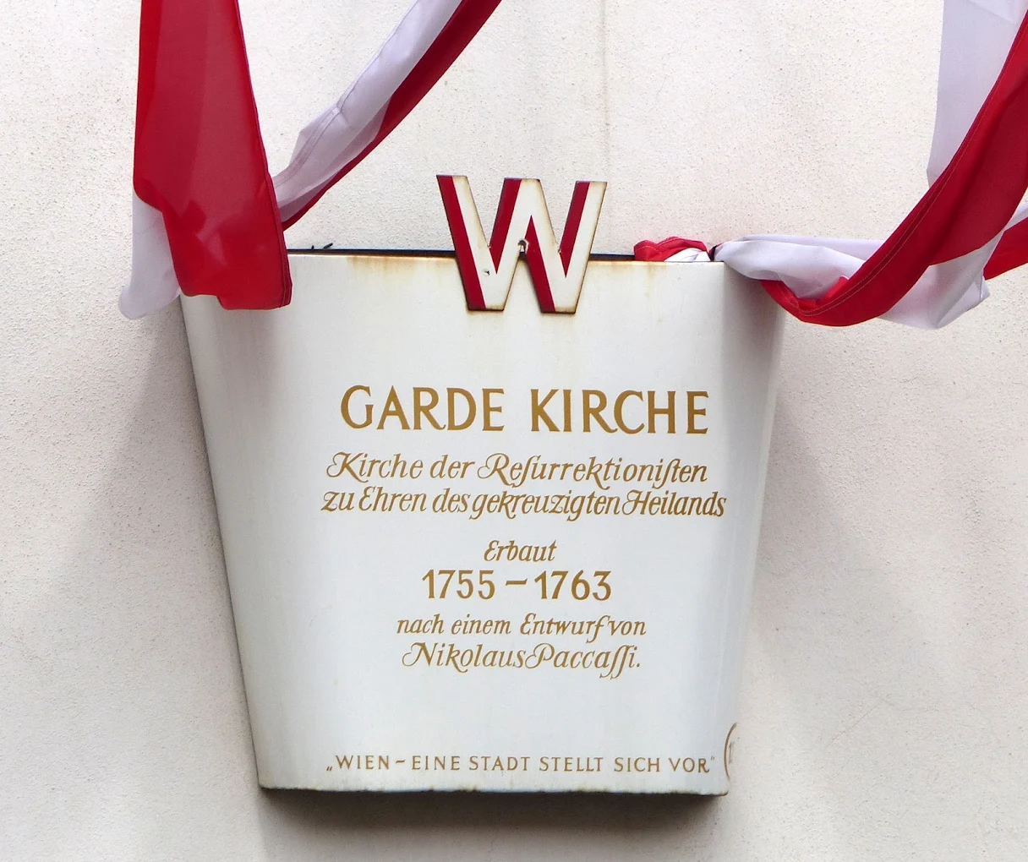
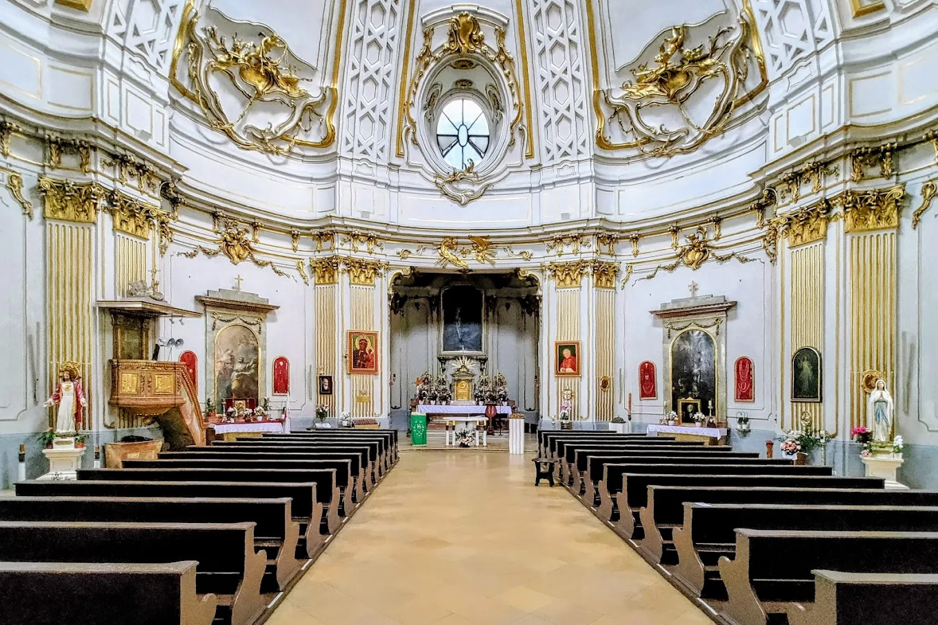
We are pilgrims on a Journey
Spiritual excursion
Opportunity to travel with (new) friends
Museum holding the relics
of
Saint John Paul II
Garde Kirche
Polish Catholic Church

Slide 7
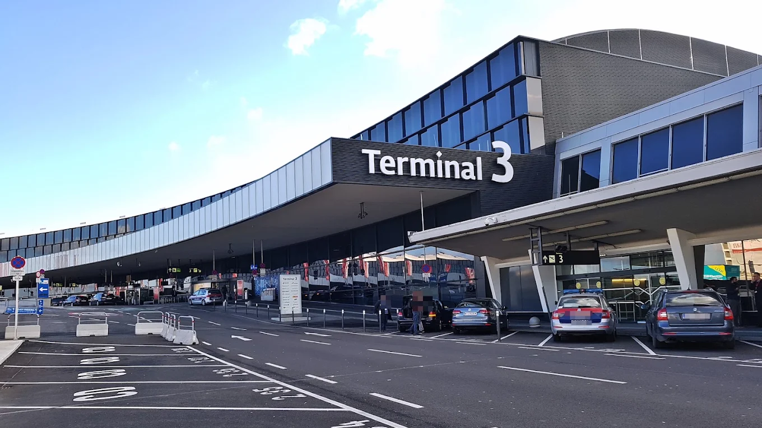
Scriptural foundations -
The spiritual importance of pilgrimage is manifested often in physical journeys and trials — from Abraham’s journey of faith all the way to the missionary journeys of Saint Paul.
Some Famous pilgrimages:
Abram
Exodus
15 of the Psalms speak of the ascent to Jerusalem
Wise men seeking the infant Jesus
The Holy Family going to Jerusalem
Jesus going to Jerusalem
Our journey to the Kingdom

Slide 8

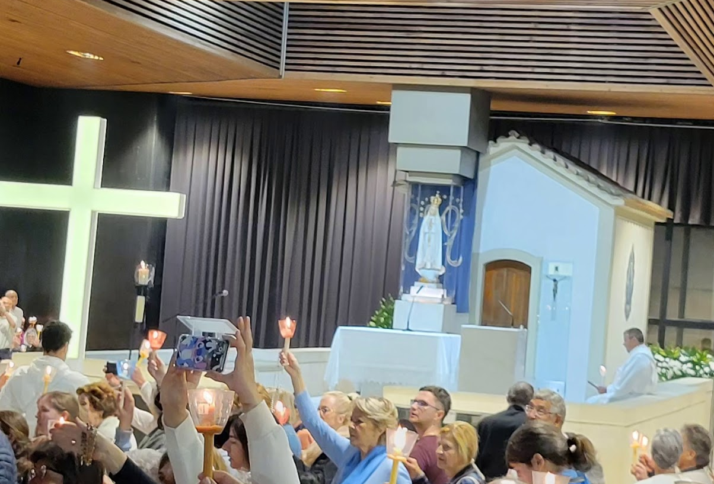
What is the difference between
a tourist
and a
religious pilgrim??

Slide 9

Pilgrims
do not
complain
We offer it up!

Slide 10
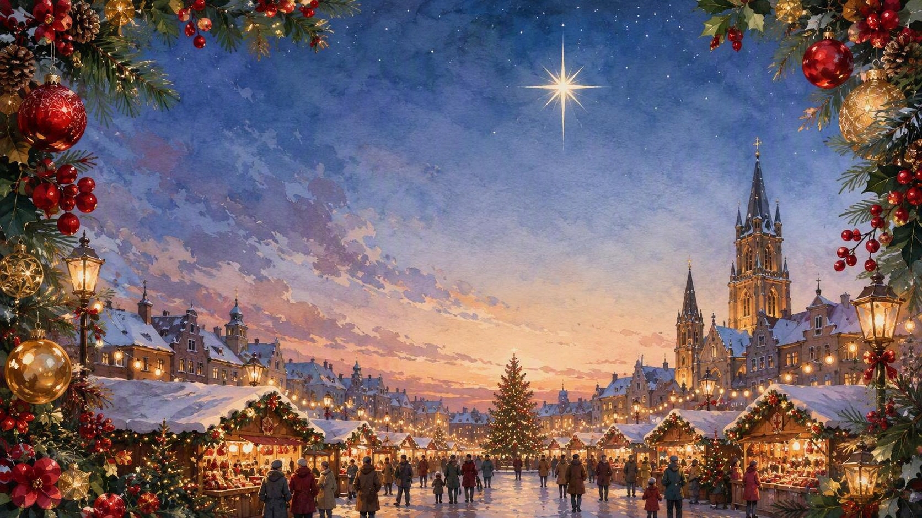
20 Best Christmas Markets in EUROPE 2026-2027 Travel Guide
(Ctrl / click on link- click on 1st 2 sections of market listings)

Slide 11
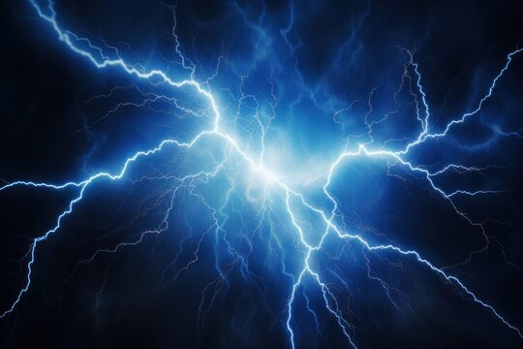
Electricity:
Europe’s electricity is 230 Volt 50hz.
Your electronics need a power adapter/converter
You will need a 2-prong adapter for your electronic items, which will fit into European outlets with two/three holes.

Slide 12
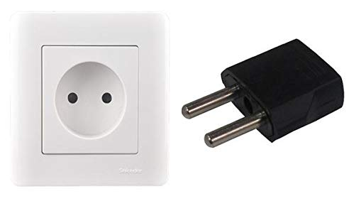
Plug adapters vs converters
The USA operates on 110 volts
Most of Europe operates on 220 volts
Adapters help the plugs fit into the outlet
Converters change the voltage of the electricity

Slide 13
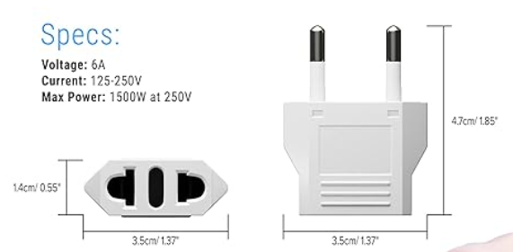
Adapter
https://www.amazon.com/s?k=european+travel+power+converter&i=tools&crid=1V2S2NQ5VG1CN&sprefix=european+travel+power+converter%2Ctools%2C82&ref=nb_sb_noss_1

Slide 14
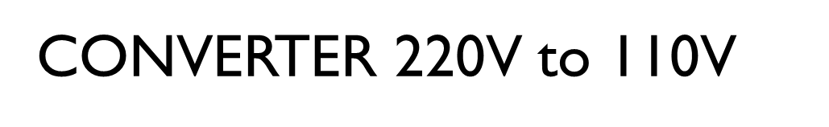
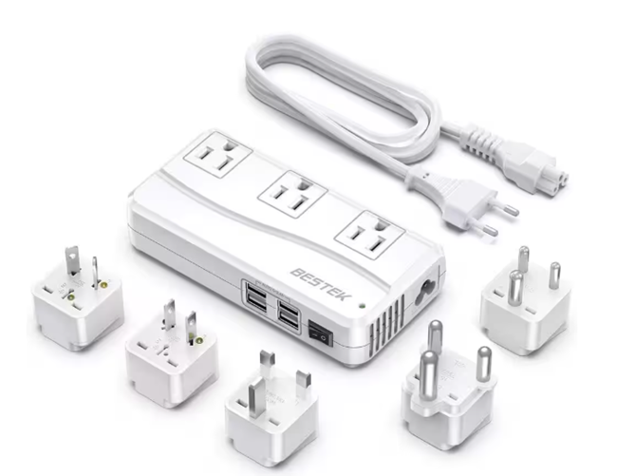
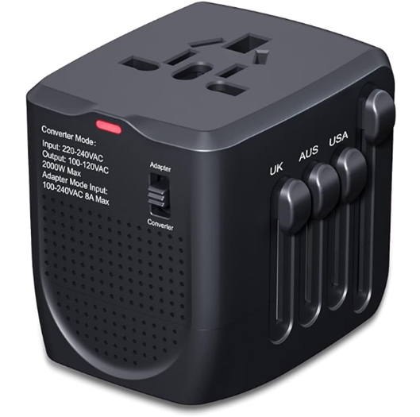

Slide 15
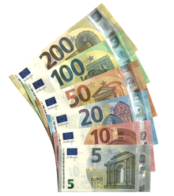
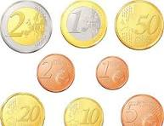
Money
Europe’s currency is the euro (€). All major credit cards are widely accepted in Europe, though some establishments do not accept American Express and Diners.
You can purchase Euros (currency) through your bank

Slide 16
Exchange rate $1 =
Euros to US Dollars: exchange rates today
EUR | USD
1 EUR | 1.19 USD
10 EUR | 11.92 USD
20 EUR | 23.84 USD
50 EUR | 59.59 USD
0.87 Euro
September 22, 2026
It's a good idea to exchange currency before traveling to ensure you have some local currency on-hand when you arrive.

Slide 17

Things to check:
Cellular telephone coverage
Health insurance / coverage
Debit Cards – PIN issues
Credit Cards – say no to FOREIGN TRANSACTION FEES
How will you get to and from the airport?

Slide 18
TSA
What can I bring?
Liquids, Aerosols, and Gels Rule
Two-minute travel tips from Select International

Slide 19
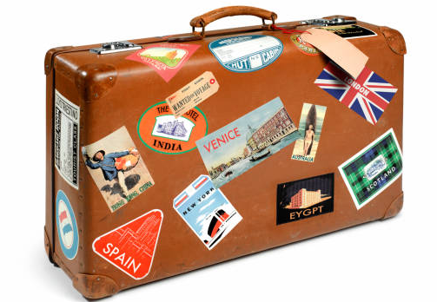
Luggage / baggage
Checked baggage – One single piece of baggage
  Not more 62 linear inches [height + width + length] in size, and 50 lbs. for Economy Class and 70 lbs. for Business Class.
One piece of cabin baggage per passenger
  not to exceed 21.7” x 13.8” x 9” in size and 26 lbs. in weight
One personal item per passenger
  not to exceed 40x30x15 inches in size and 9 lbs. in weight
Air France baggage American Airlines baggage

Slide 20
Weather early December on the Danube River, Europe
Weather along the Danube River during the Christmas Market season (late November through December) is typically cold, often overcast, and frequently damp.
Temperature Ranges
Daytime Highs: Usually range from the high 30s to the low 40s°F.
Nighttime Lows: Frequently fall below freezing (32°F).

Slide 21
I live in Texas! What should I pack for a chance of snow or rain for the Christmas Markets?
Precipitation and Conditions
Rain and Snow: Rain, mist, and sleet are common, and snow is possible though a heavy, constant snow-covered landscape isn't guaranteed every day.
Daylight: Days are short, with darkness falling by 4:30 PM, which gets the city lights and market illuminations glowing early.
What to Pack
Layers: Thermal underwear or base layers.
Outerwear: A windproof, insulated, and water-resistant winter coat.
Accessories: Warm hats, thick scarves, and insulated, waterproof gloves.
Footwear: Comfortable, waterproof walking boots with good traction for slick cobblestones.

Slide 22
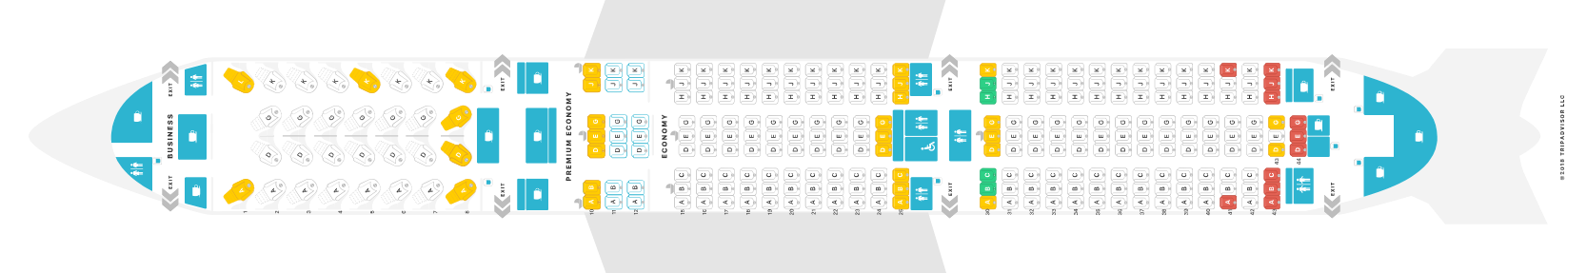
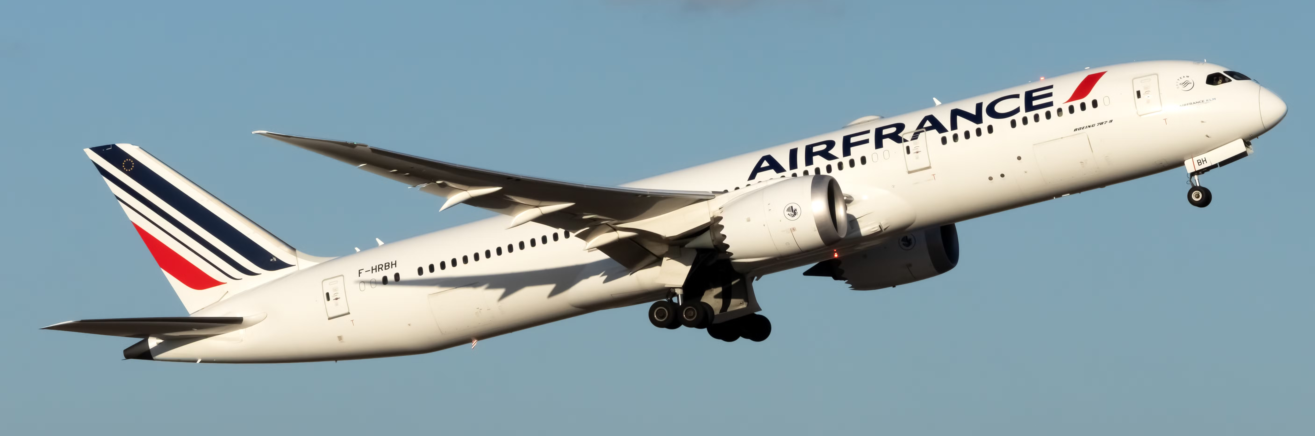
Day One
Air France
December 5, 2026
Dallas/ Fort Worth 7:00 pm
Evening departure from the United States (currently 7:00 pm)
Dinner and Breakfast served on the plane
Premium and business class upgrades available - work with the airline directly – October 16
https://www.seatguru.com/airlines/Air_France/Air_France_Boeing_787-9.php

Slide 23
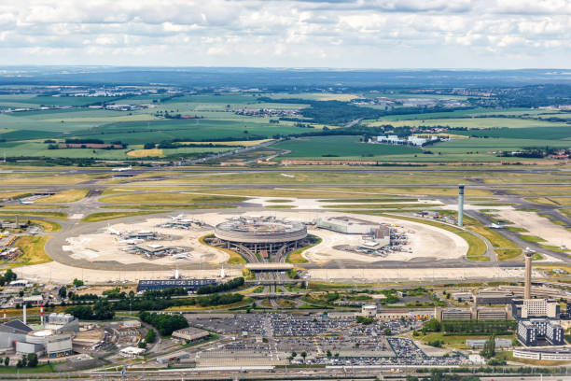
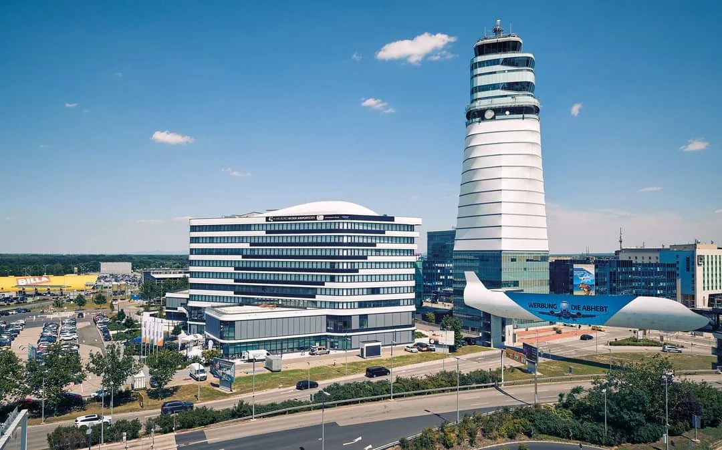
Dec 6 Arrive in Paris at 11:15 a.m. and Depart to Vienna at 3:25
Dec 6 Arrive in Vienna, Austria 5:35 p.m.
Welcome to Paris &
Welcome to Vienna

Slide 24
Christmas Markets with a Danube River Cruise Pilgrimage

Slide 25
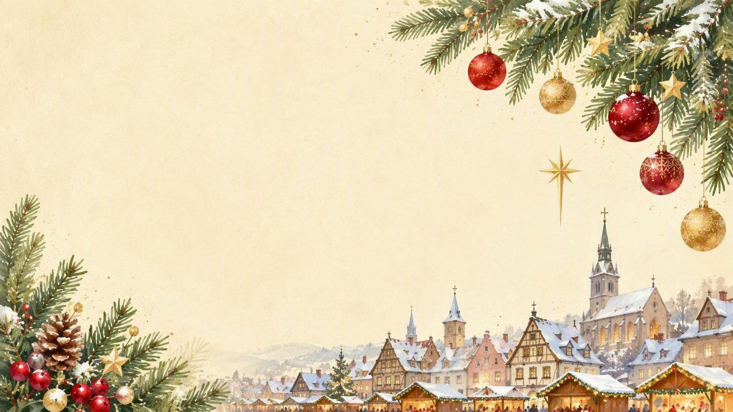
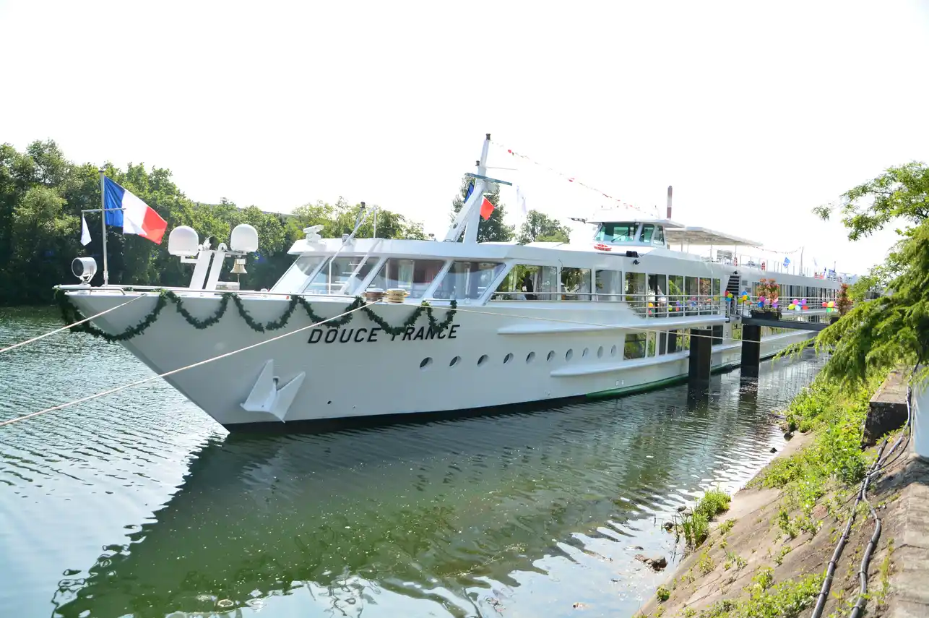
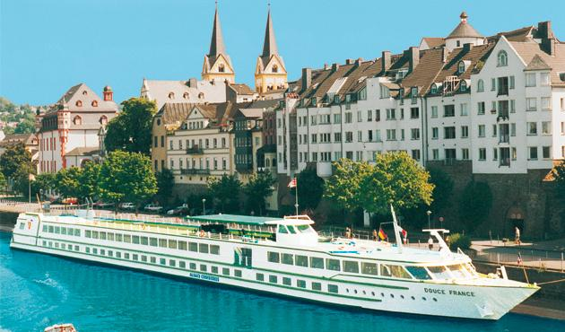
Douce France Long Ship
“Sweet France”

Slide 26
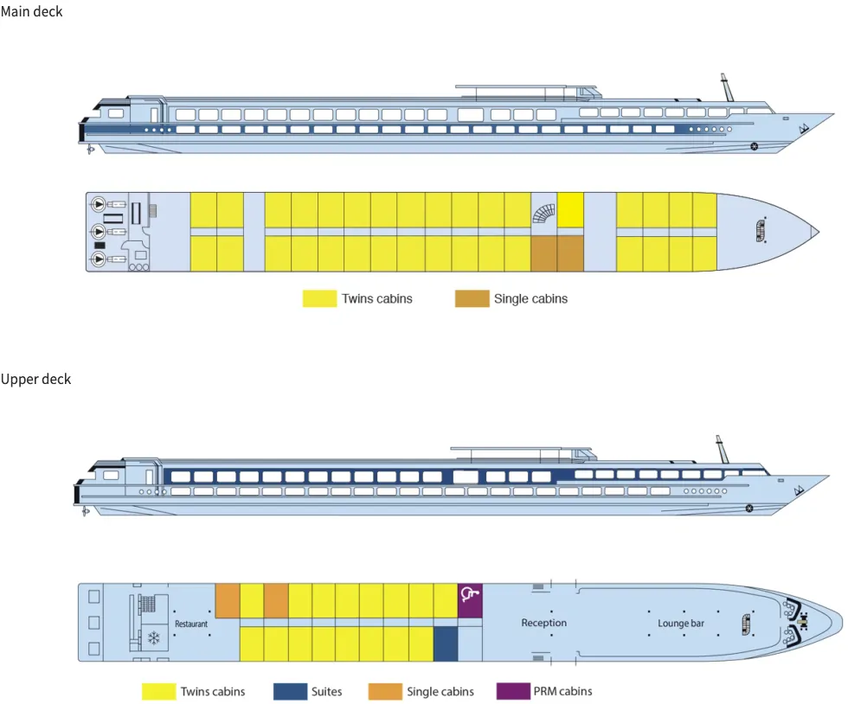
MS Douce France “Sweet France”

Slide 27
MS Douce France “Sweet France”

Slide 28
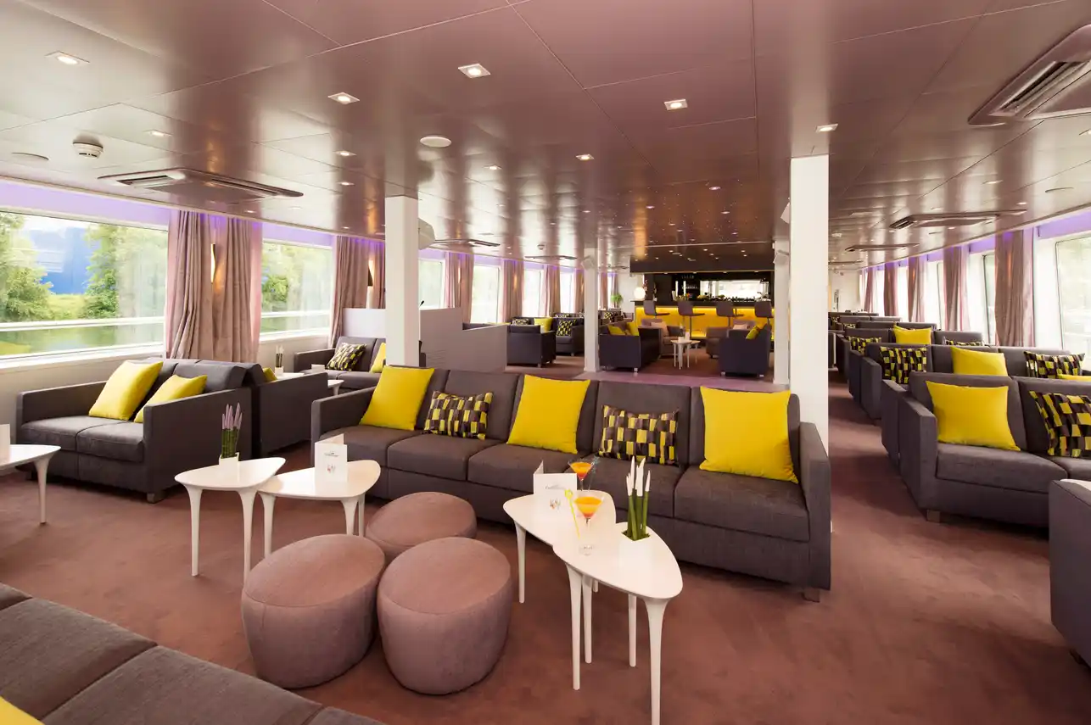
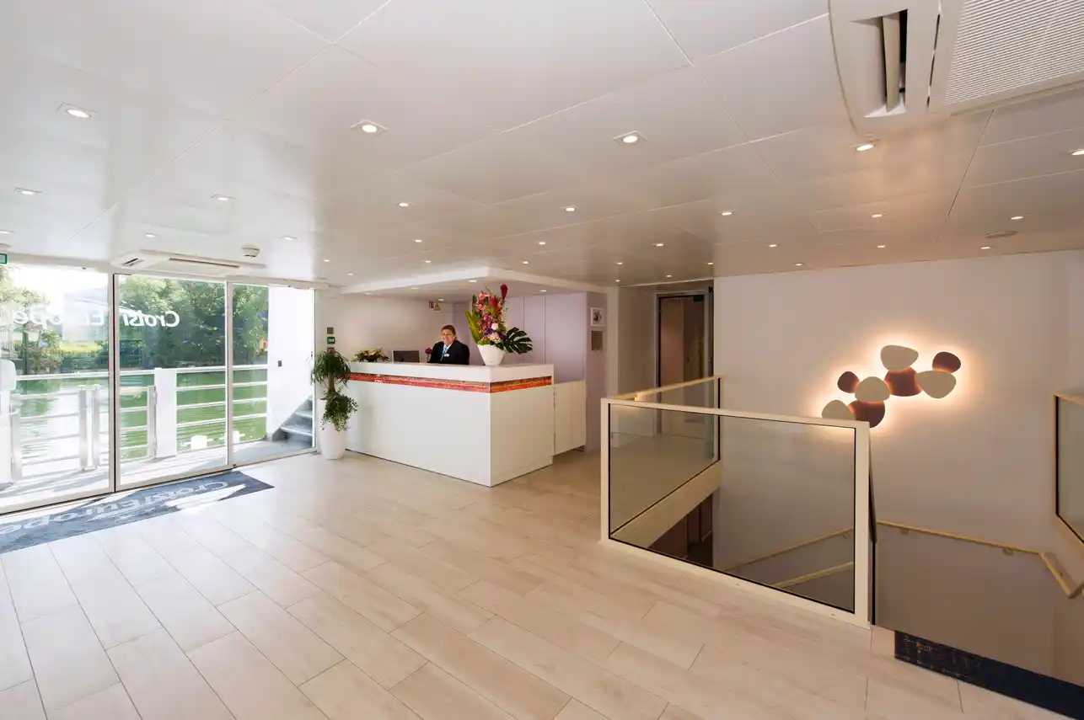
Welcome
Check-in
Lounge and Bar

Slide 29
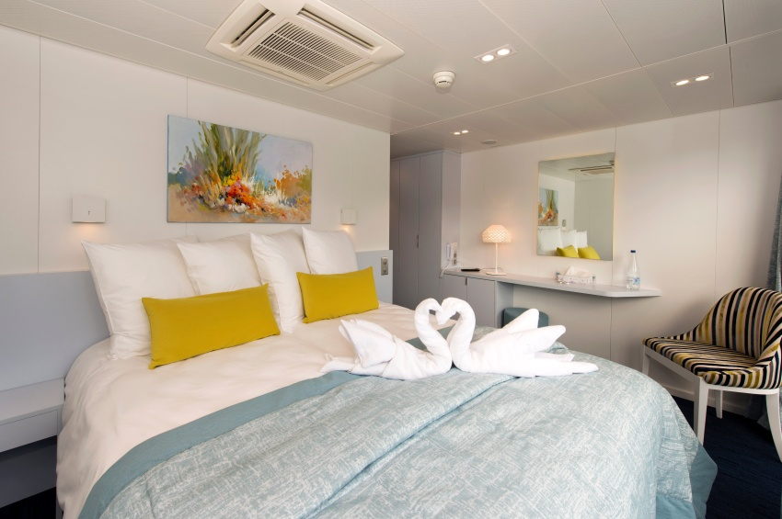
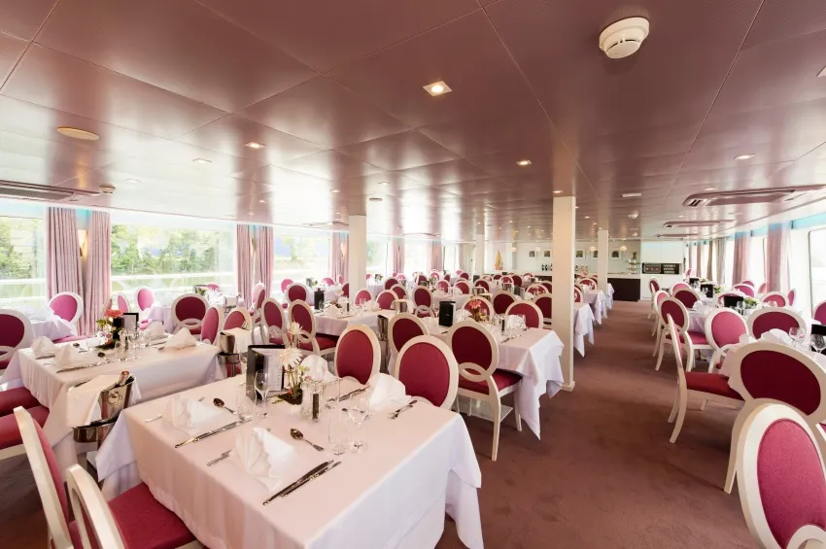
Dinning Room
Spacious Cabins

Slide 30
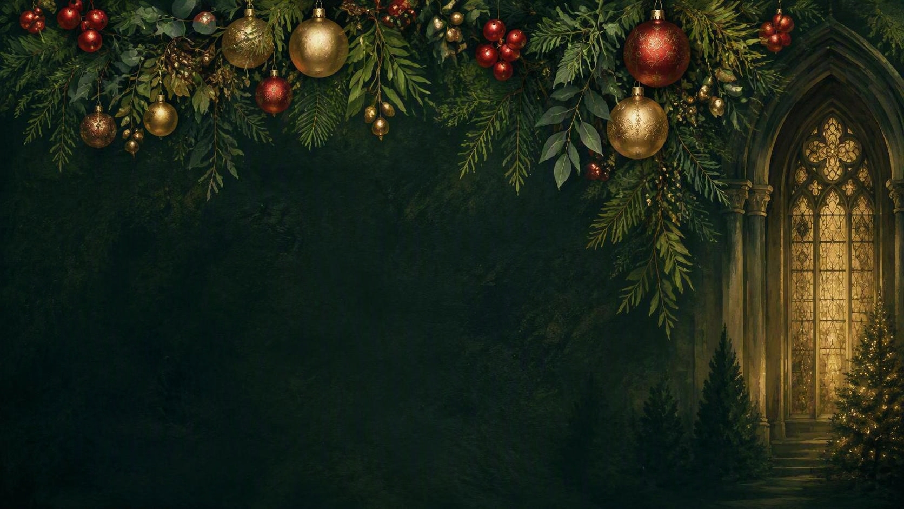
Itinerary
December 6, Sunday, Day 2
Vienna
Polish Church in Vienna to celebrate Mass and explore the small museum of St. John Paul II relics and gift shop.
Lunch at one of the Christmas Markets. Board the ship at 4 p.m.
Unpack and enjoy Cocktails and dinner followed by music in the lounge.

Slide 31
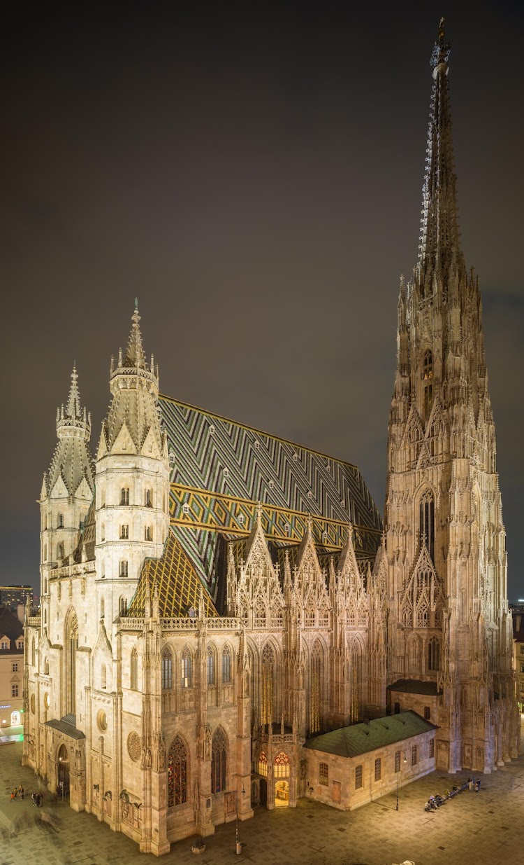
St. Stephens Cathedral
in Vienna
Slide title
Day 3
Mass
Panoramic tour of the Ringstrasse area
90-minute guided walking tour of the city center, Donner Fountain, Belvedere Palace gardens, Hofburg Palace, and the Spanish horses training site.
Lunch on the ship or on your own in town.

Slide 32
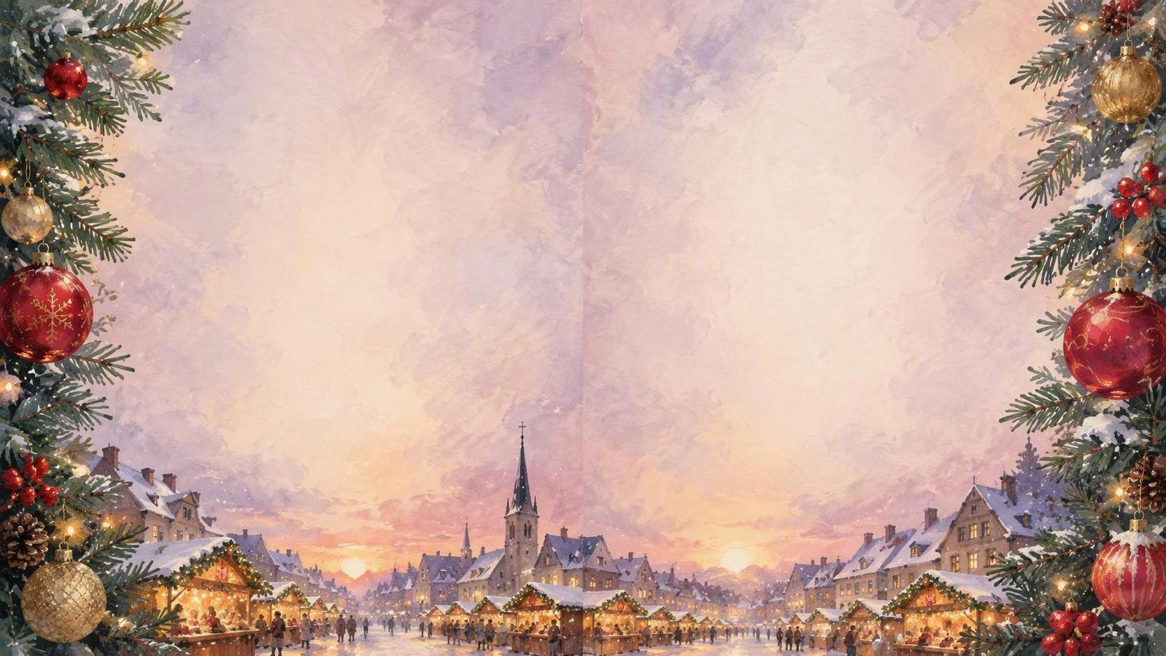
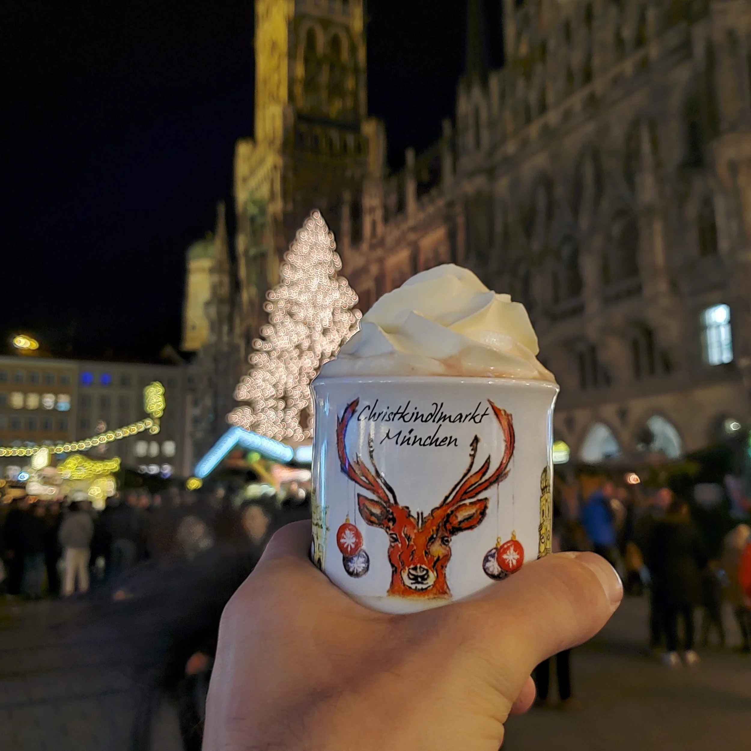
2nd Half of Day 3
Enjoy the Vienna Christmas Markets
Mulled wine and tasting local cuisine.
Return to ship for dinner.
Trivia Evening.
Cruise overnight.

Slide 33
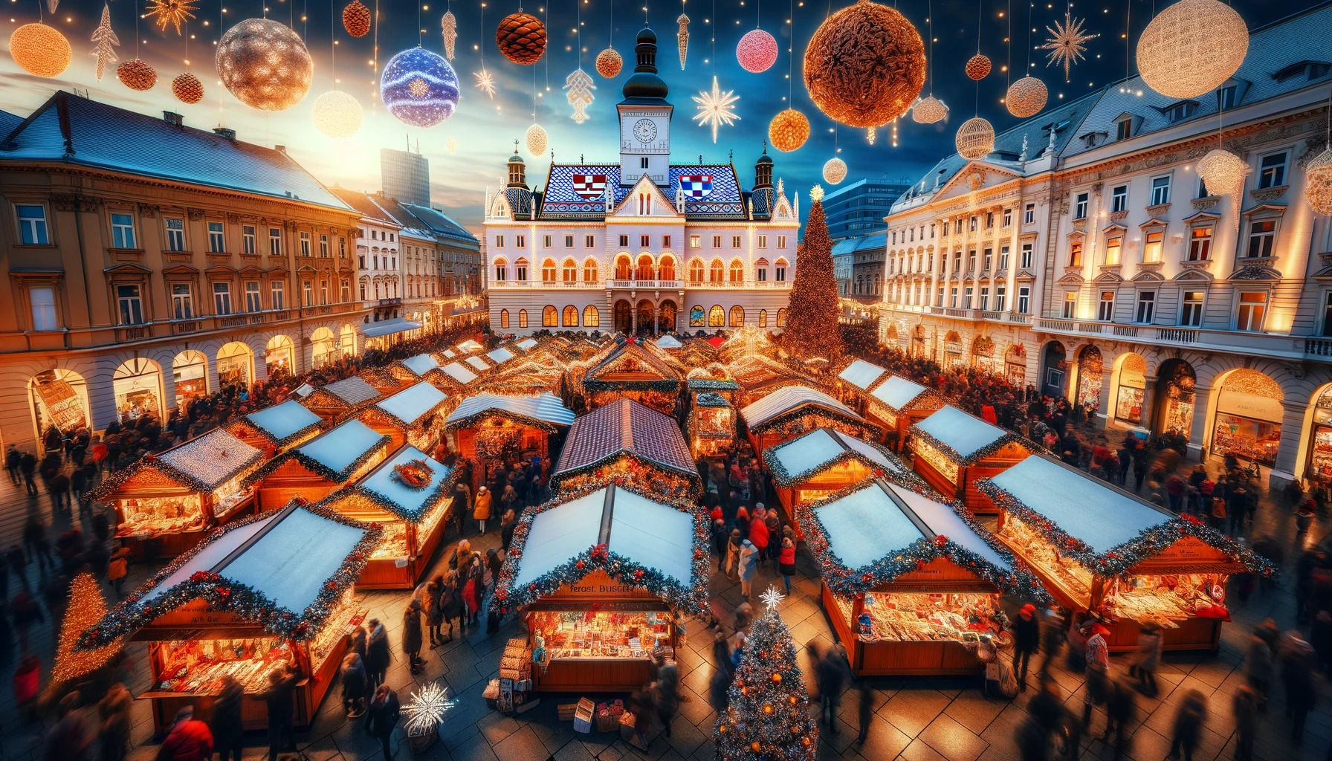
VIENNA CHRISTMAS MARKET
Right-column heading
Add a comparison, example, or supporting detail.
Left-column heading
Add key points, an image, or a short list.

Slide 34
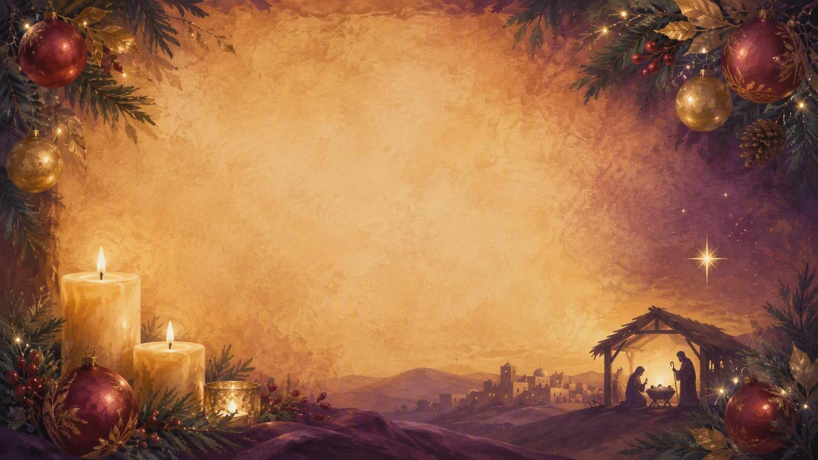
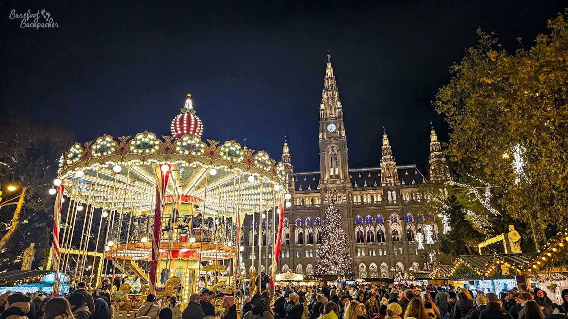
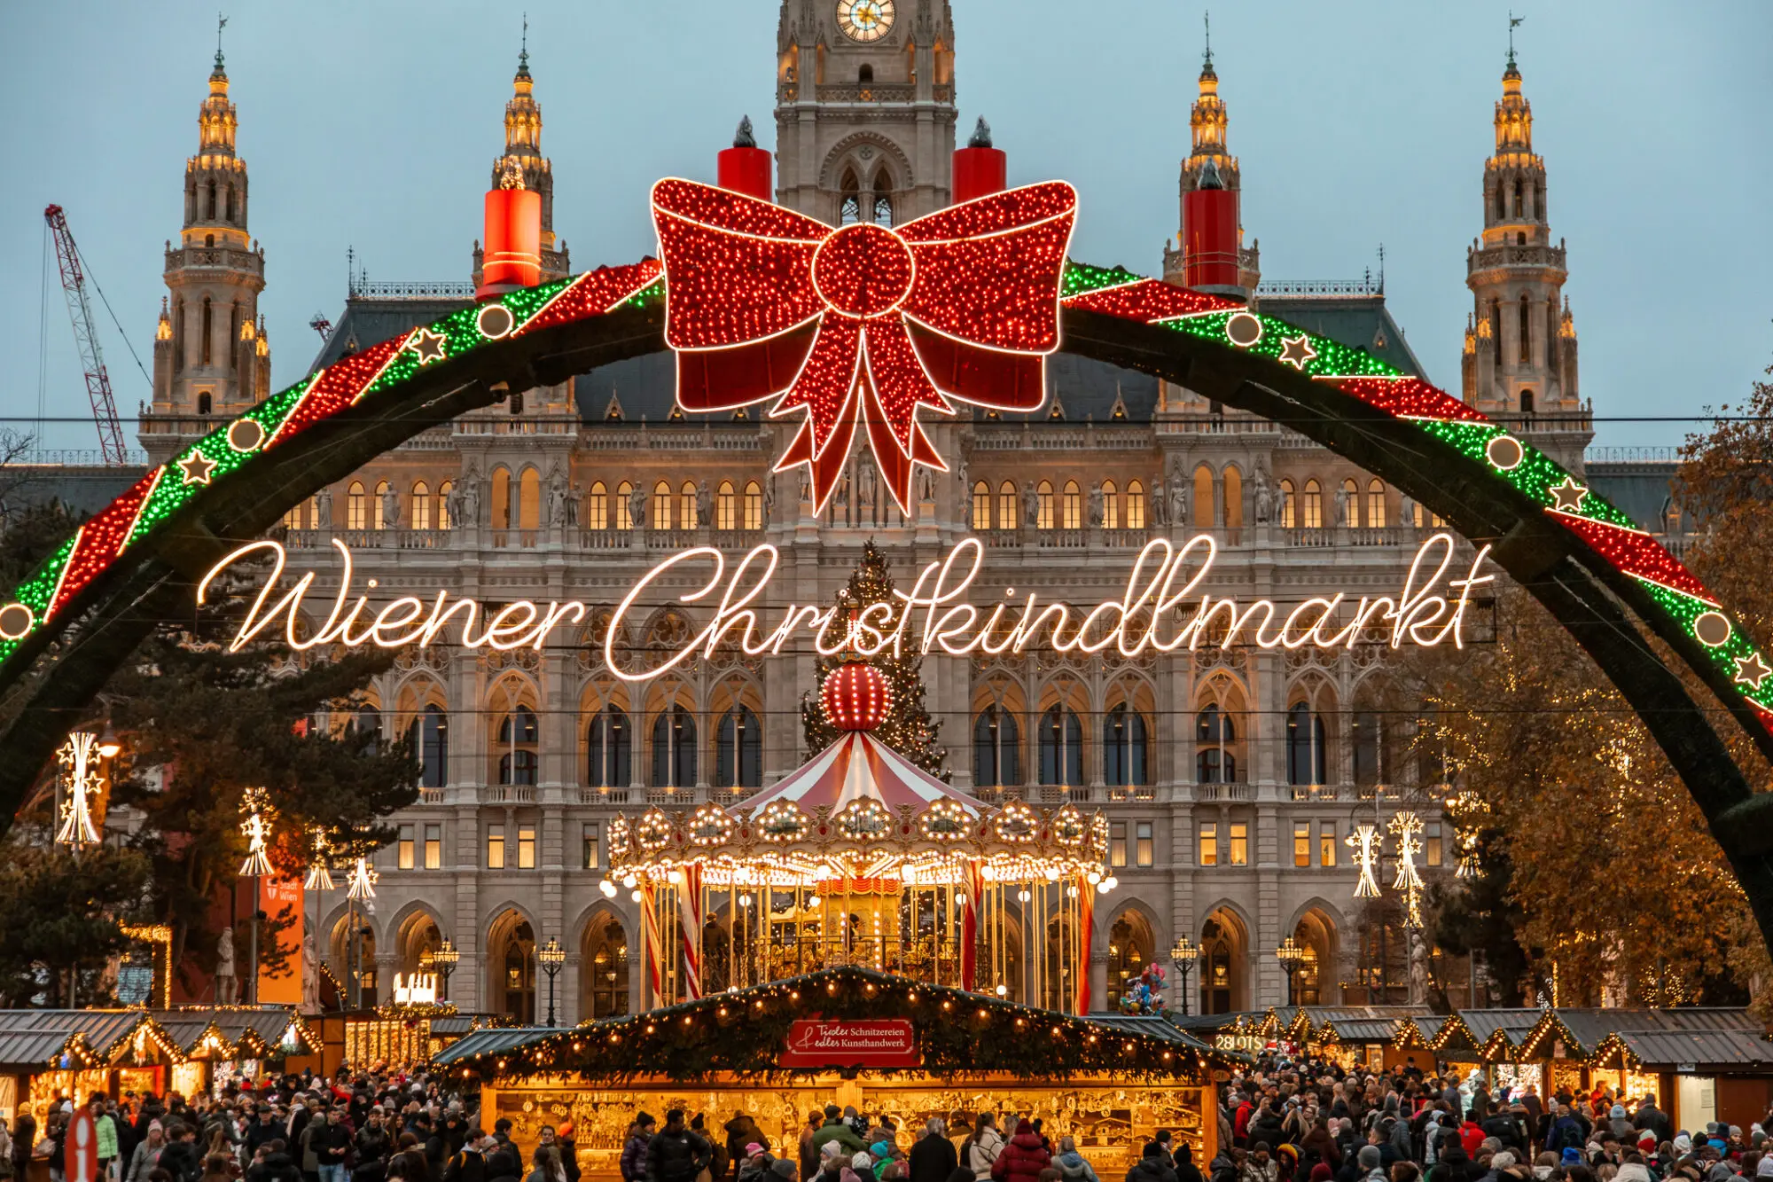
Vienna
Christmas Market

Slide 35
Questions??

Slide 36
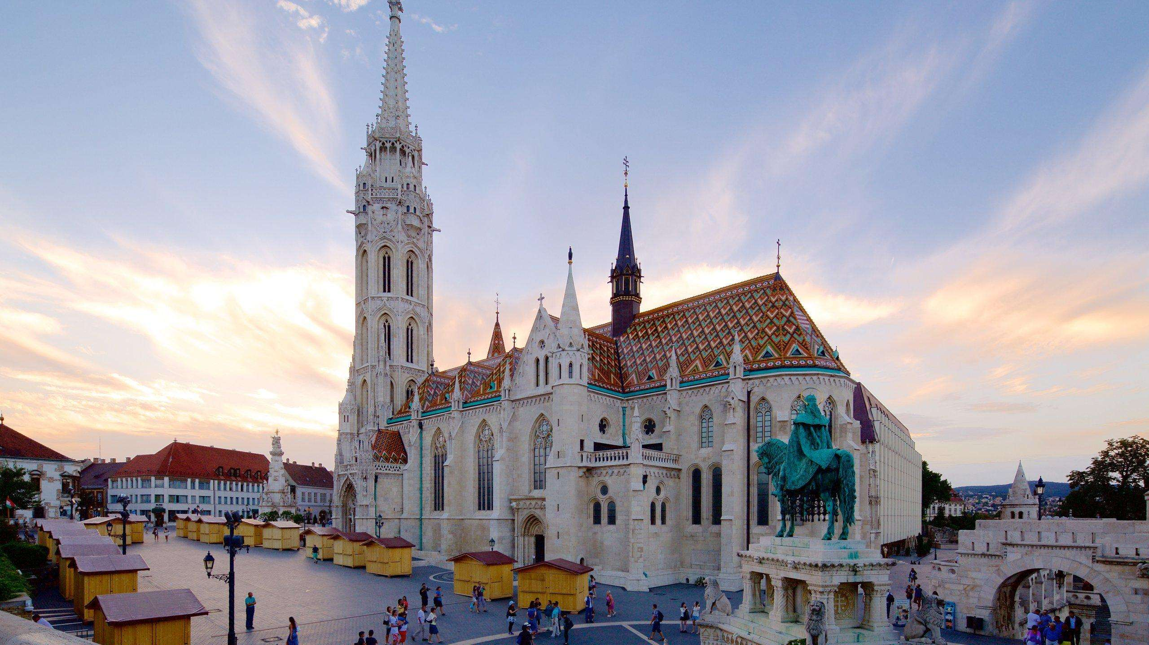
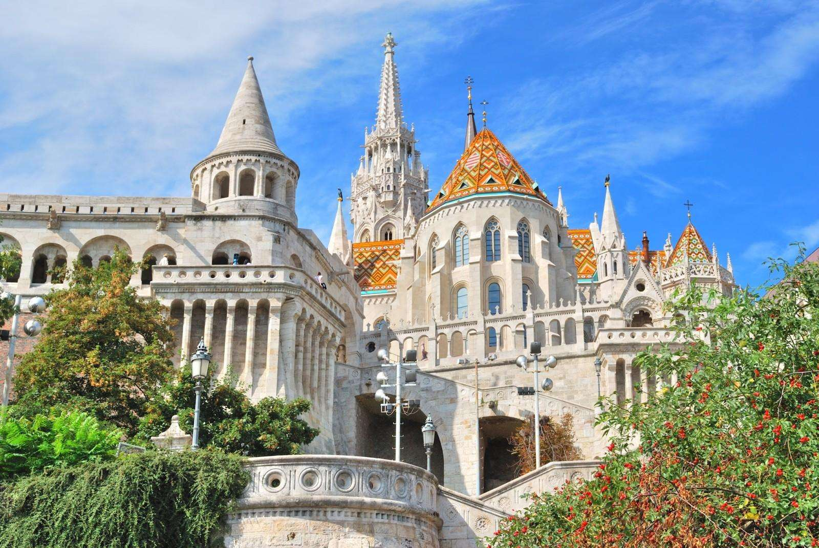
Budapest Hungary Day 4
Mathias Church
Itinerary
Breakfast
Mass
Tour of both sides of the city: the Pest and the Buda

Slide 37
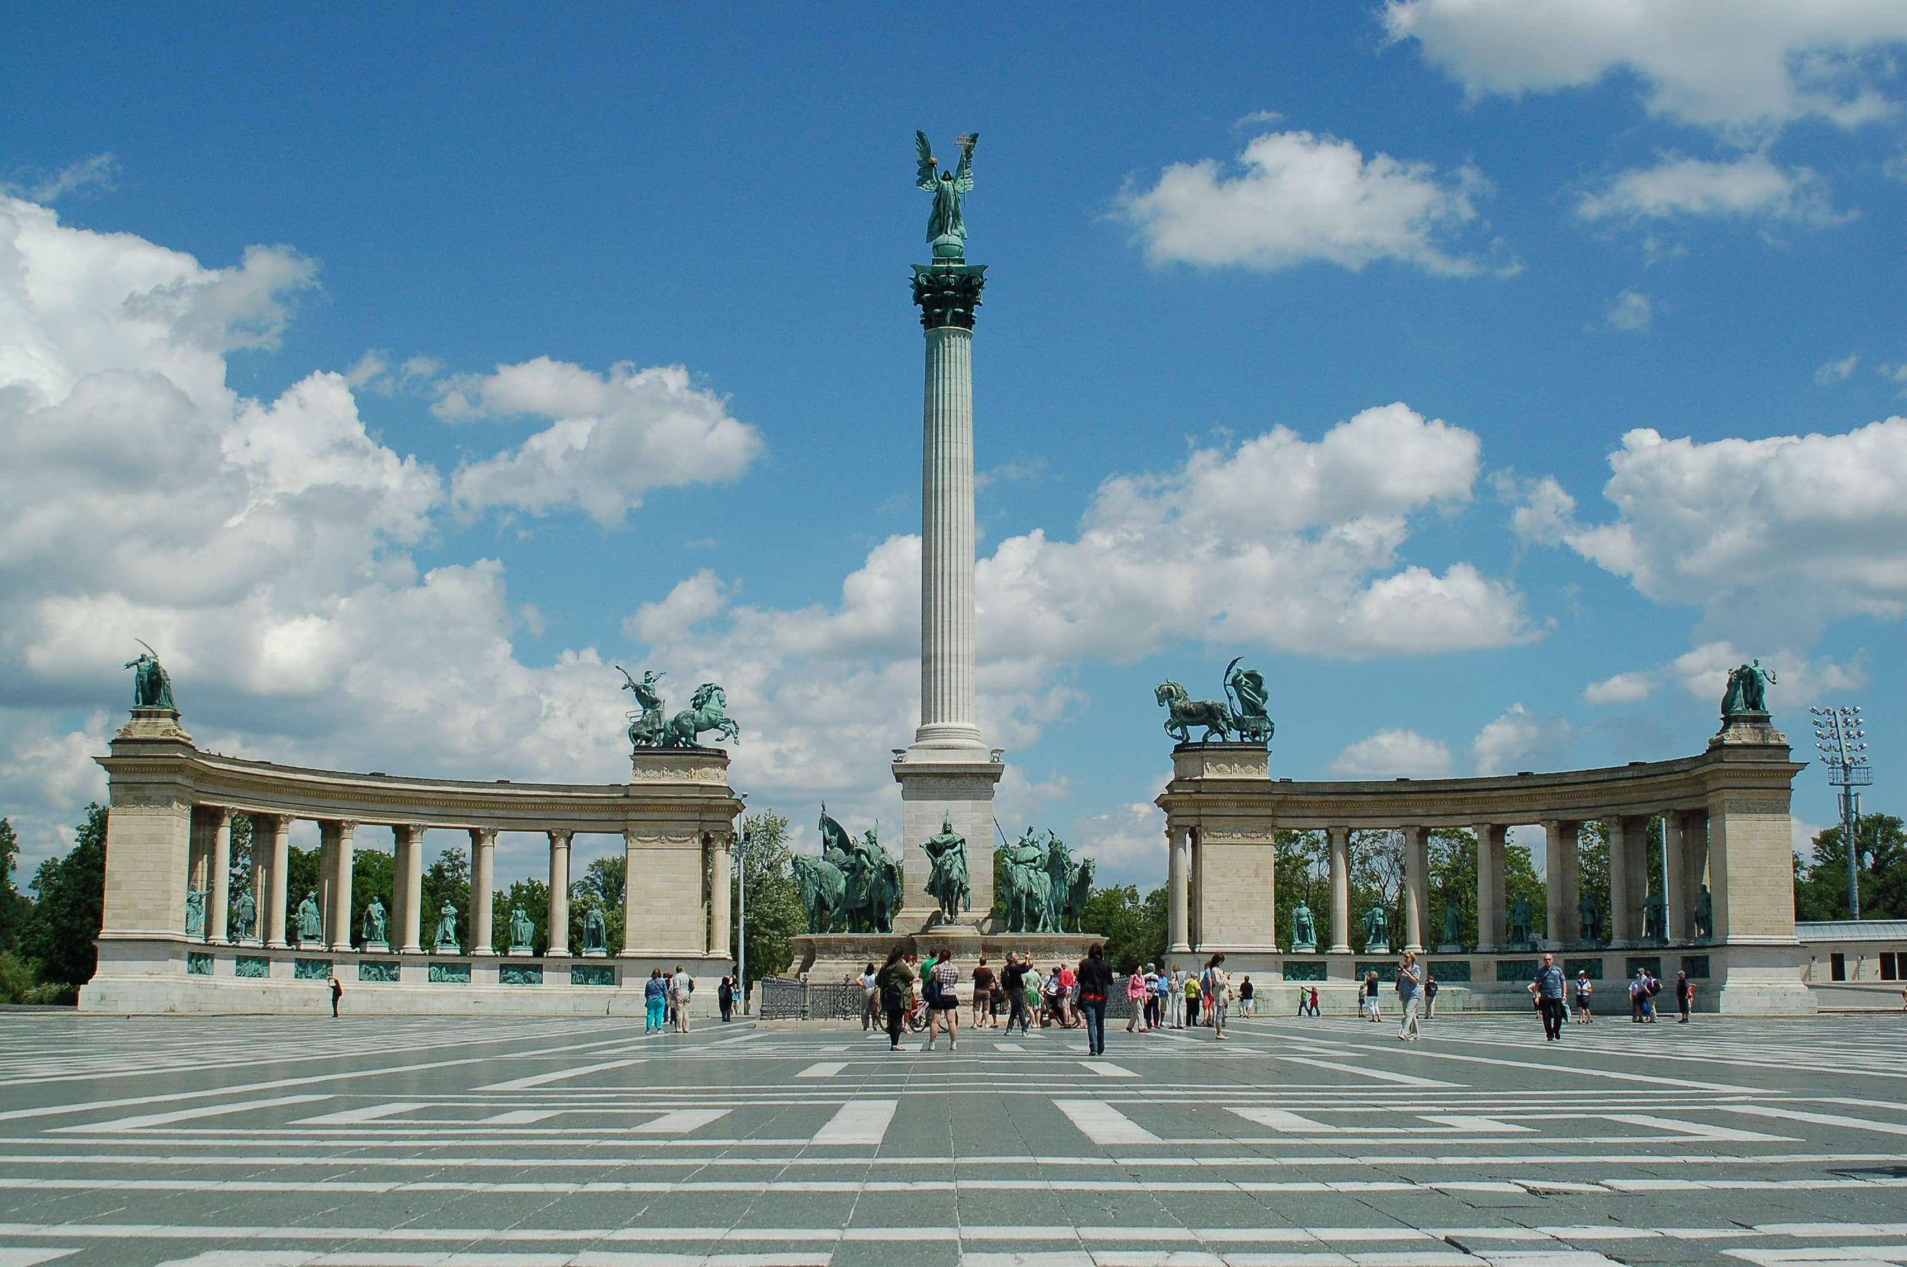
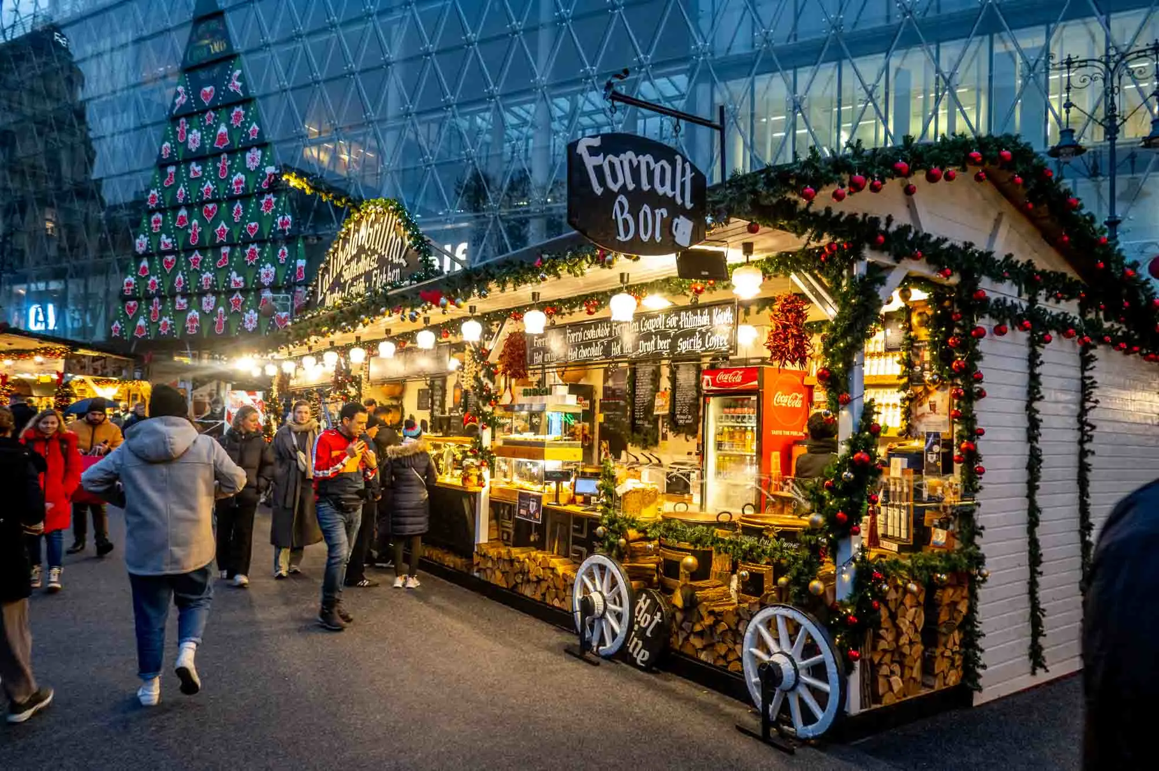
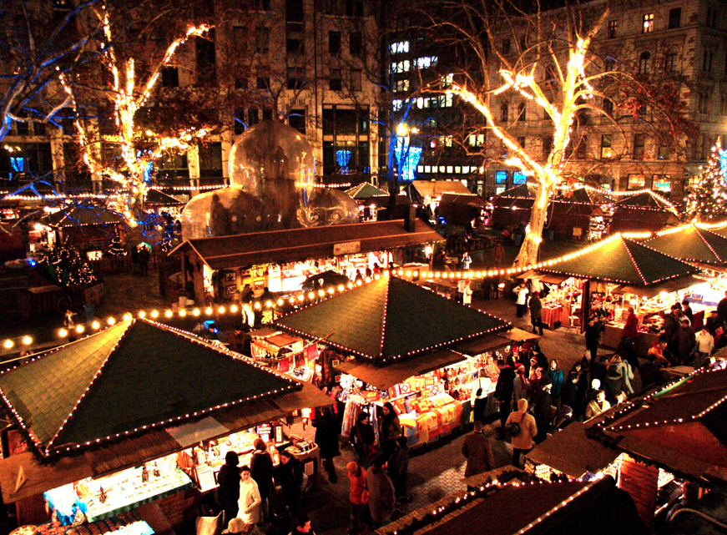
Vorosmarty Heros’ Square
Vorosmarty Square
Christmas
Market

Slide 38
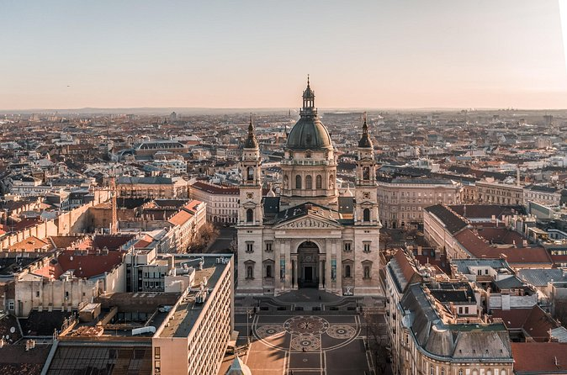
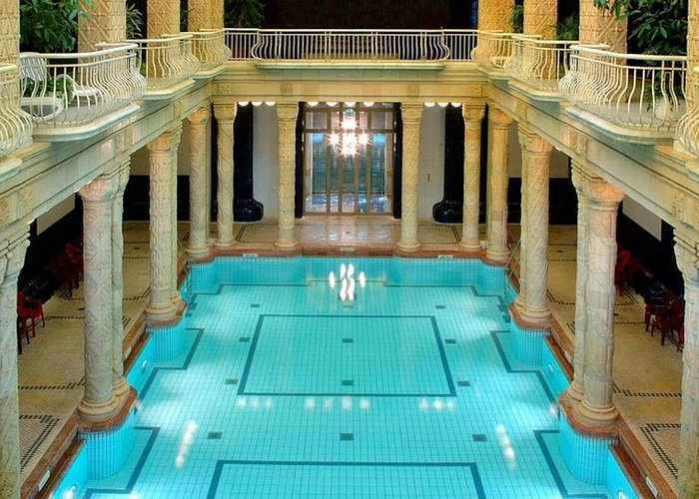
Day 4
Budapest Continued
Christmas Markets,
Lunch on board ship or on your own.
Back to market or take a soak in the famous Gellert Spa (reservations required).
Return to the ship for dinner followed by a folklore show.
Cruise overnight.
St. Stephen’s Basilica

Slide 39
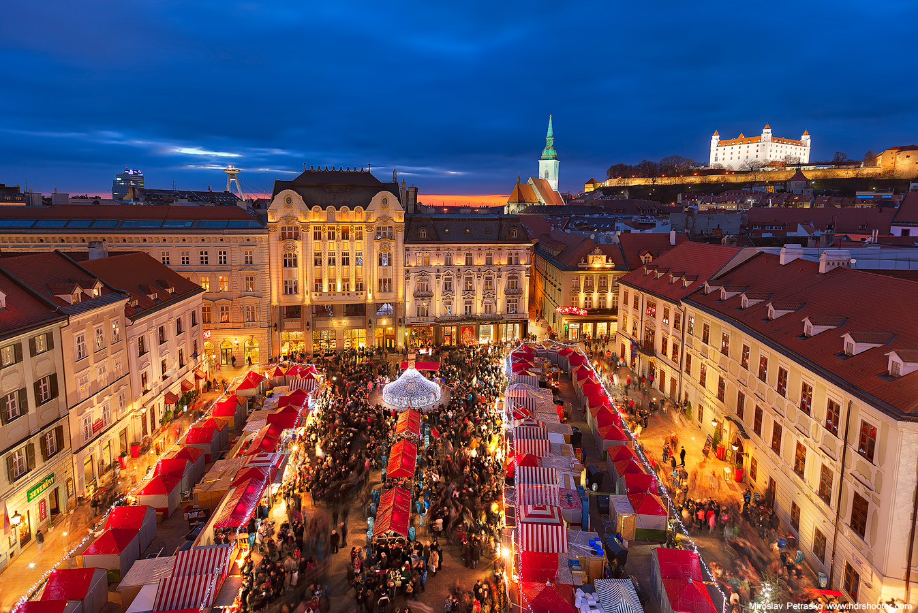
BRATISLAVA
Day 5
Rosary
Retreat with Father Leo.
Mass on ship
Light lunch and arrive in Bratislava at 4 pm
Enjoy the Christmas Markets
Farewell party on ship with music and dancing.
Last overnight on the cruise
Itinerary

Slide 40
(72) SALZBURG: The Most Magical Christmas Market in Austria - YouTube
We travel to Salzburg to browse the Christmas Market.
Mass
Trace a scene from the Sound of Music.
Sample Chocolates
Mozarts Home
Day 6 Salzburg

Slide 41
Meeting 3

Slide 42
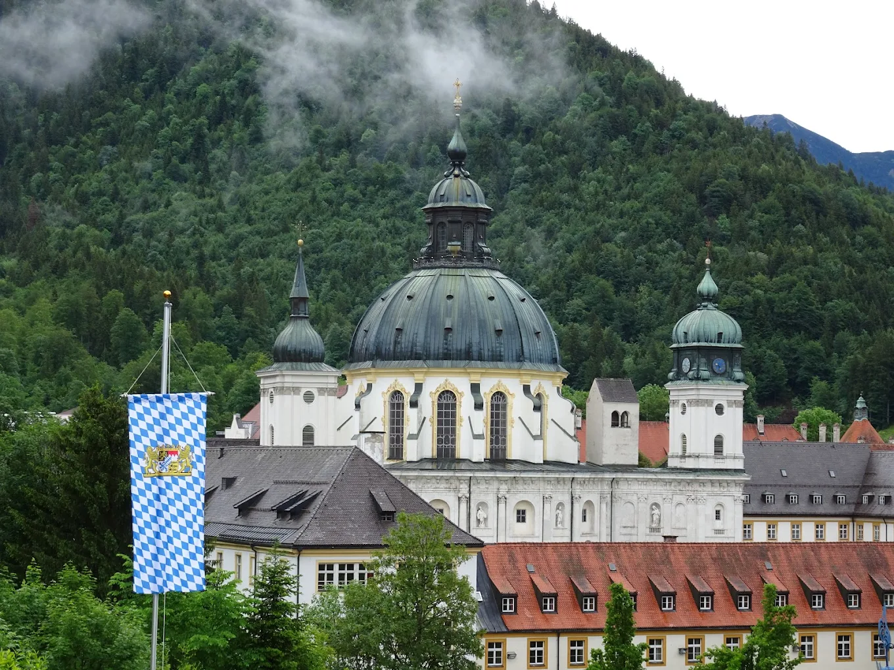
Munich
Day 7
Mass
Experience Brewer, Monks have ben crafting specialty beer since 1609
Oberammergau, known for Passion Play every 10 years. Visit the Oberammergau Museum.
Wood Carvers Village
Dinner at leisure in Munich
Ettal Monastery-Benedictine monastery in the Ammergau Alps
Christmas In Munich: A Walking Tour Of The Christmas Markets

Slide 43
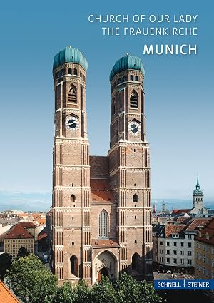

Church Of Our Lady
Iconic twin towers
St. Michaels’s Stunning Renaissance Church
Munich Day 8
Lunch on your own
Explore Munich’s diverse Christmas Markets: Medieval Christmas Market &
Christmas Village at the Residenz.
Farewell-Special Dinner at local Restaurant

Slide 44
Day 9
Depart for the US
After breakfast, we are transferred to the airport for our flights back to the USA

