Slide 1

Prayer intentions
Marian Shrines 2026
This slide show is provided to inform you that your prayer requests we remembered on the 50th Anniversary Marian Shrines pilgrimage.
All prayer intentions were uploaded to a USB drive from the website.
The USB drive was placed in a Saint Vincent de Paul 50th Anniversary box.
The box was set on every altar where we celebrated Mass,
and we prayed for your intentions at every Mass.

Slide 2
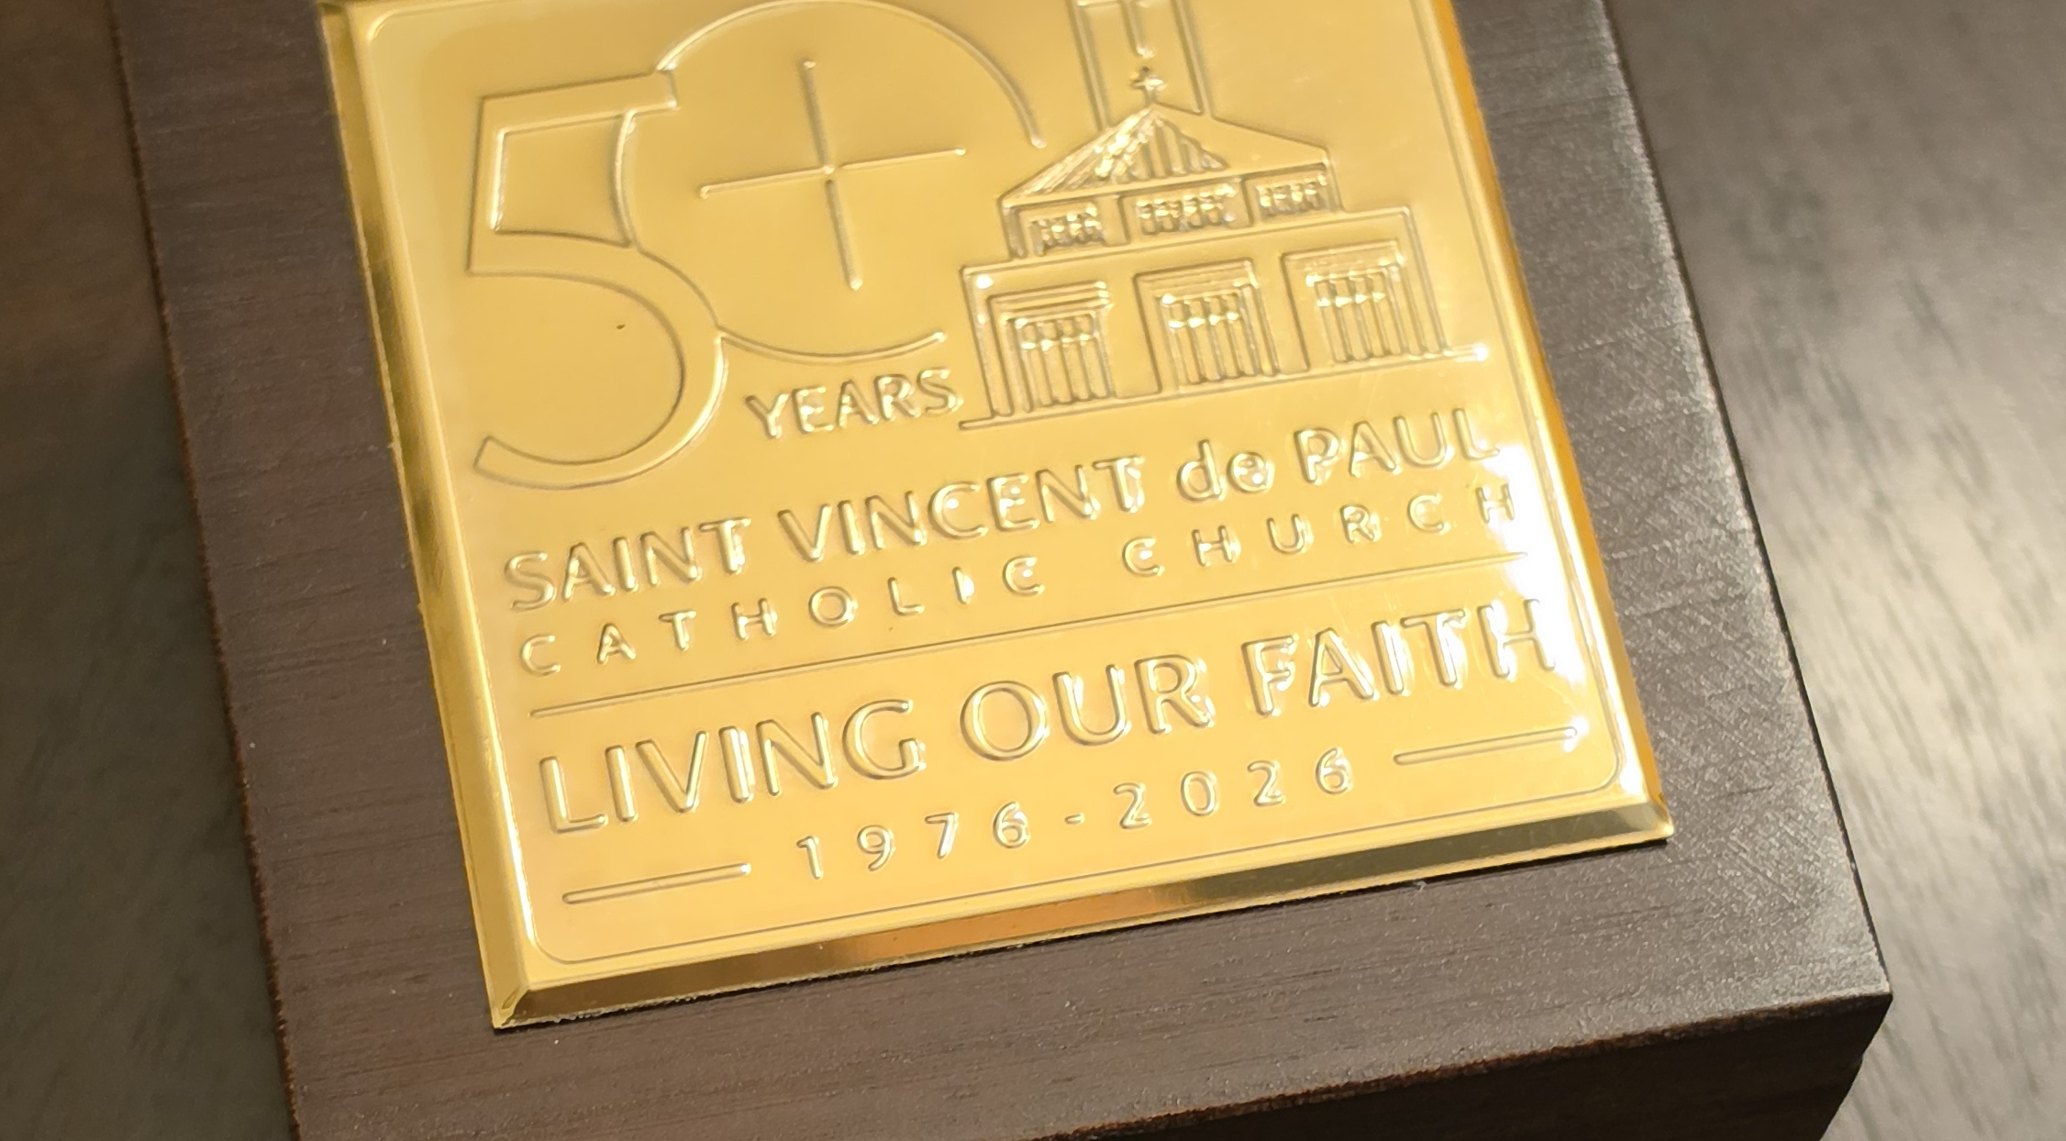
The 50th Anniversary box

Slide 3
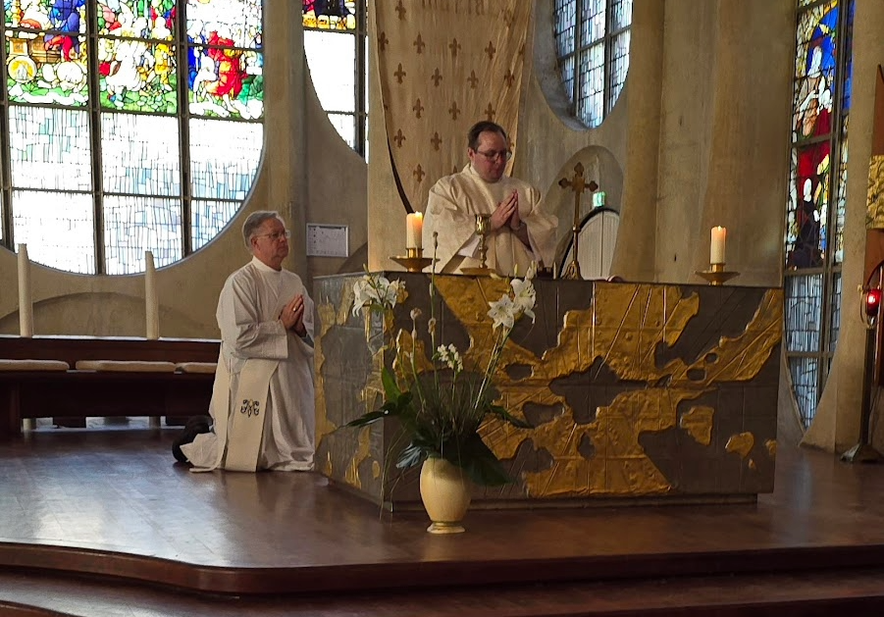
Church of Saint Joan D’arc - April 22

Slide 4
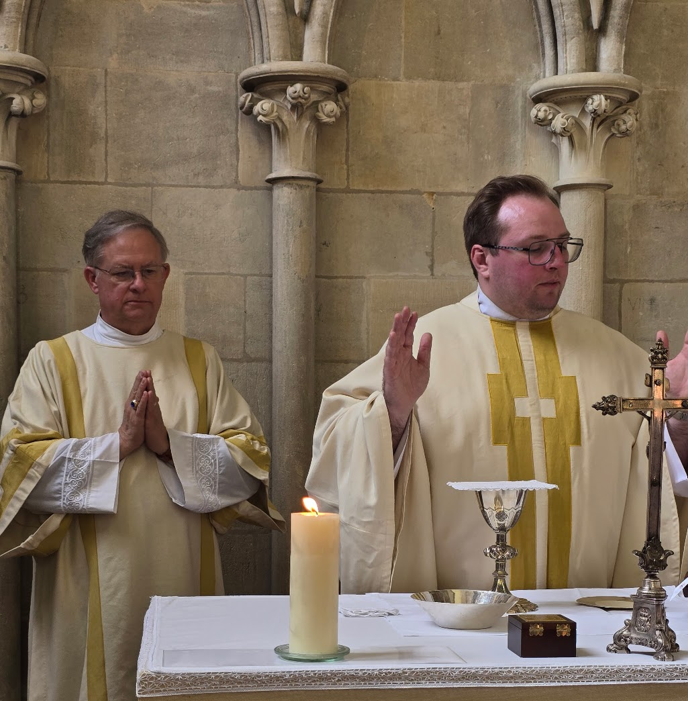
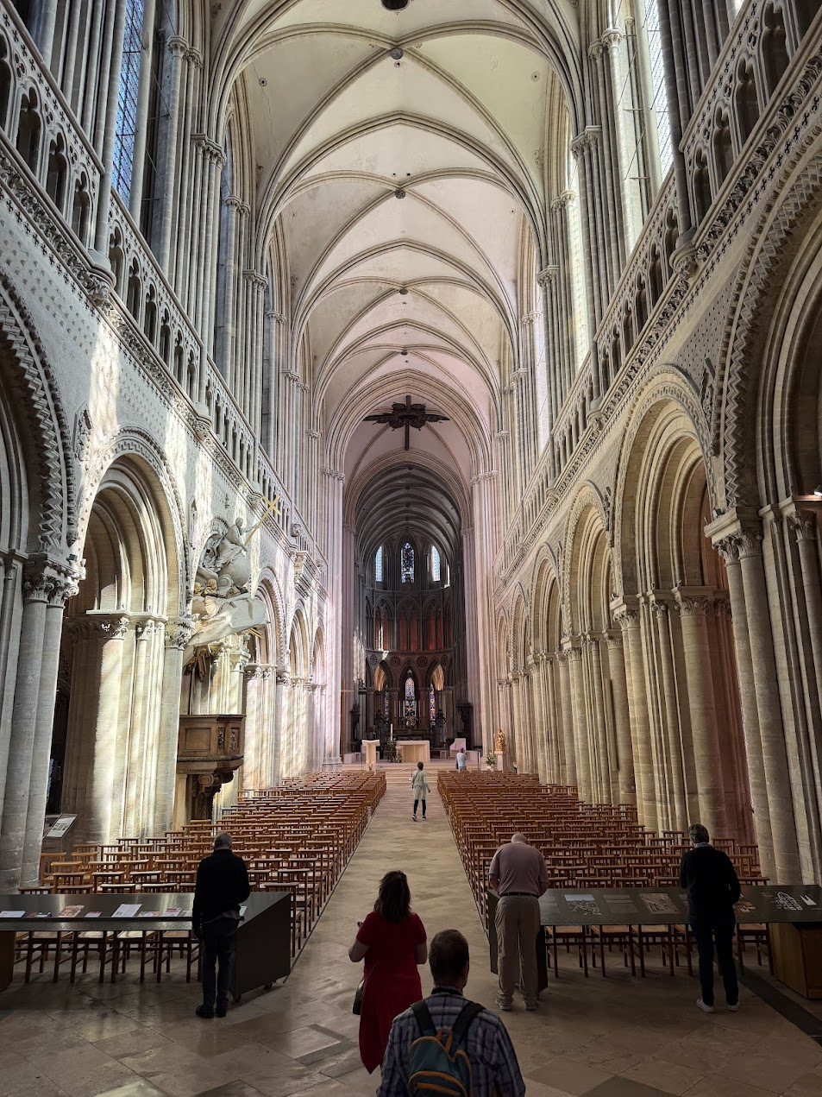
Bayeux Cathedral - April 23

Slide 5
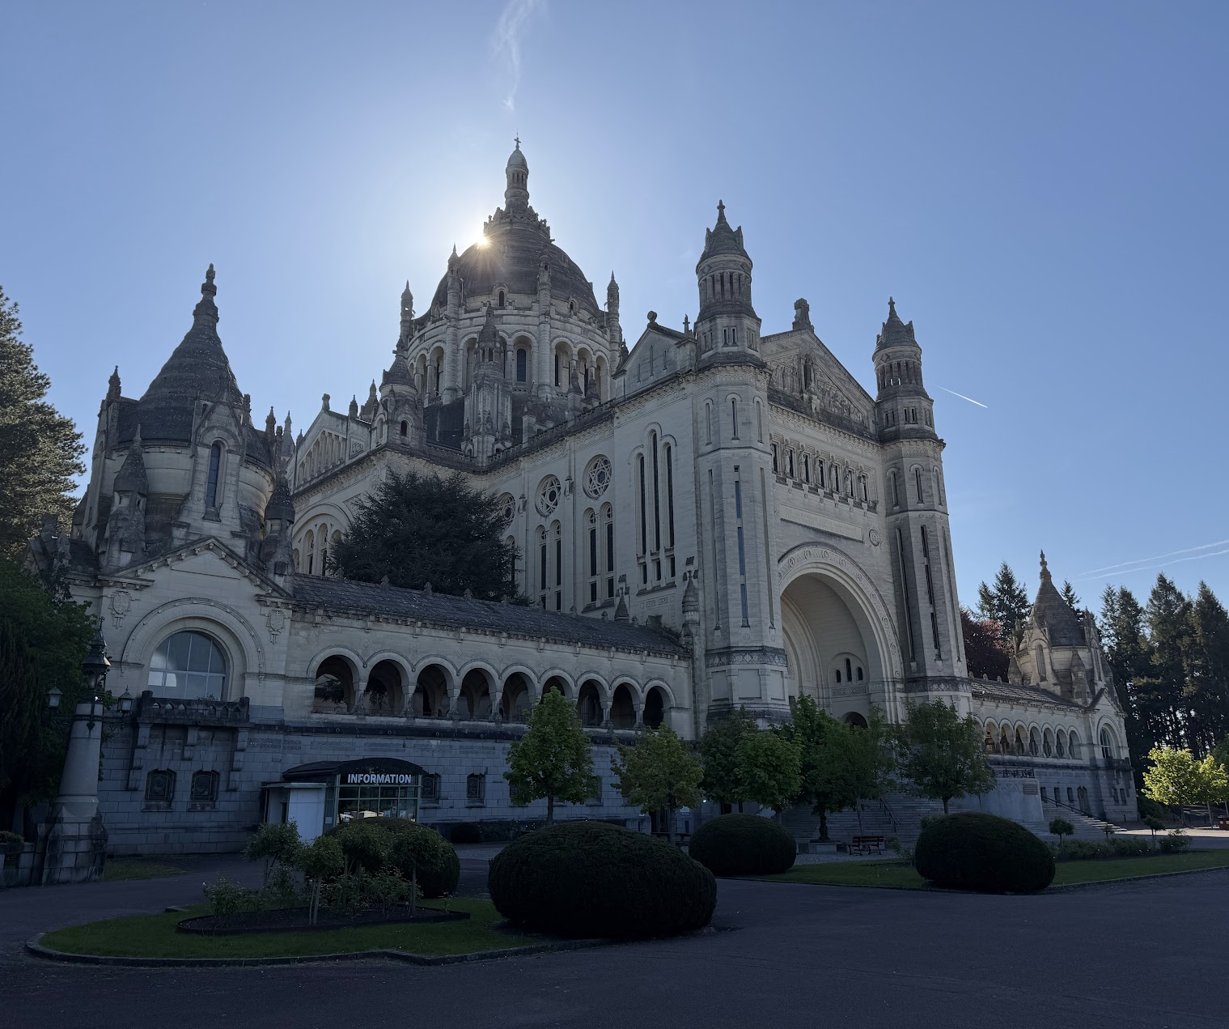
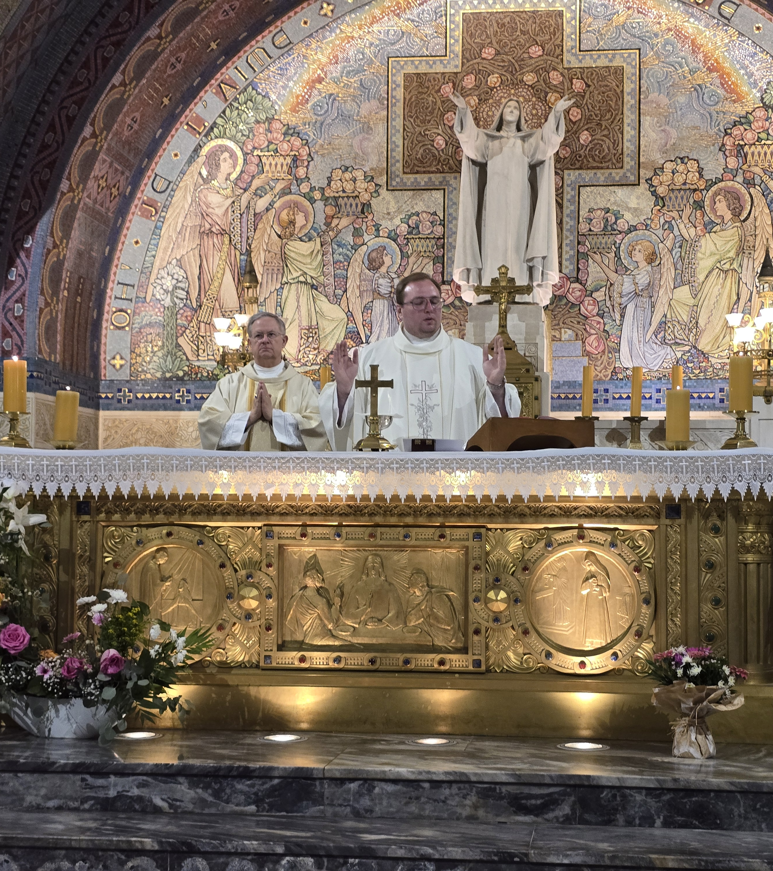
Basilica of Saint Terese of Lisieux - April 24

Slide 6
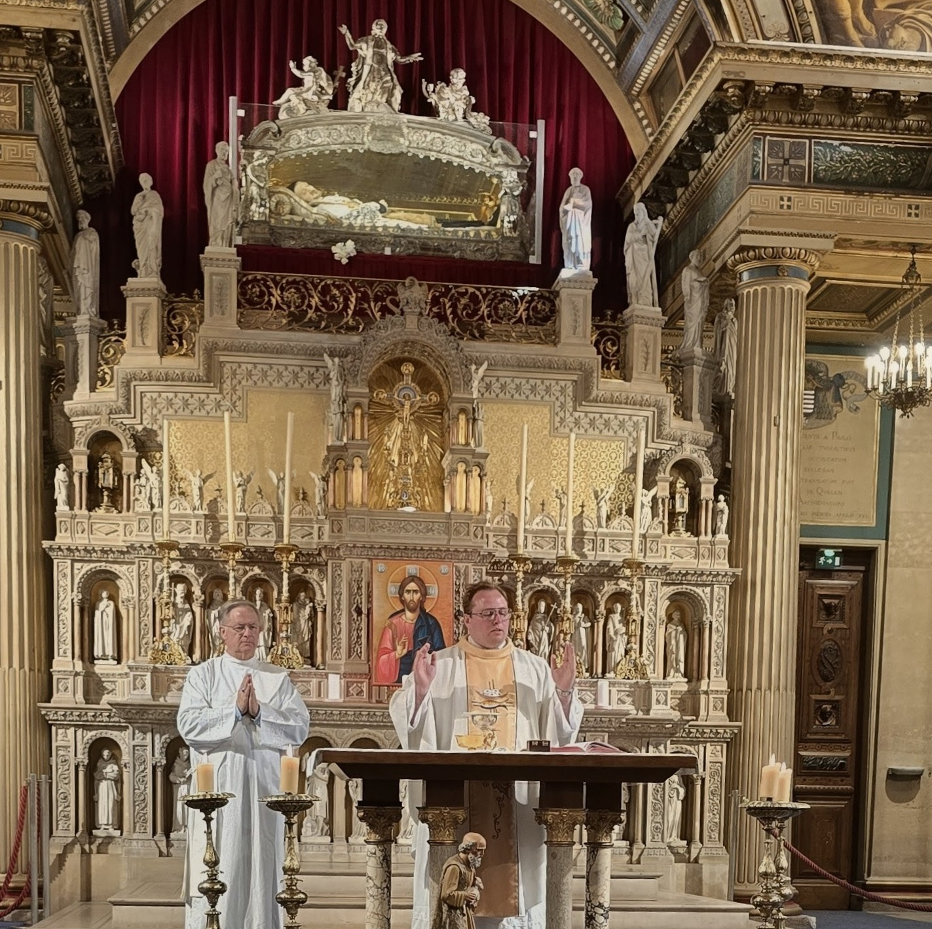
Church of Saint Vincent de Paul –
April 25

Slide 7
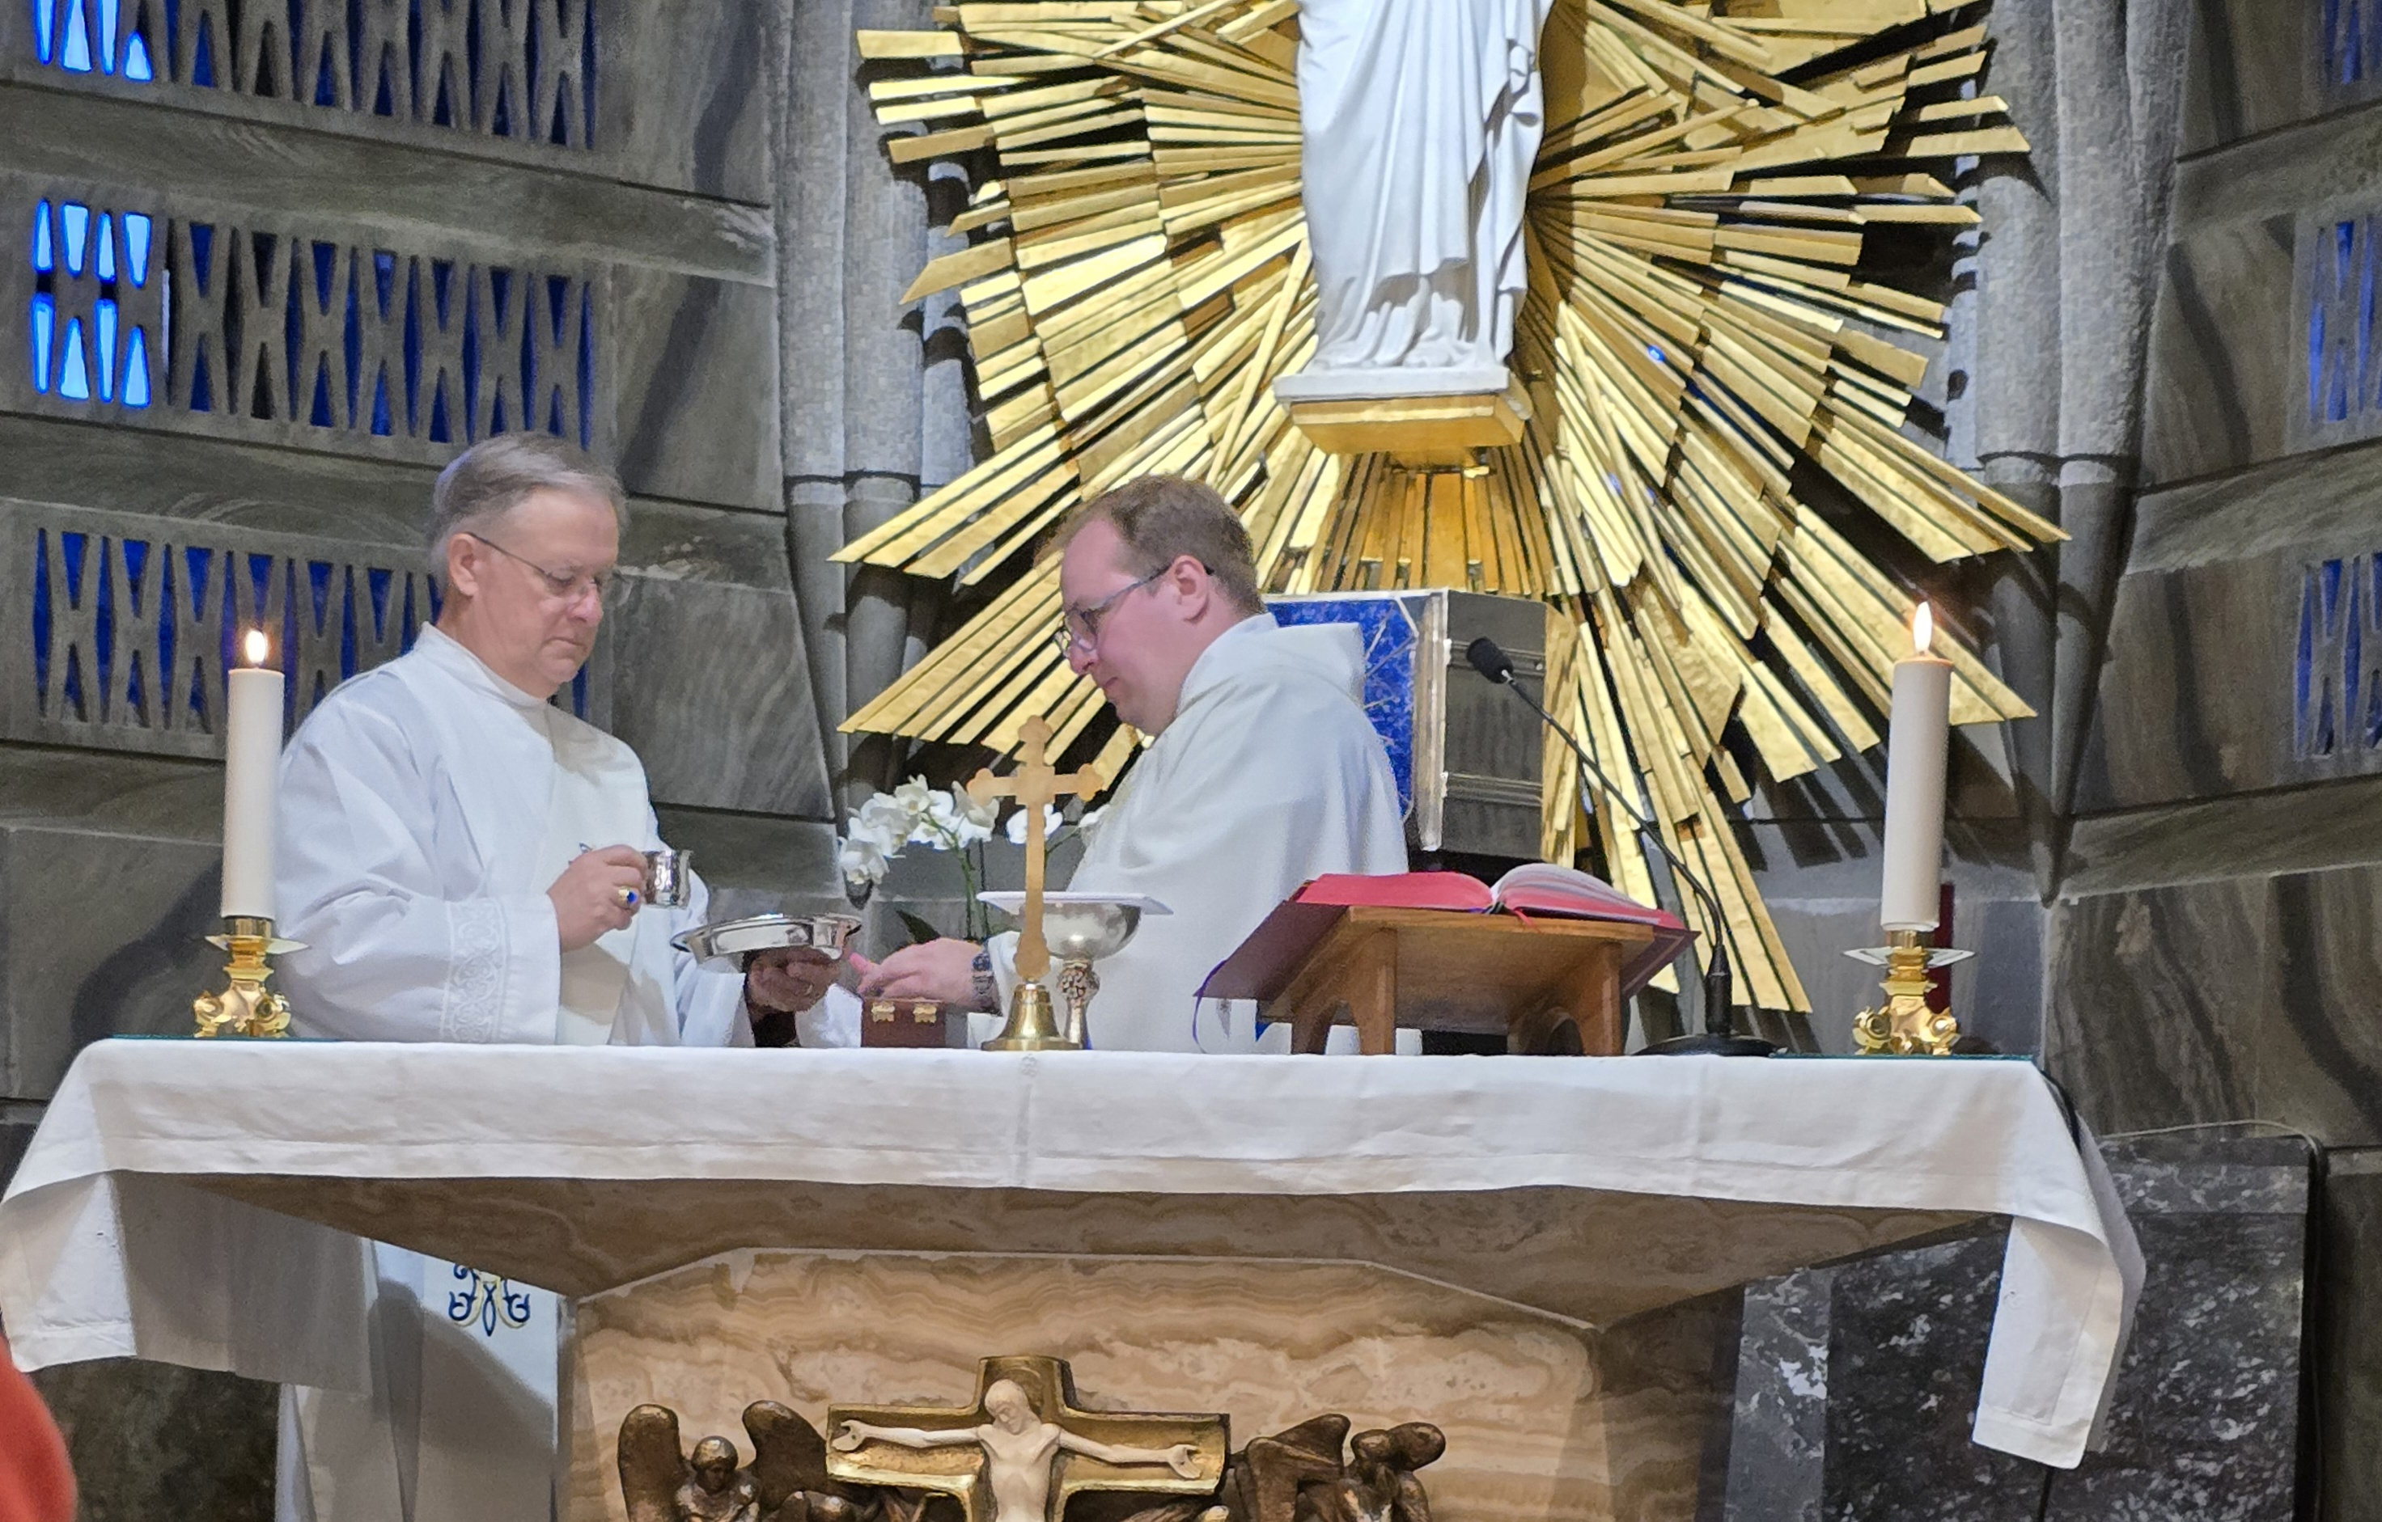
Crypt Chapel, Lourdes - April 26

Slide 8
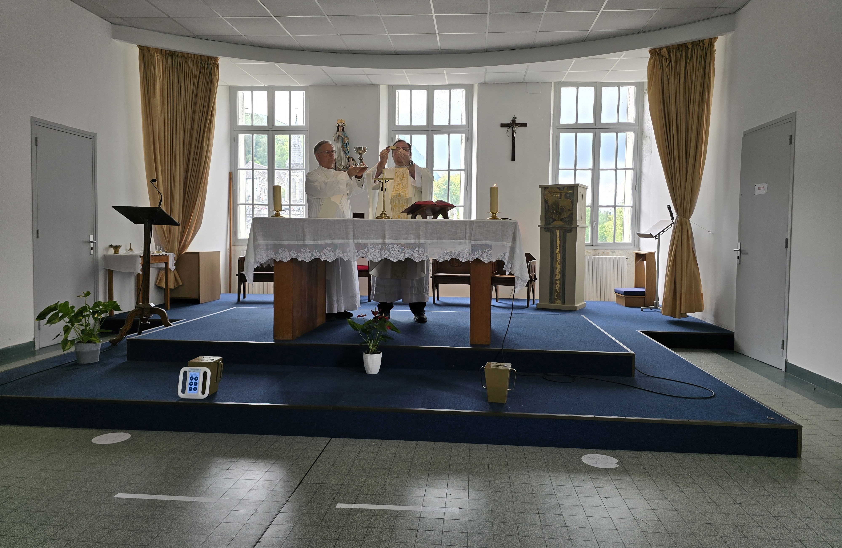
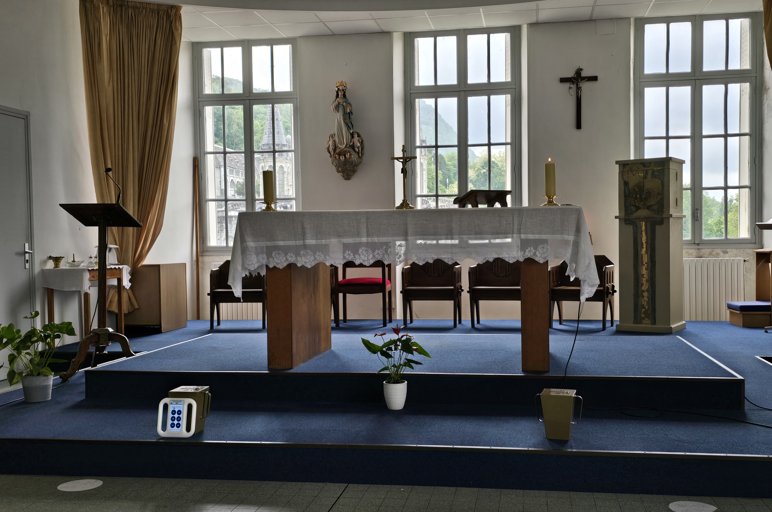

Saint John Vianney Chapel - April 28

Slide 9
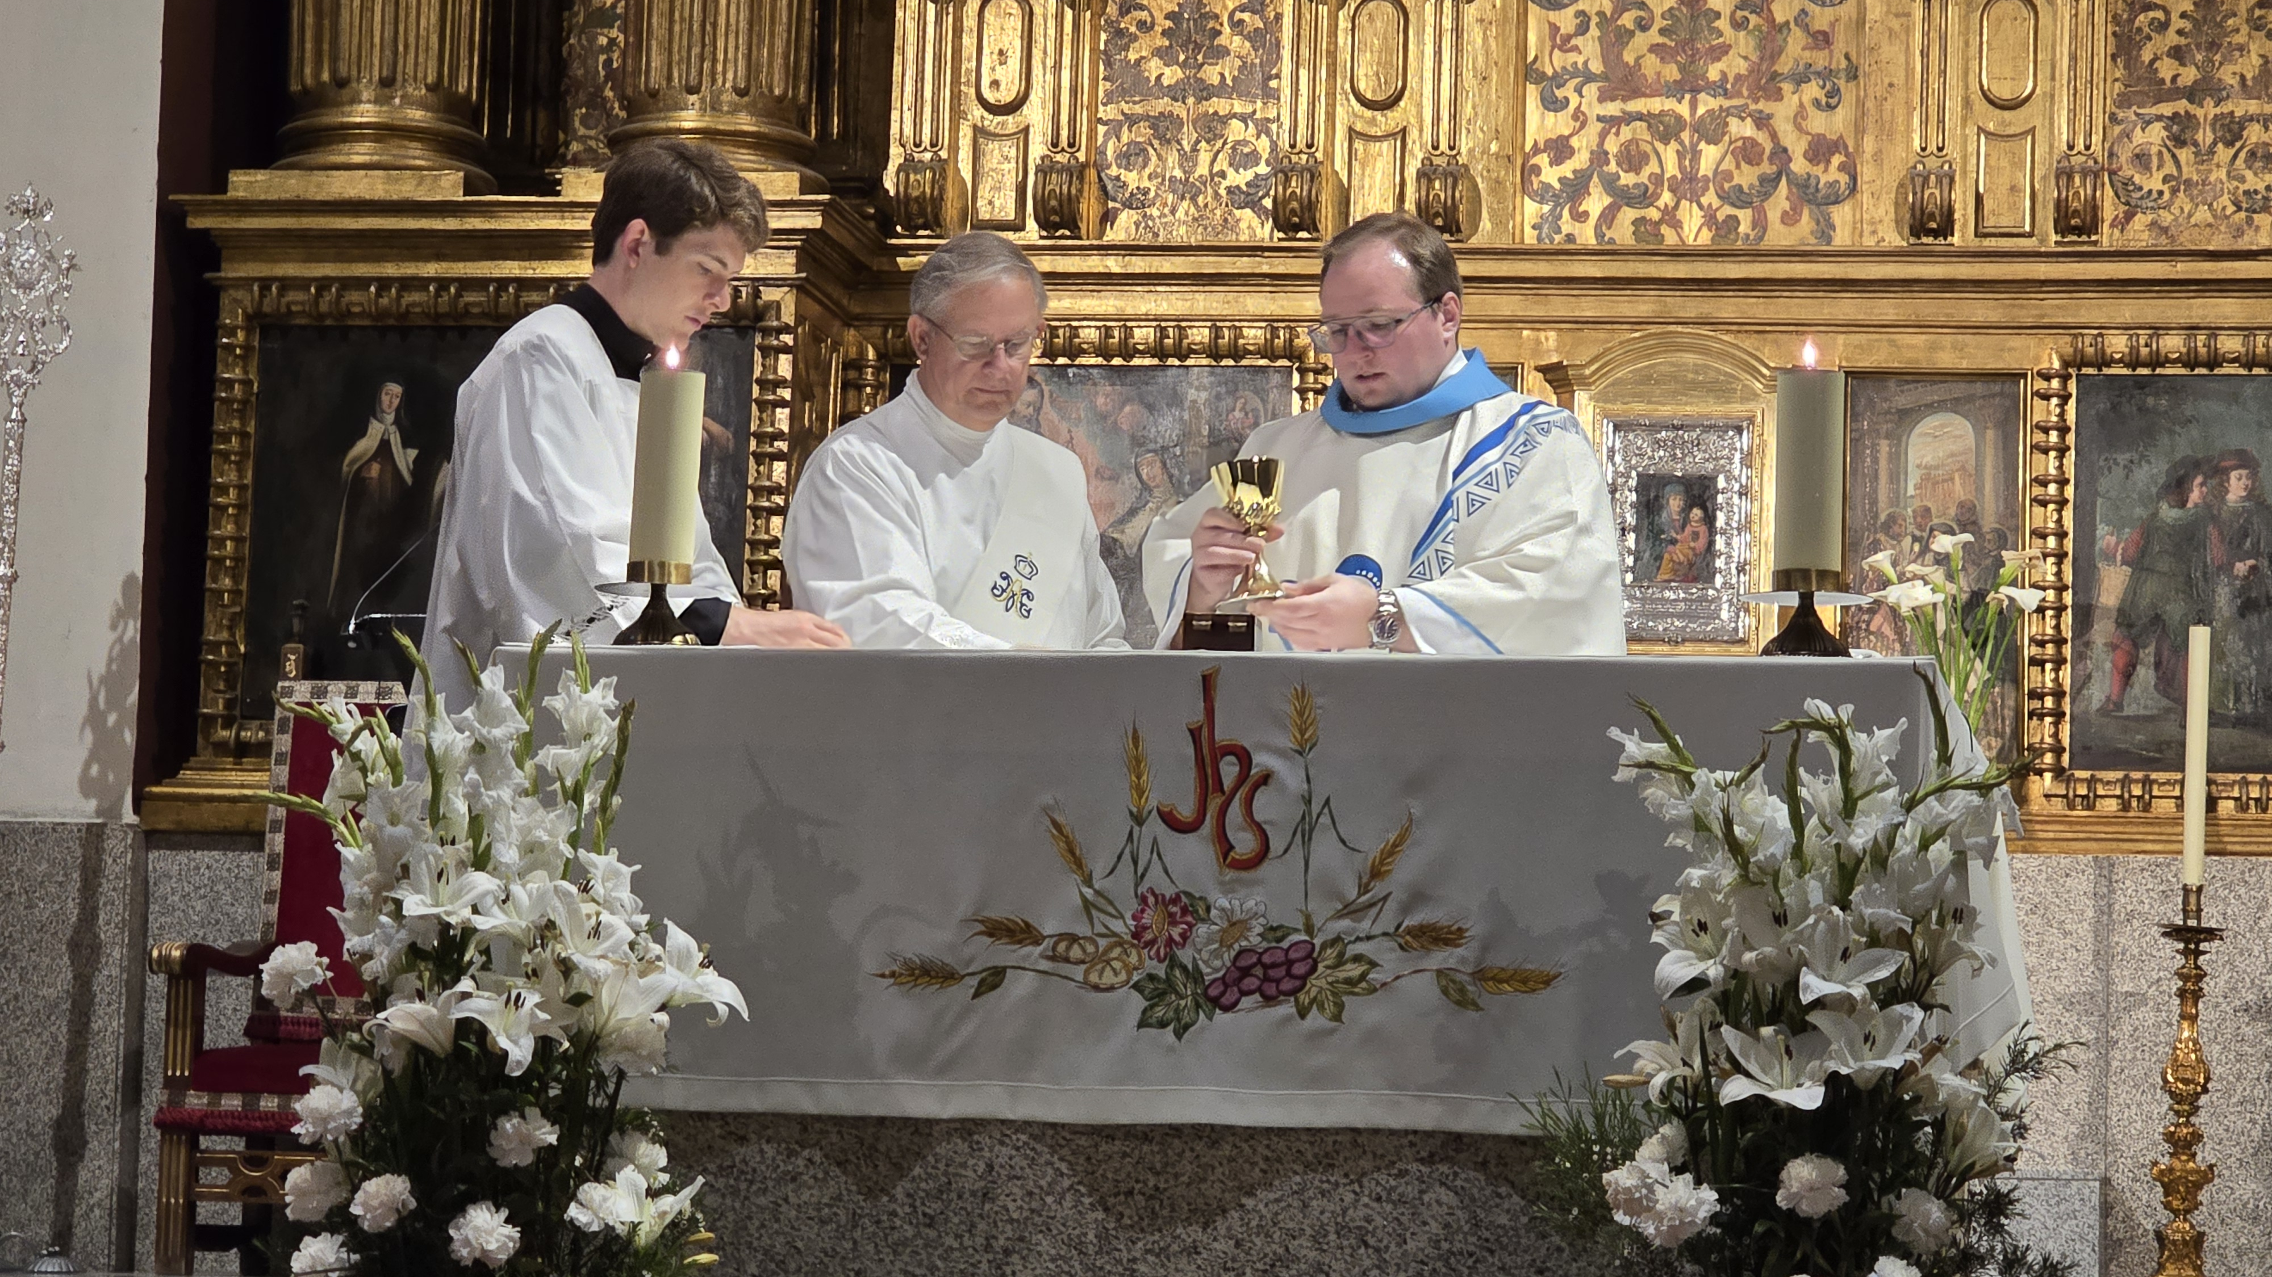
Basilica of Saint Theresa of Avila - April 29

Slide 10
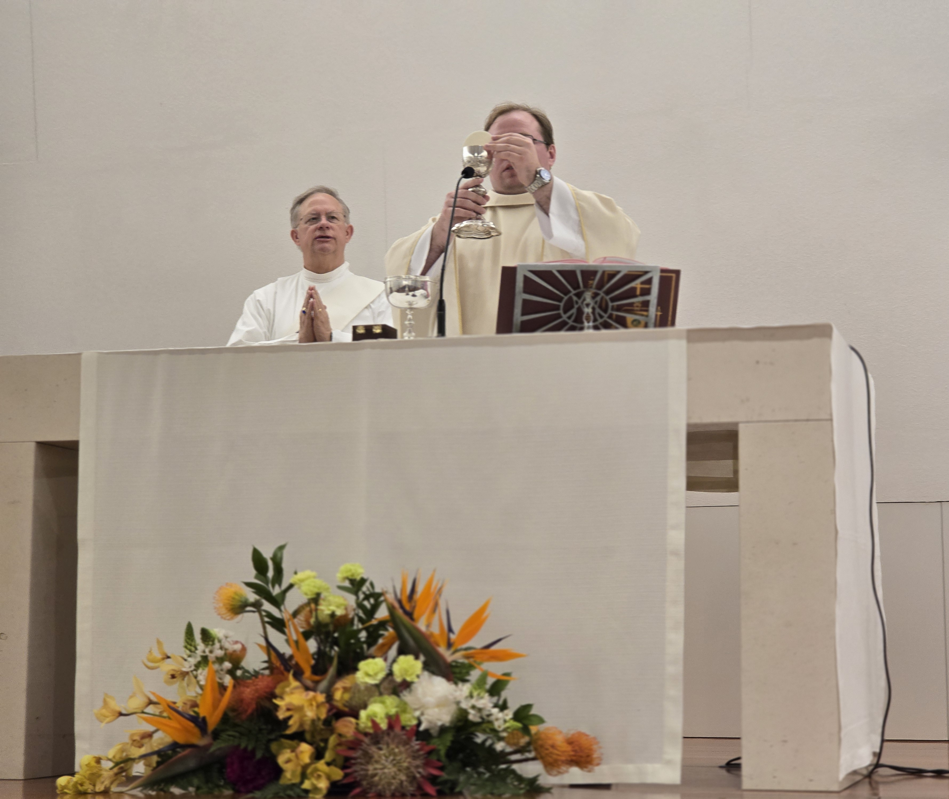
Fatima, Chapel of the Resurrection of Jesus - April 30

Slide 11
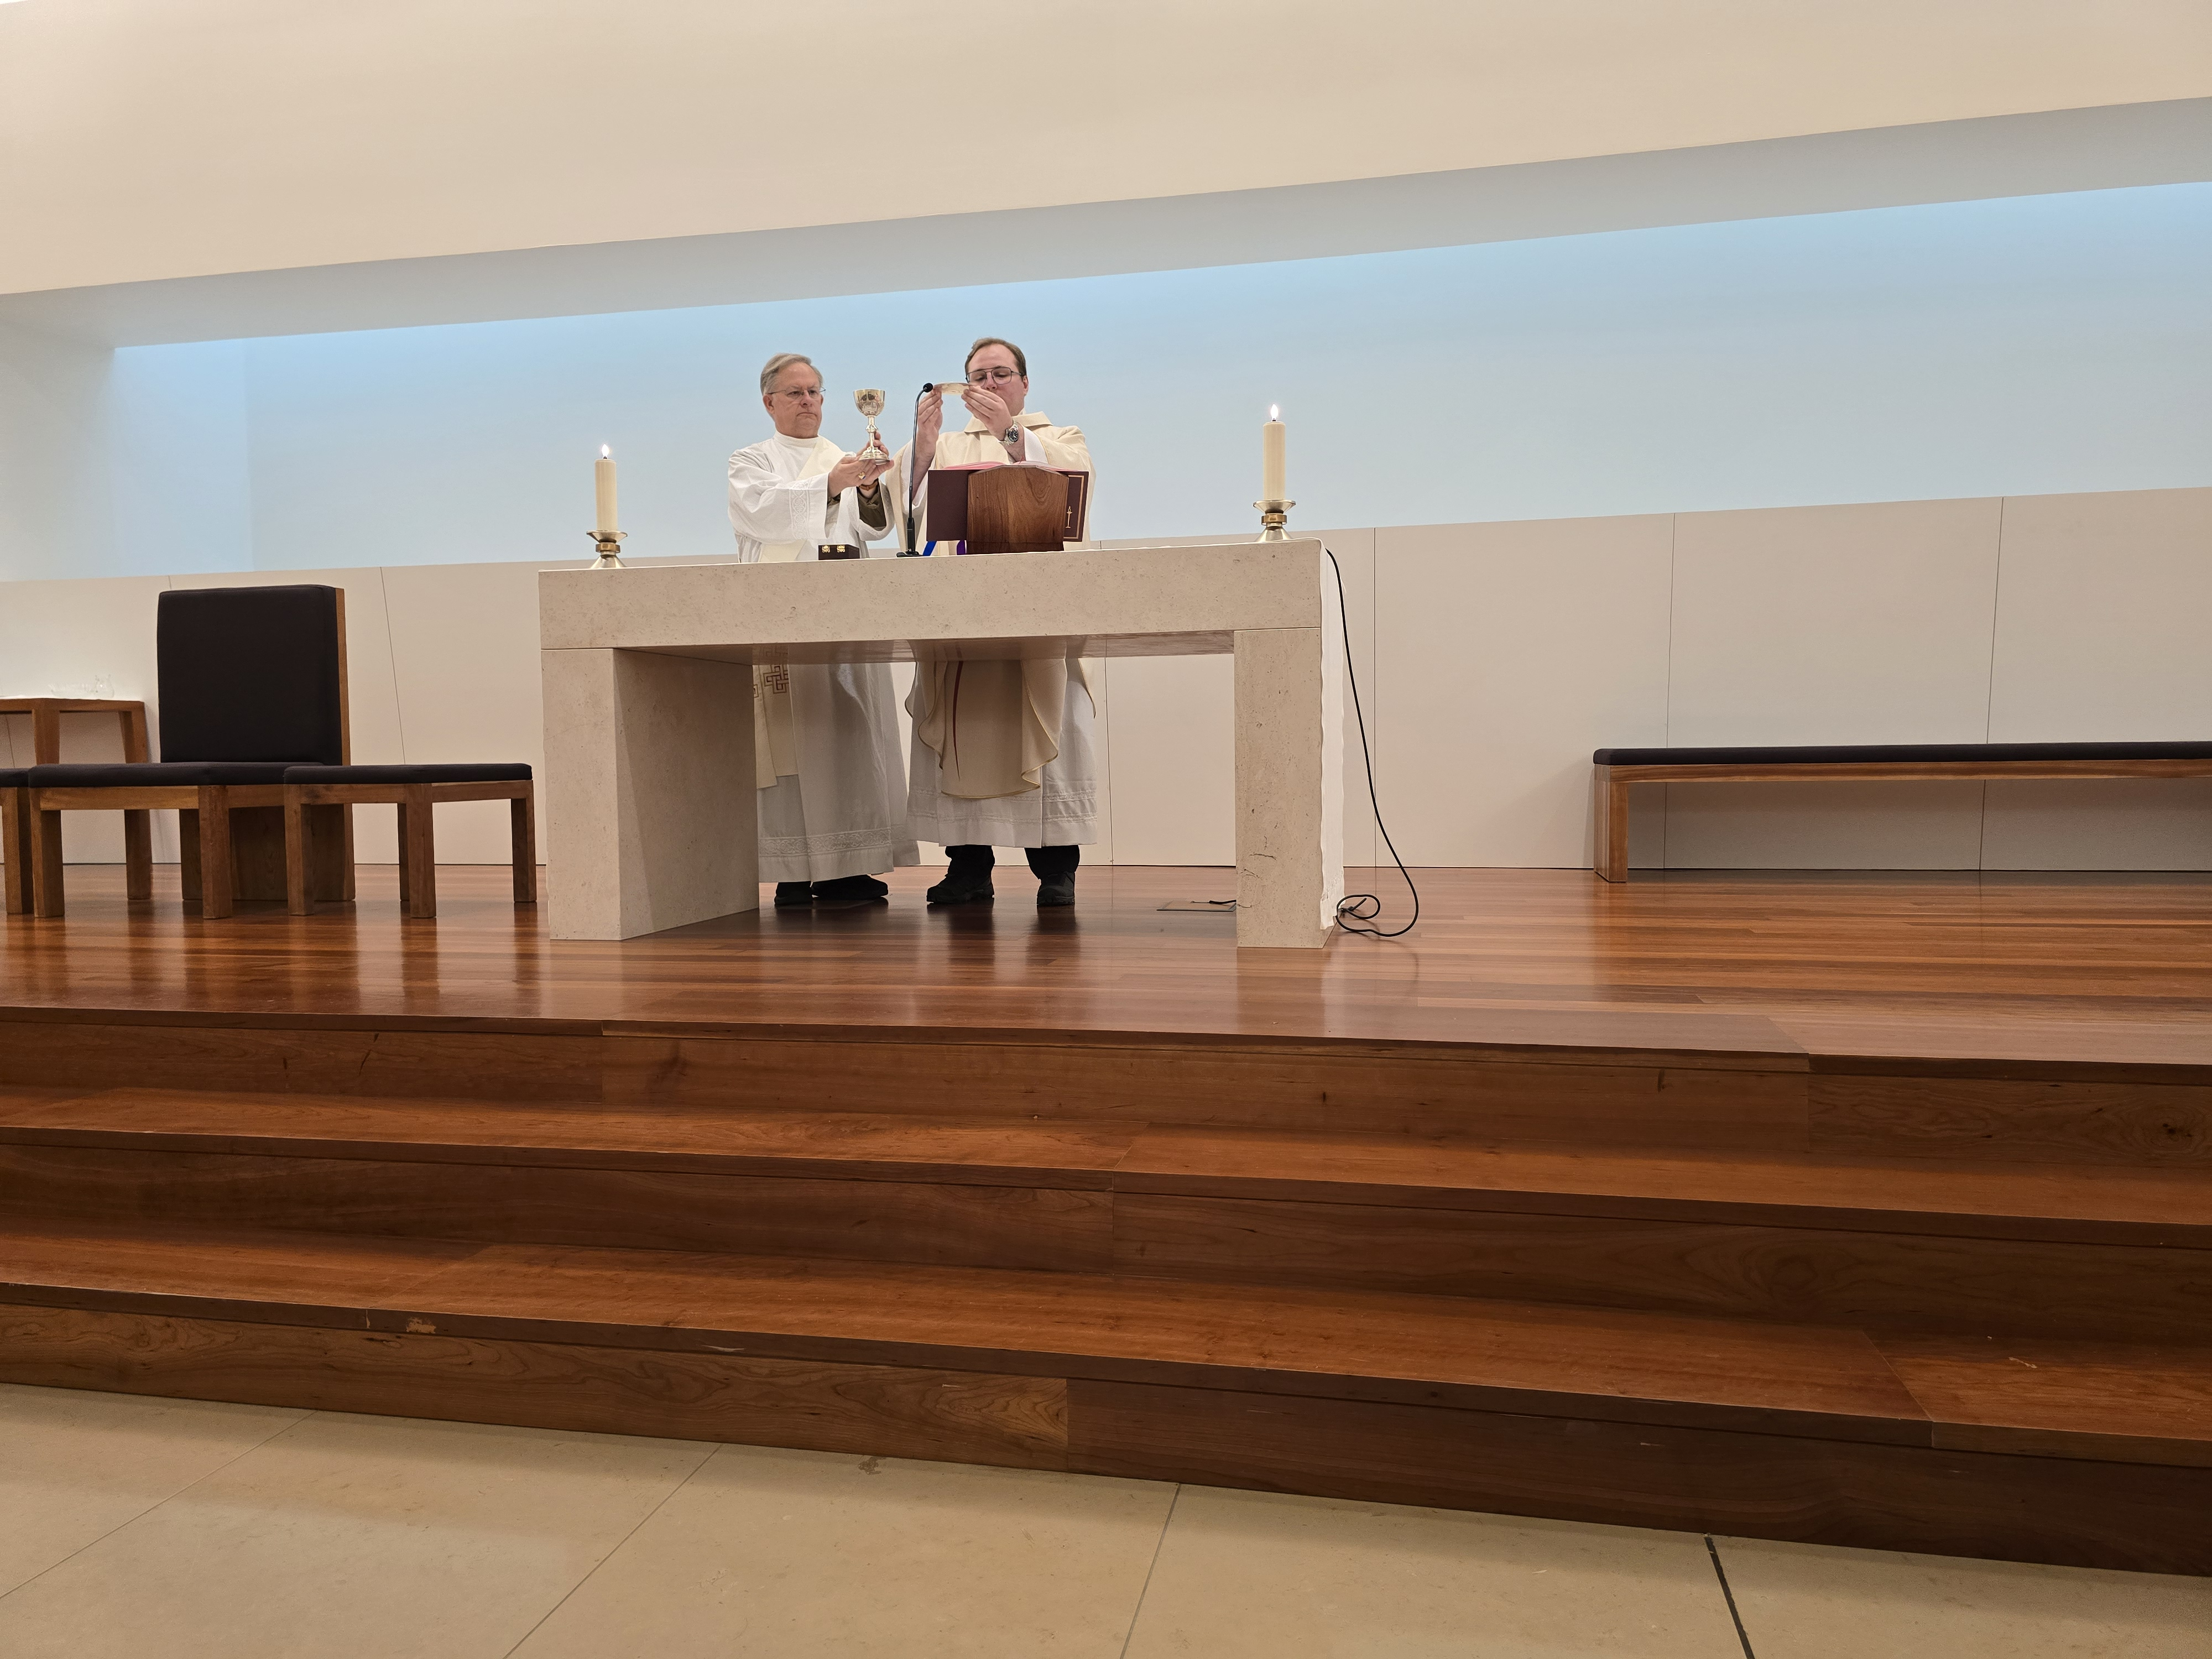
Fatima, Chapel of the Death of Jesus
May 1

Slide 12
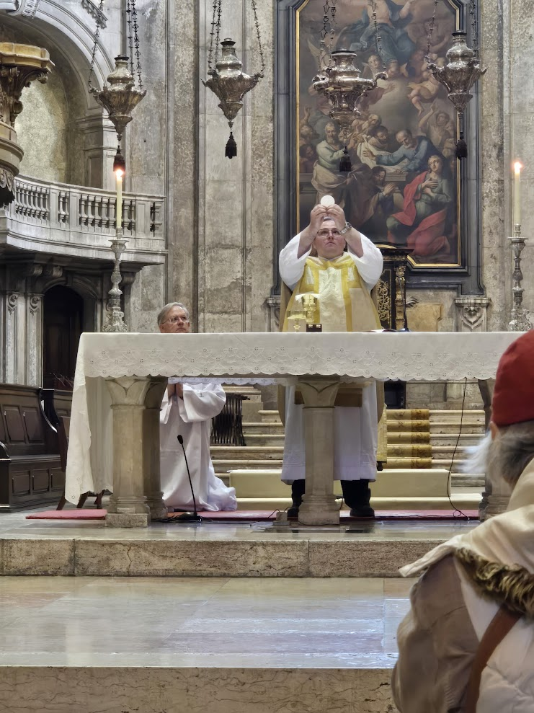
Lisbon Cathedral
– May 2

