Slide 1
Paris, Lourdes, and Fatima
Deacon Kevin Bagley, D. Min.
13 Days- April 21 - May 3, 2026

Slide 2

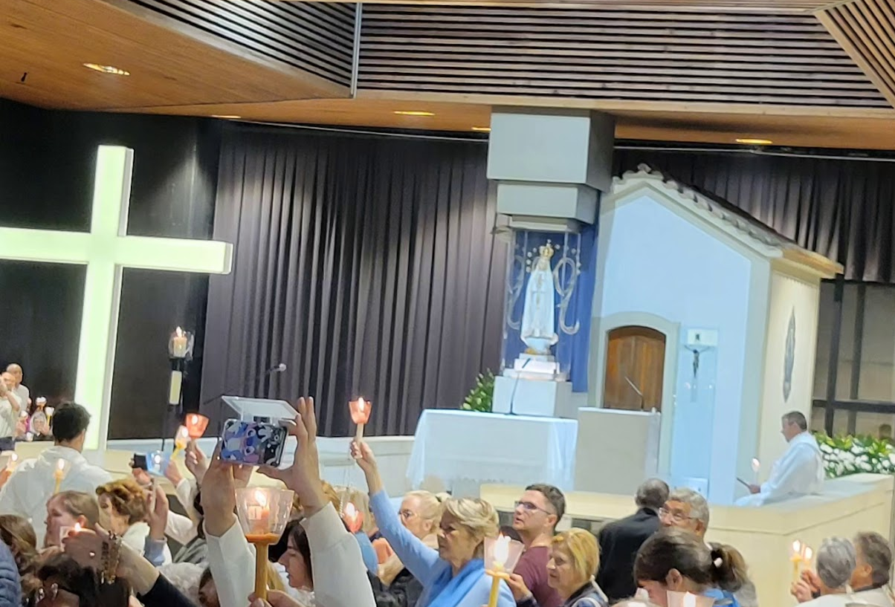
What is the difference between
a tourist and a
religious pilgrim??

Slide 3

Pilgrims do not complain
We offer it up!

Slide 4
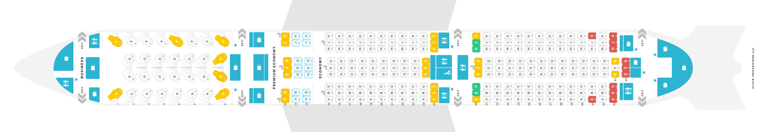
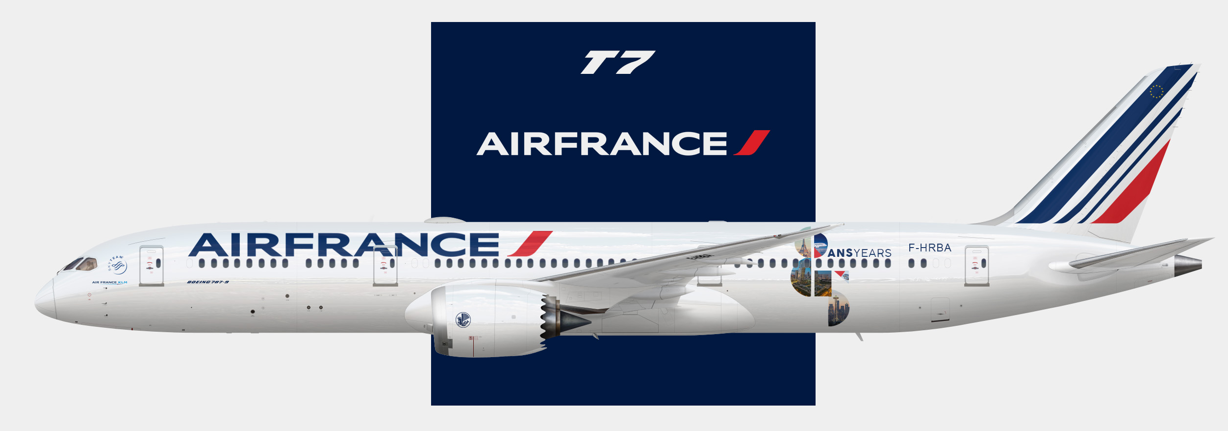
Day One Air France
April 21, 2026
Dallas/ Fort Worth
Evening departure from the United States (currently 3:50pm)
Dinner and Breakfast served on plane
Premium and business class upgrades available upon request
https://www.seatguru.com/airlines/Air_France/Air_France_Boeing_787-9.php

Slide 5
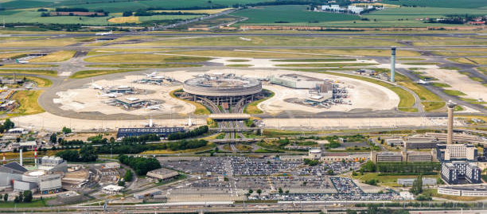
Arrive in Paris Bus ride to Lisieux
April 22
Bienvenue à Paris, France
Welcome to Paris

Slide 6
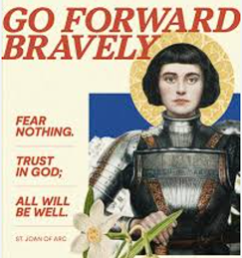
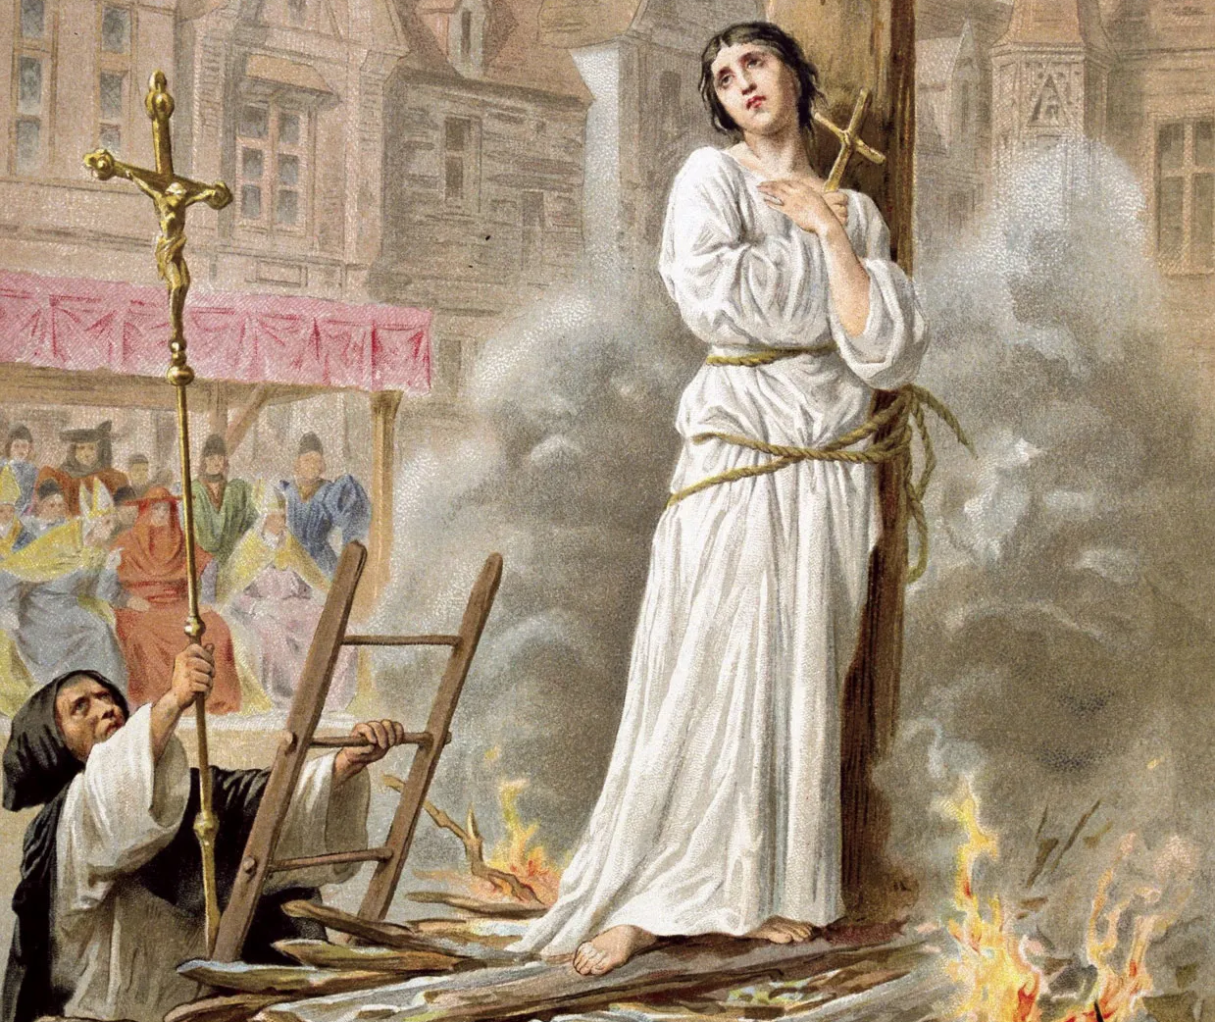
Saint Joan of Arc
April 22
St. Joan of Arc is a heroine of France and revered as a holy person for her faithfulness and courage, which she displayed in battle, but even more acutely in her trial and execution.
She was born Jeanne in 1412 on the feast of the Epiphany.
At the age of 14, she began hearing voices telling her she had a mission to save France during the Hundred Years’ War with England.
She marched into battle with a banner that proclaimed the names of Jesus and Mary.
Tortured and burned at the stake at age 19.
https://www.youtube.com/watch?v=bs9J-fuwRk0
https://www.youtube.com/watch?v=I5mVr2R5D-Y

Slide 7
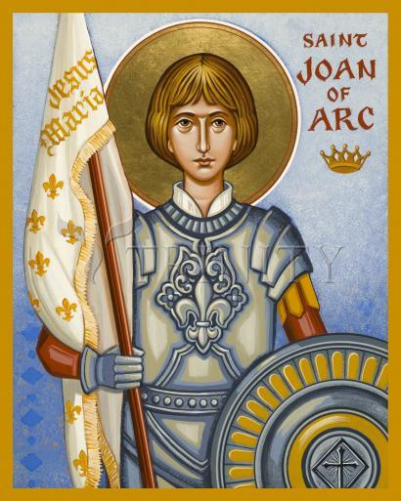
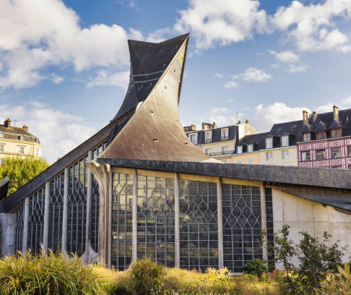
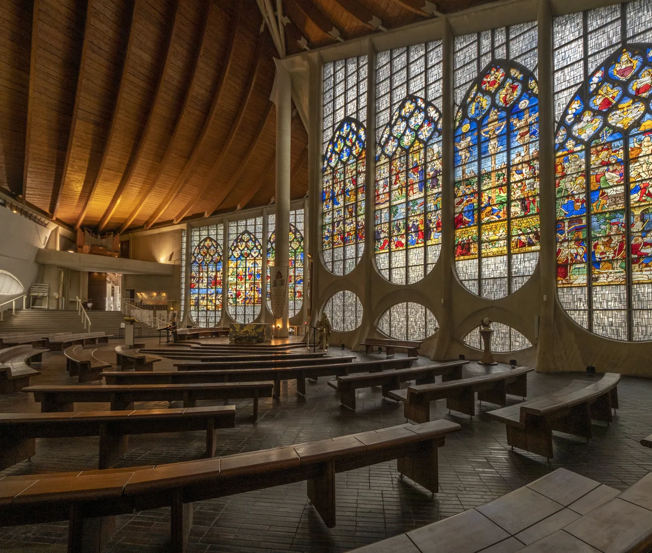
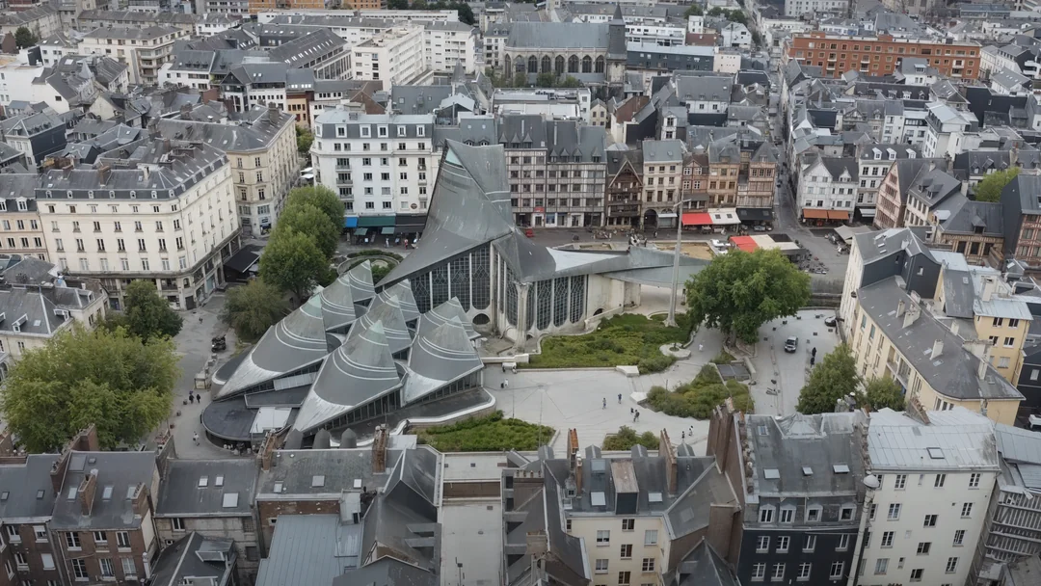
Rouen City of Saint Joan of Arc
https://www.reddit.com/r/architecture/comments/1k3odxy/the_church_of_saint_joan_of_arc_rouen_france_1979/
Mass at 3:30

Slide 8
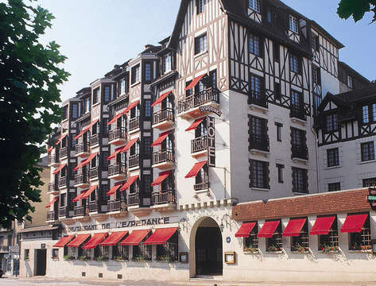
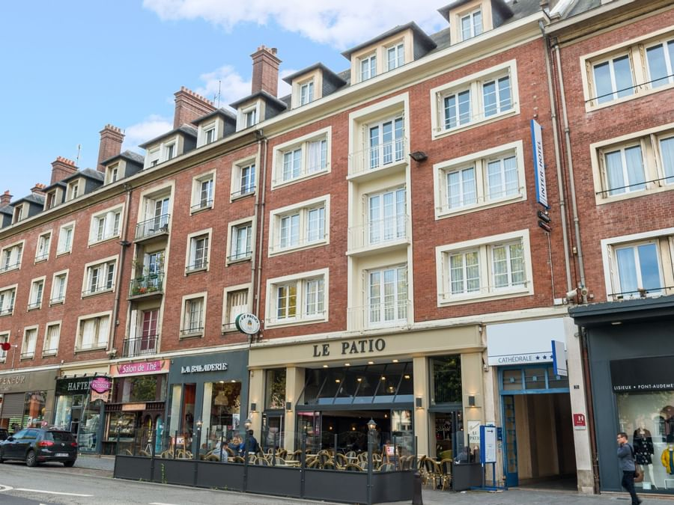
Lisieux (two nights)
GRAND HOTEL DE L’ESPERANCE THE ORIGINALS CITY HOTEL
https://www.lisieux-hotel.com/fr https://www.theoriginalshotels.com/en/hotels/lisieux-cathedrale

Slide 9
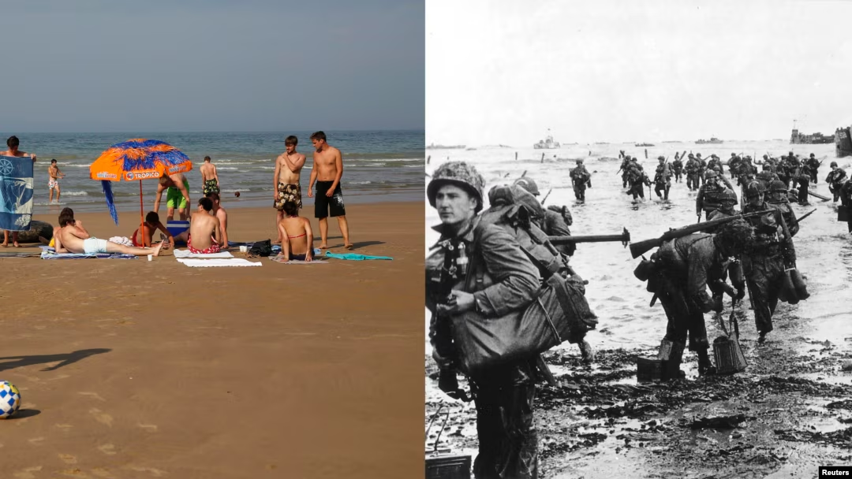
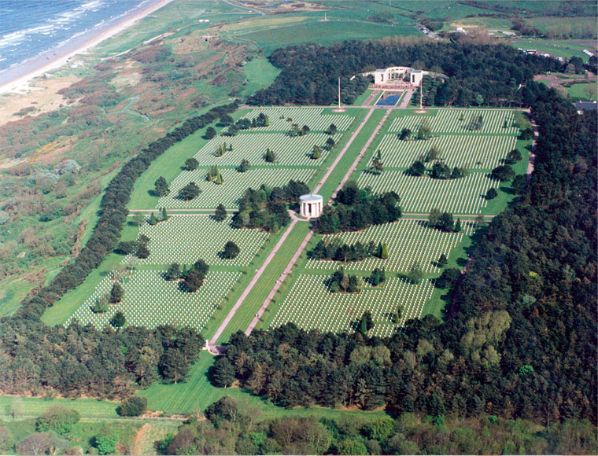

Beaches of Normandy
https://www.abmc.gov/cemeteries-memorials/about-normandy-american-cemetery/
April 23

Slide 10
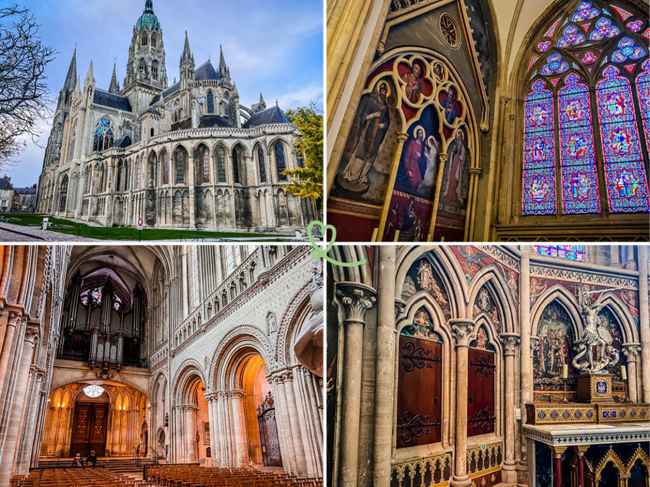
Cathedral of Bayeux
https://bayeux-bessin-tourisme.com/en/visits/monuments/bayeux/cathedrale-de-bayeux

Slide 11
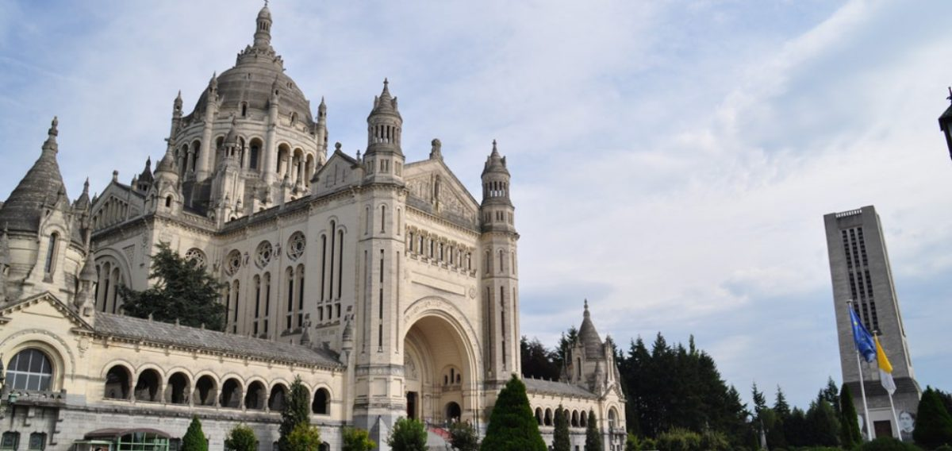
Lisieux, France
Basilica of St. Thérèse
Saint Thérèse
of Lisieux
Doctor of the Church
Lisieux, France, holds significant Catholic importance as the home of Saint Thérèse of Lisieux. The town is a major pilgrimage site, second only to Lourdes, due to its association with her life and the large basilica built in her honor.
Thérèse Martin, known as "The Little Flower," was a Carmelite nun who died at the young age of 24. Her autobiography, "Story of a Soul," detailed her "little way" of spiritual life, emphasizing simplicity and trust in God's love.
Saint Thérèse is the patron saint of missionaries, florists, and the sick, among others. Her intercession is often sought for healing and guidance, with some devotees reporting the appearance of roses, her symbolic flower, when they pray to her.
April 24
https://www.catholic.org/saints/saint.php?saint_id=105

Slide 12
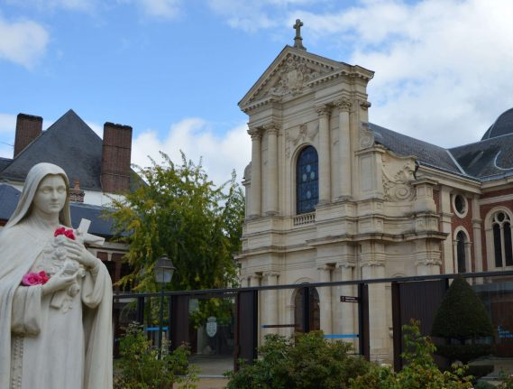
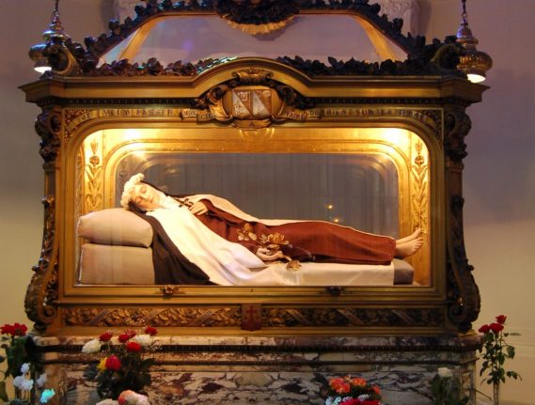
Celebrate Mass at the Carmel Convent
April 24

Slide 13
A panoramic tour of Paris
April 25
Arc de Triomphe
The Arc de Triomphe is an iconic symbol of French national identity and took 30 years to build. The Tour de bicycle race ends near it each year, and the annual military parade marking July 14—known both as French National Day and Bastille Day—begins its journey at the arch.

Slide 14
Notre Dame Cathedral
Notre Dame Cathedral is the most famous of the Gothic cathedrals of the Middle Ages and is distinguished for it’s size, antiquity, and architectural interest.
https://www.britannica.com/topic/Notre-Dame-de-Paris

Slide 15
Celebrating Mass at Sacre Coeur Church

Slide 16
Eiffel Tower
Day 3 Cont.
It took 2 years, 2 months and 5 days to complete the Eiffel Tower
https://www.toureiffel.paris/fr/bien-preparer-votre-visite

Slide 17
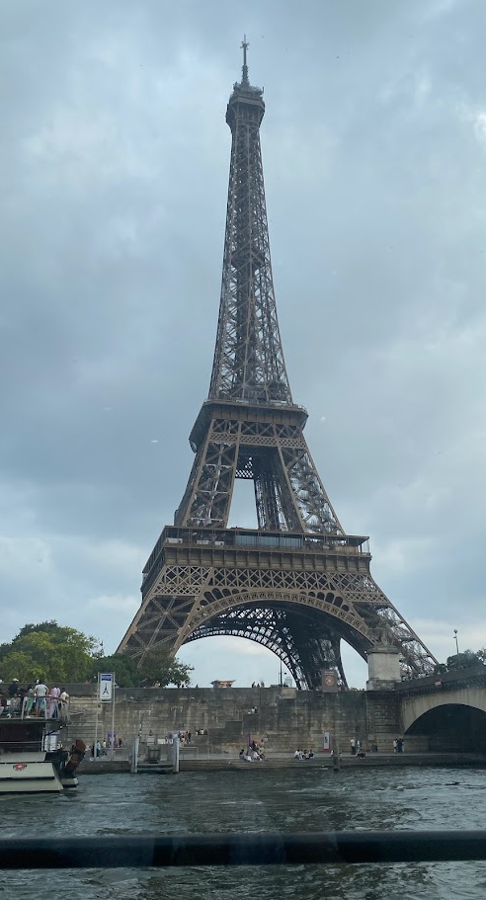
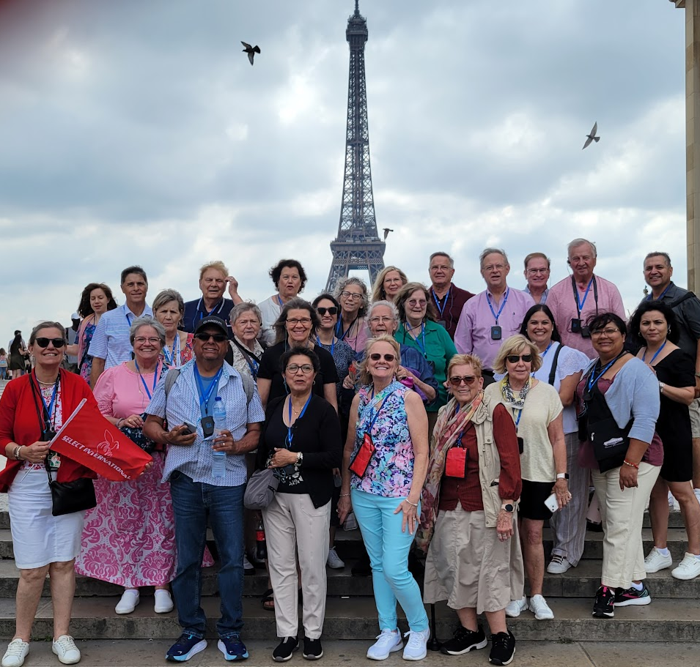
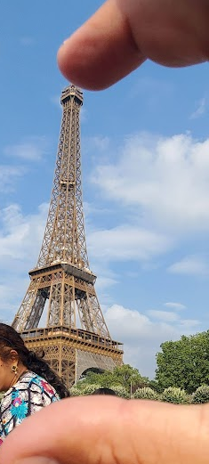

Slide 18

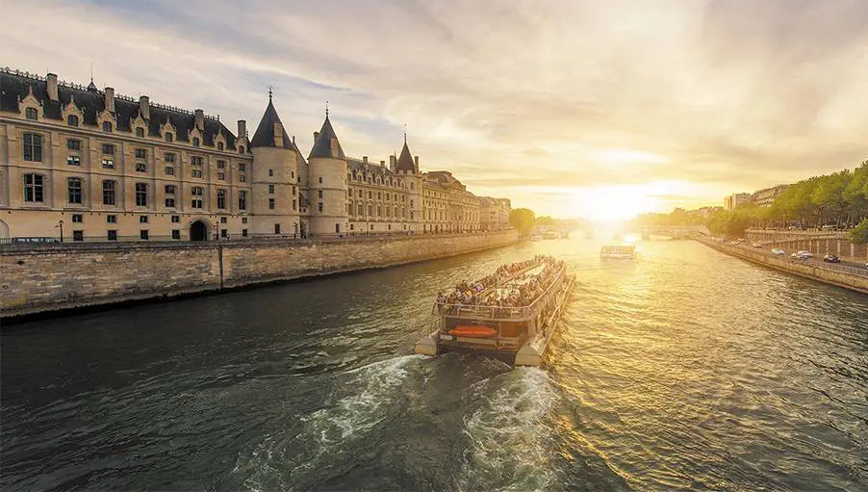
Seine River Cruise with Dinner Bateaux Parisiens

Slide 19
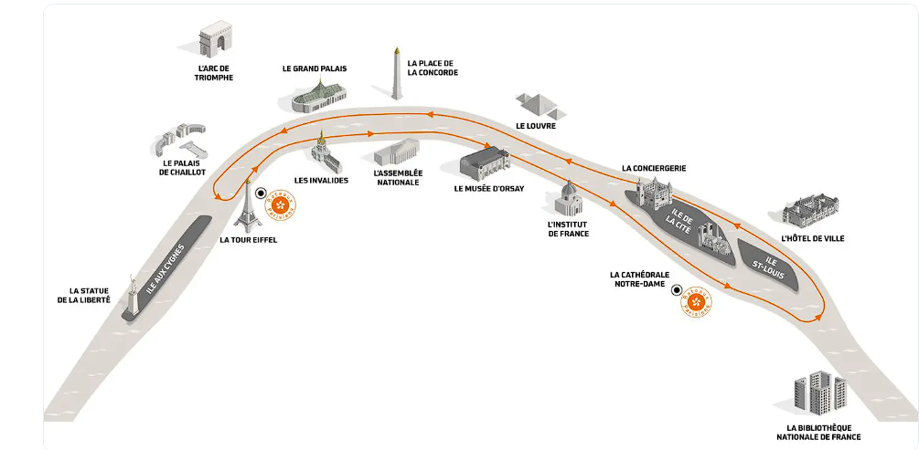

Slide 20
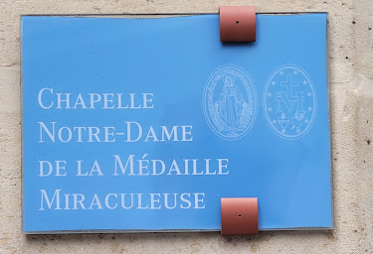
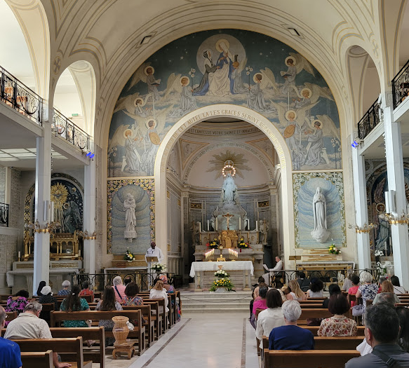
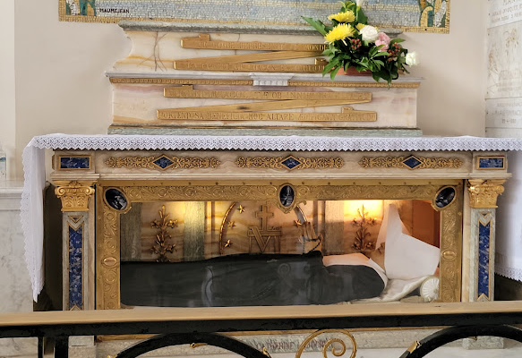
Chapel of the Miraculous Medal
April 26
Saint Catherine Laboure
Two apparitions in 1830
Notes:
Mary appeared twice to Catherine Laboure in the Chapel.

Slide 21
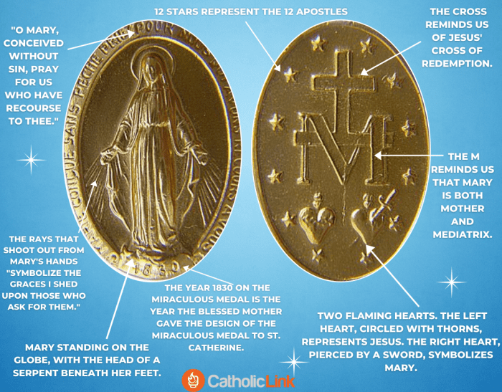
Miraculous Medal explained

Slide 22
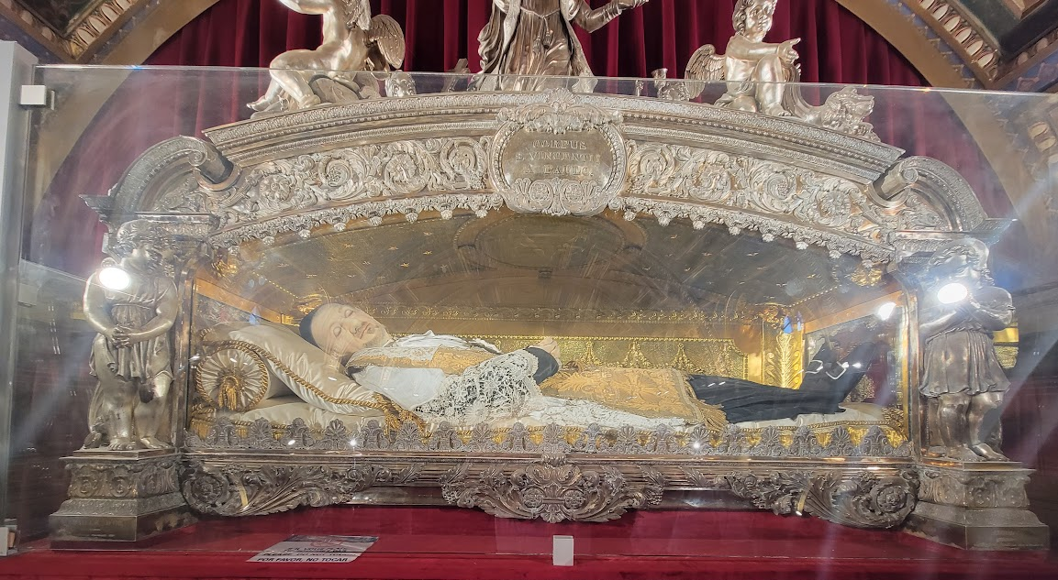
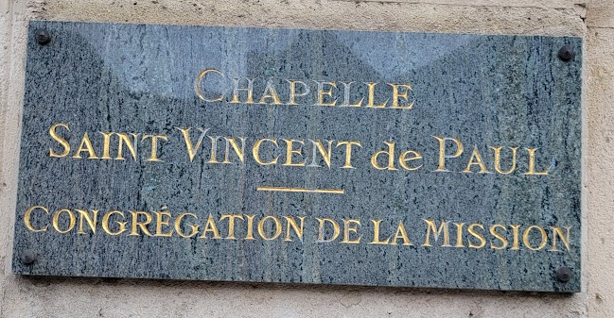
Saint Vincent de Paul
April 26
https://www.youtube.com/watch?v=WEarj49hFRg&list=PL58g24NgWPIzvBk2IQVES_xC4WTm6-CDI
Notes:
Celebrate Mass

Slide 23
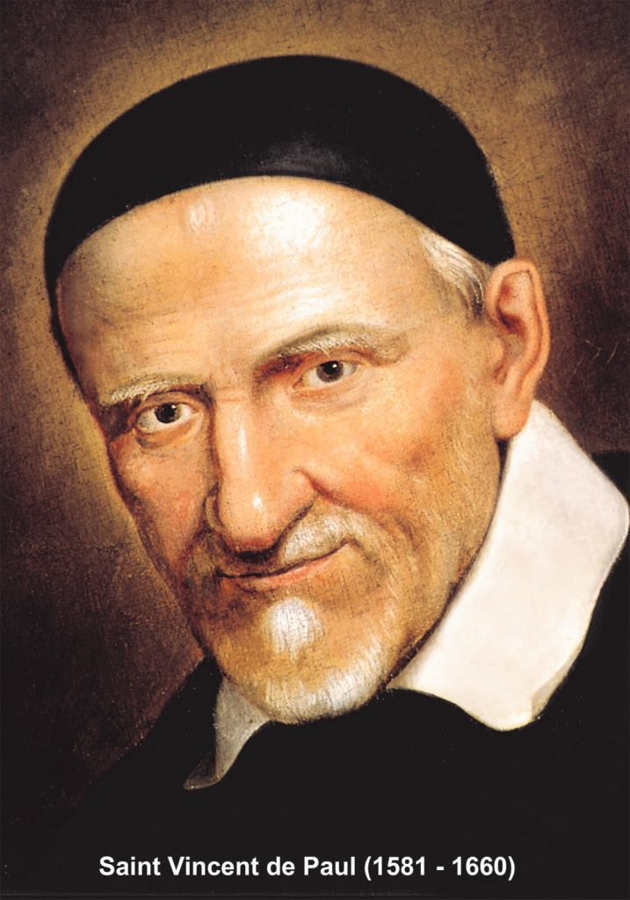
Saint Vincent de Paul
Saint Vincent de Paul (1581–1660) was a 17th-century French Roman Catholic priest who revolutionized charity and social reform by dedicating his life to serving the poor, marginalized, and imprisoned.
Born to a peasant family, he overcame humble beginnings to become a key figure in the Counter-Reformation, founding the Congregation of the Mission (Vincentians) and co-founding the Daughters of Charity with St. Louise de Marillac.

Slide 24
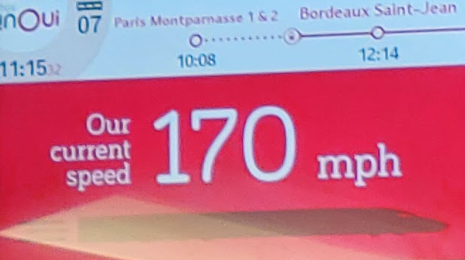

April 26
Sunday
After Mass, head to the train station (lunch along the way), depart Montparnasse train station to Lourdes, France
https://video.search.yahoo.com/search/video?fr=pk4afpq0b2f&ei=UTF-8&p=inoui+tgv&type=E210US714G91762#id=18&vid=9541541d71104a64925beae39ace16ce&action=view

Slide 25
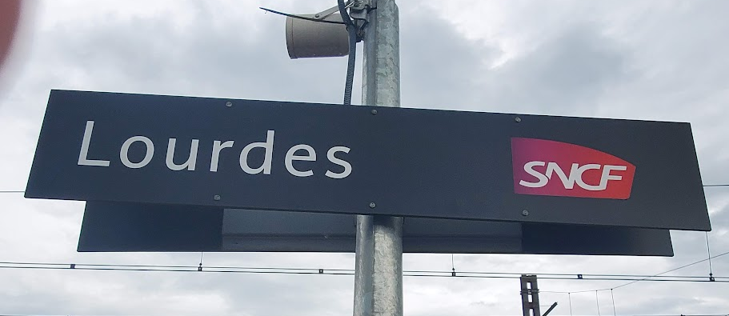
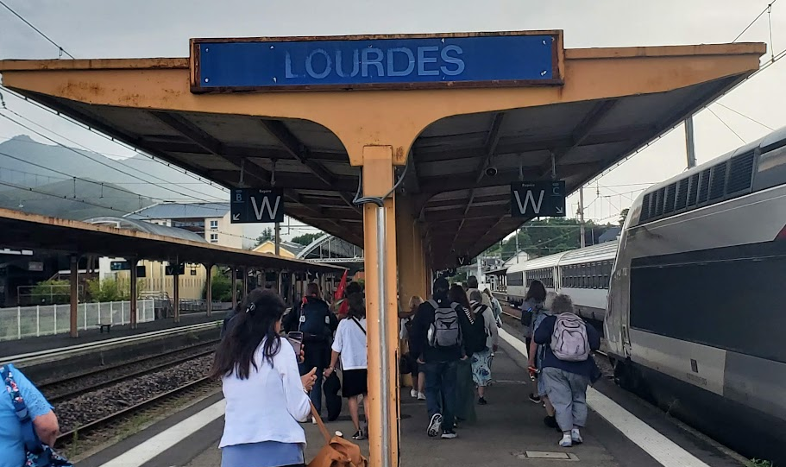
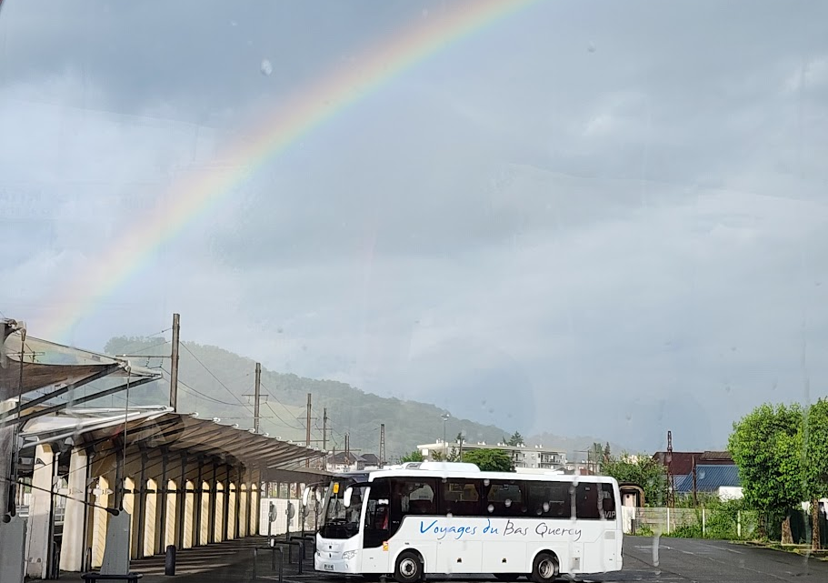

Slide 26
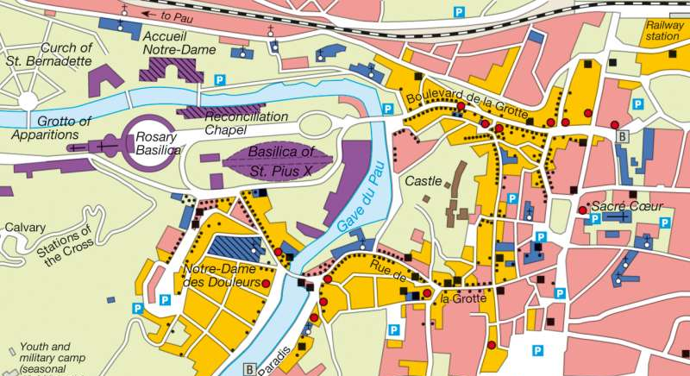

Slide 27
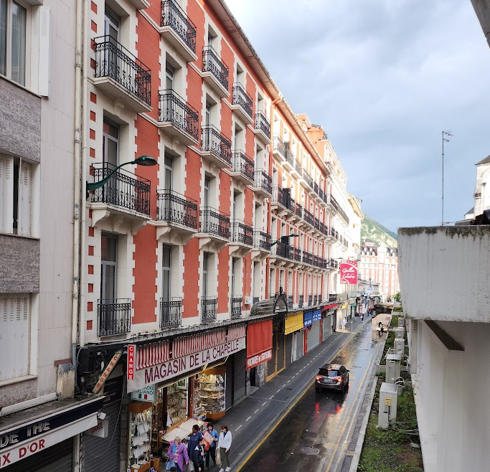
Hotel Gallia et Londres
https://www.hotelgallialondres.com/en/hotel-spa-lourdes

Slide 28
April 26 & 27
Lourdes, France
Walking tour of Lourdes and celebrate Mass. We will see the places associated with the apparition of the Blessed Mother and the life of little Bernadette.
https://www.youtube.com/watch?v=IzeO0E36RJw
Opportunity to join the
Candlelight Procession

Slide 29
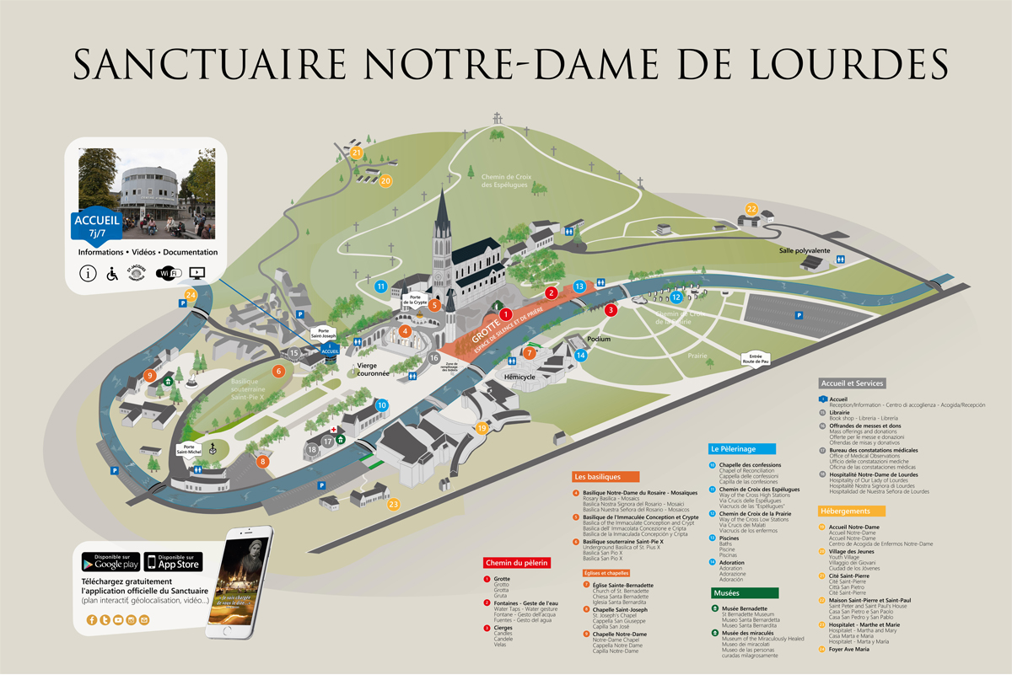

Slide 30
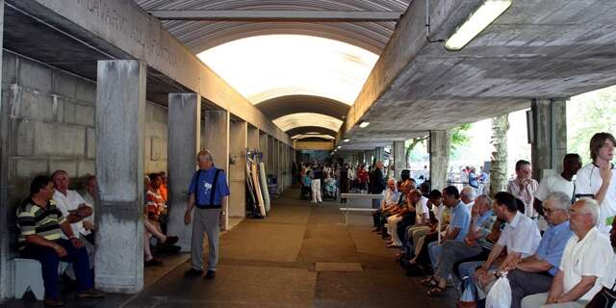
April 27 & 28
Lourdes
Walking Pilgrimage schedule which includes comprehensive spiritual activities
Bathe in the baths at the grotto.
Mass at the Grotto

Slide 31
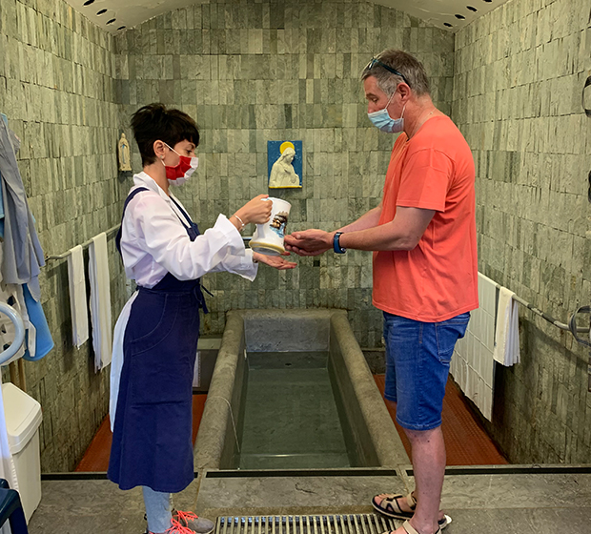
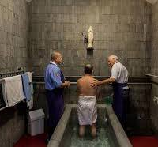
The Baths at the Sanctuary of Our Lady of Lourdes
Water Gesture
Immersion

Slide 32
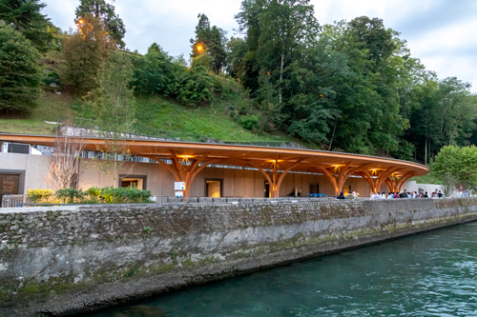
The Baths

Slide 33
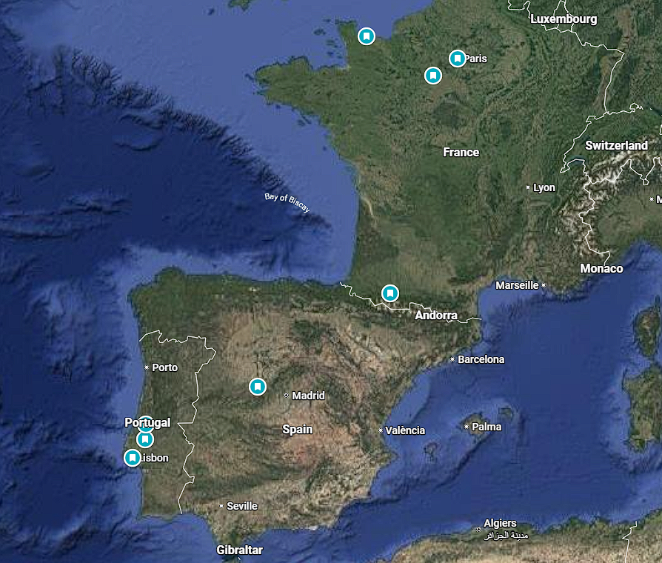
Marian Shrines Pilgrimage

Slide 34
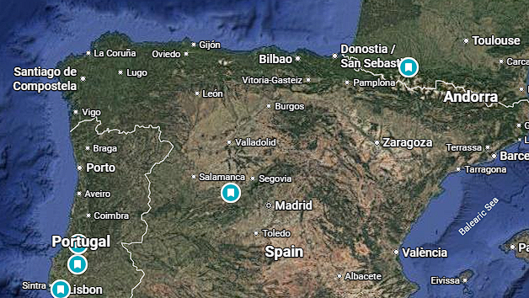
Lourdes to Avila 7.5 hours

Slide 35
Lourdes –Avila, Spain
April 29
Avila
The magnificent walled city dedicated to St. Teresa of Avila.
City dedicated to St. Teresa - the first woman to be named a Doctor of the Church.
Visit the Crypt of La Encarnacion Convent, where she became a nun.
See the Cathedral and the Cuatro Postes, which commemorates St. Teresa.
Mass will be celebrated
Dinner and overnight in Avila

Slide 36
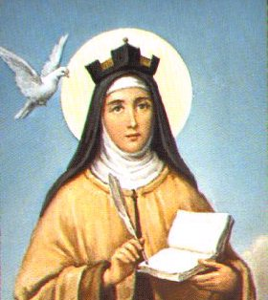
Saint Teresa of Avila
A doctor of the church is a person whose teaching on faith has been deemed sound and of benefit to the church through their writing, study, or research. Along with significant theological contribution, the person must also display a high degree of sanctity, which is why all church doctors are also canonized saints. A third requirement to be named a doctor of the church is formal proclamation as such by the pope or an ecumenical council.
The first church doctors were declared by Pope Boniface VIII in the 13th century: Sts. Ambrose, Jerome, Augustine, and Pope Gregory the Great. The first women to be named as church doctors were Sts. Teresa of Ávila and Catherine of Siena in 1970 by Pope Paul VI.

Slide 37
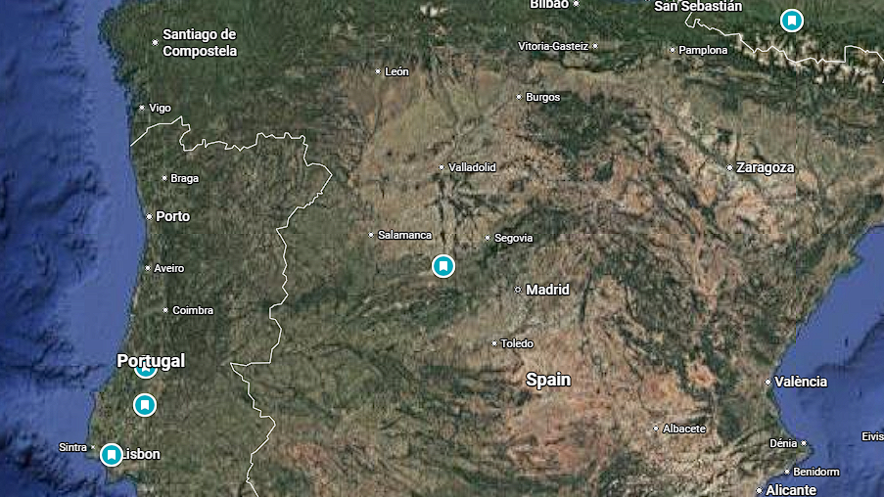
Avila to Fatima 8 hours

Slide 38
Avila-Fatima, Portugal
April 30
Fatima
Journey through Spain toward Portugal.
Late in the afternoon, we will arrive in Fatima, one of the most visited pilgrimage sites in the world.
Well known for the story of the apparition of Our Lady to three shepherd children in 1917
Mass will be celebrated
Overnight in Fatima

Slide 39
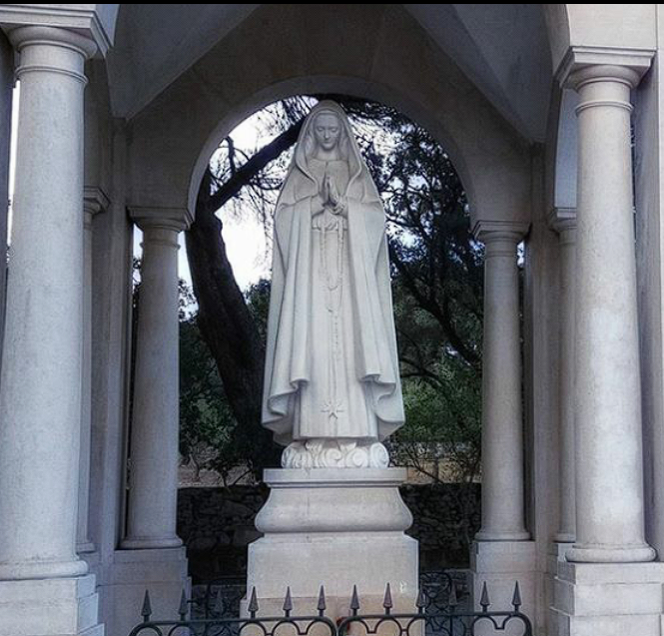
Aljustrel and Valinhos
May 1
Valinhos is a countryside place on the outskirts of Fátima, Portugal. This place became famous for the 19 August 1917 apparition of Our Lady of Fátima and by the 1st and 3rd apparitions of the Guardian Angel of Portugal (also named the Angel of Peace ).
Aljustrel is where the shepherd children lived
Valinhos
Aljustrel is where the shepherd children lived

Slide 40
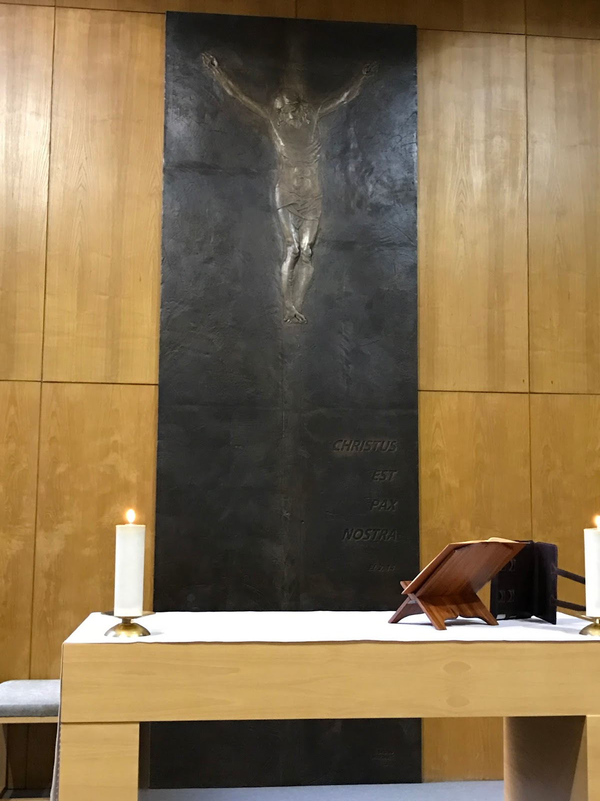
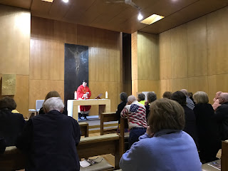
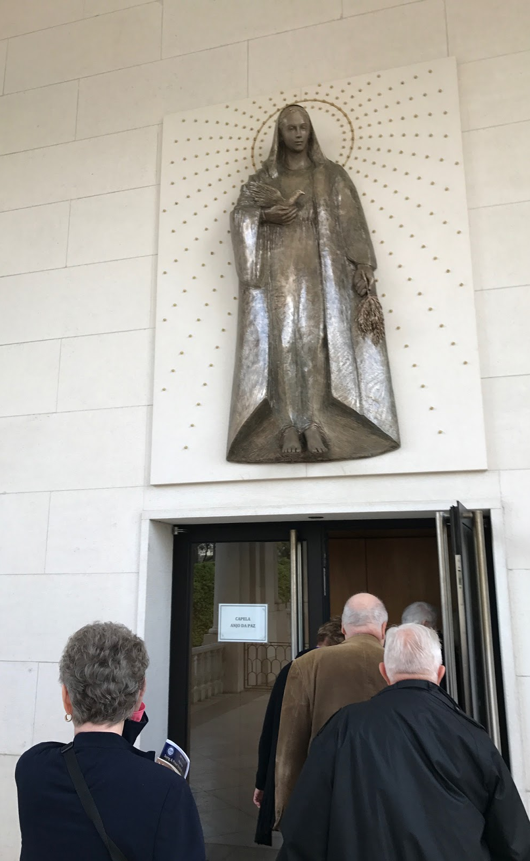
Fatima, Chapel of the Angel of Peace
Day 11, Monday

Slide 41
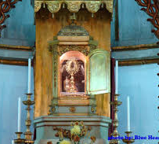
Santarem – Eucharistic Miracle
May 2
The 13th-century Eucharistic Miracle of Santarém (c. 1247 or 1266) involved a woman who stole a consecrated host for a sorceress, causing the host to bleed immediately. The host was hidden in a chest, which later emitted a radiant light. The relic is preserved at the Sanctuary of the Holy Miracle in Portugal.

Slide 42

May 3
Flight Home
Adeus, Viagens Seguras!
Goodbye, Safe Travels!

