Slide 1
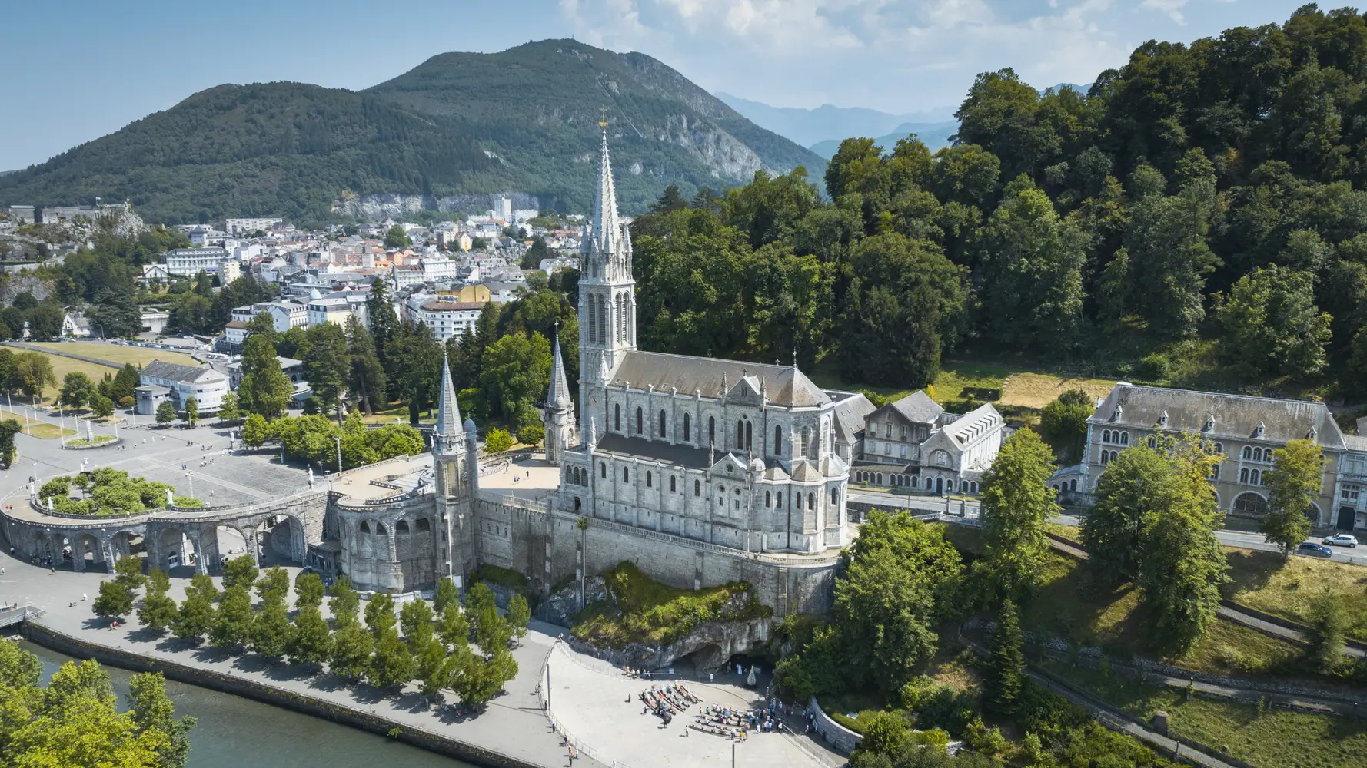
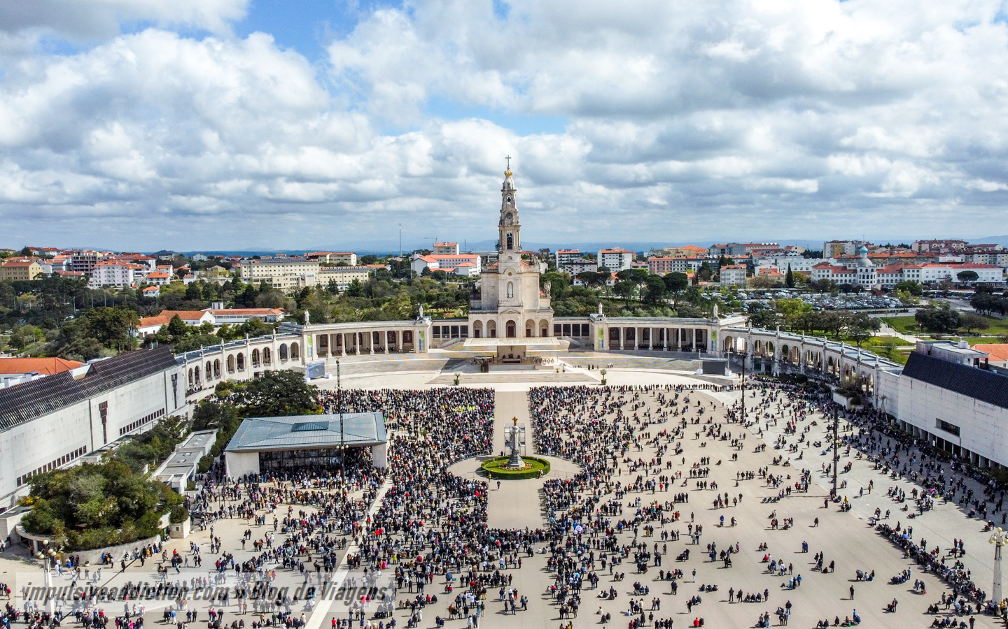
Paris, Lourdes, and Fatima
Deacon Kevin Bagley, D. Min.
13 Days
April 21 - May 3, 2026

Slide 2
Pilgrims Prayer
Dear God,
We ask your blessing when we travel.
Guide our minds as we celebrate the places
and the pilgrims who came before us.
Give us a hunger to seek your face in our paths
and recognize you along the way.
Bless us on our travels as we experience holy places and sacred images.
Nurture our fellowship, so we see each other
as brothers and sisters on our pilgrimage together,
as we all journey to your blessed kingdom
where you live and reign, forever and ever. Amen

Slide 3
Land & Group Air vs Land Only
Land & Group Air
Land Only
Airline tickets are purchased for you
Once ticketed, you can contact the airline to change/upgrade your seat
We travel as a group on the airplane
You purchase your own airline tickets
You are responsible for getting to
  Charles de Gaulle Airport
  Baggage claim
  April 22 at 9 am
Once on the bus, there is no difference!

Slide 4
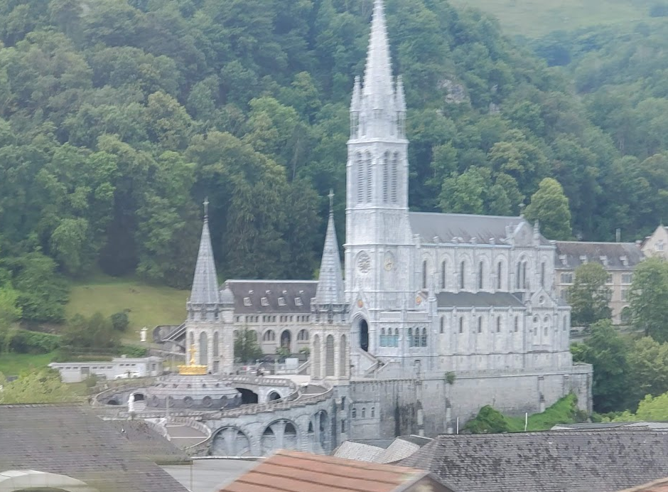
What is a pilgrimage?
A pilgrimage is a journey religious people take to a holy place or a place of religious significance.
Pilgrimage can be a physical journey, but it can also represent an individual's journey of faith
Catholics may visit sites linked to famous or important saints to help them connect with their faith's history
Lourdes

Slide 5
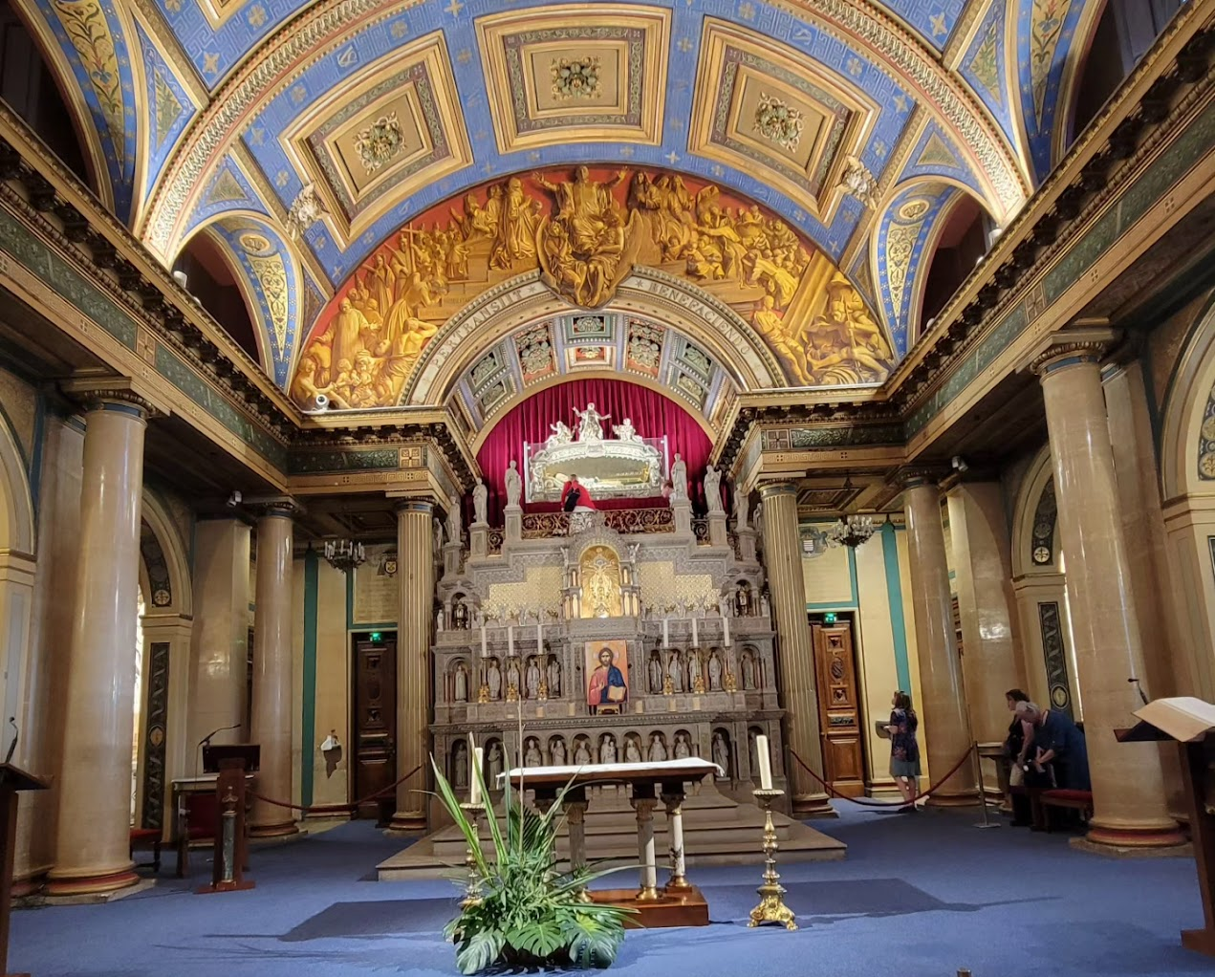
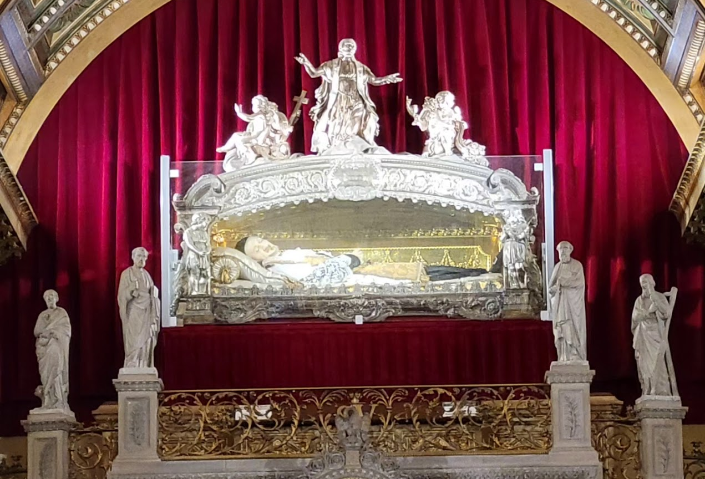
We are pilgrims on a Journey
Spiritual excursion
Opportunity to travel with (new) friends
Saint Vincent de Paul

Slide 6
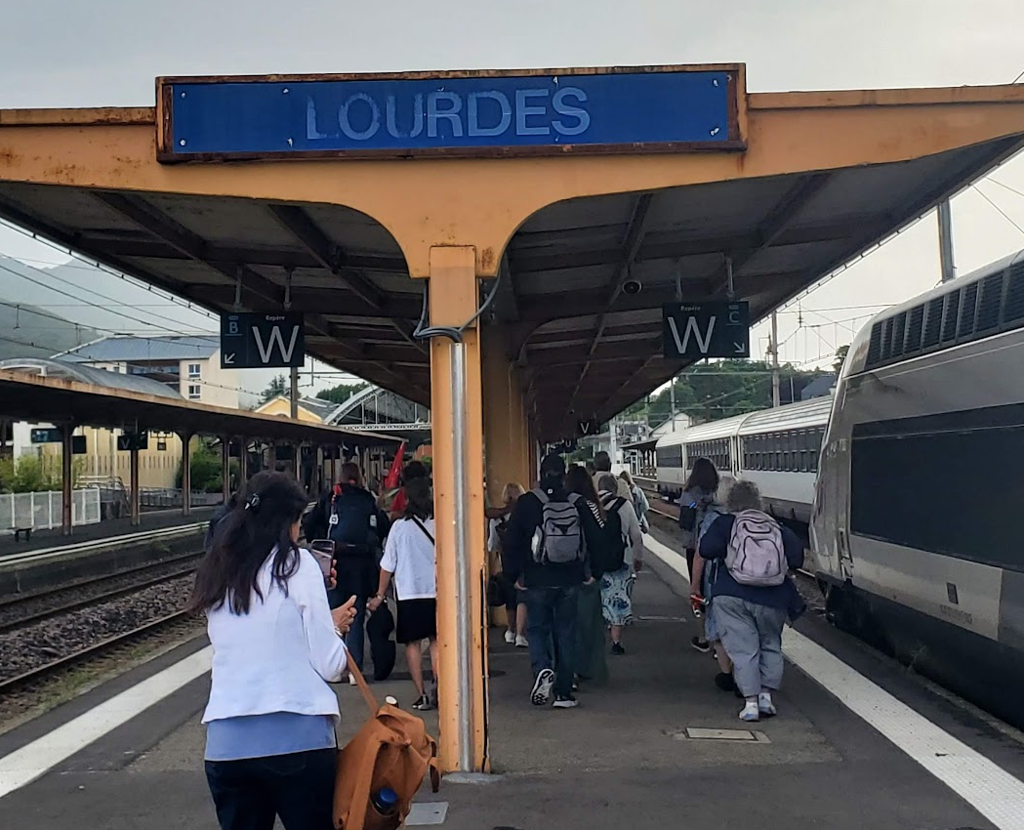
Scriptural foundations -
The spiritual importance of pilgrimage is manifested often in physical journeys and trials — from Abraham’s journey of faith all the way to the missionary journeys of Saint Paul.
Some Famous pilgrimages:
Abram
Exodus
15 of the Psalms speak of the ascent to Jerusalem
Wise men seeking the infant Jesus
The Holy Family going to Jerusalem
Jesus going to Jerusalem
Our journey to the Kingdom

Slide 7
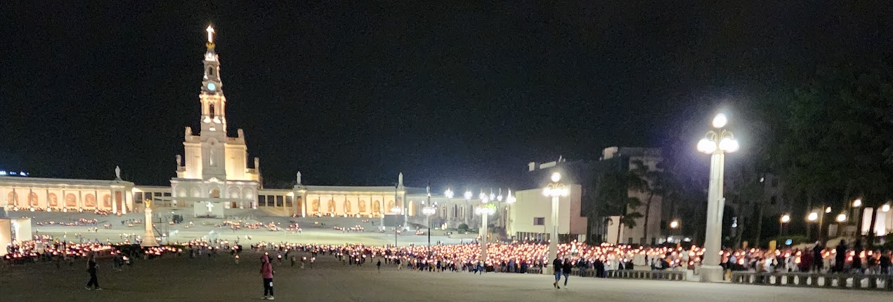
What is the Point of a Pilgrimage?
A pilgrimage is a common human experience in which one seeks to fulfill a ritual obligation, perform an act of devotion to atone for one’s sins, live a spiritual experience, or implore a grace, a miracle, a cure, etc. There are few acts of devotion as rich in history, traditions, or spirituality.
Fatima

Slide 8

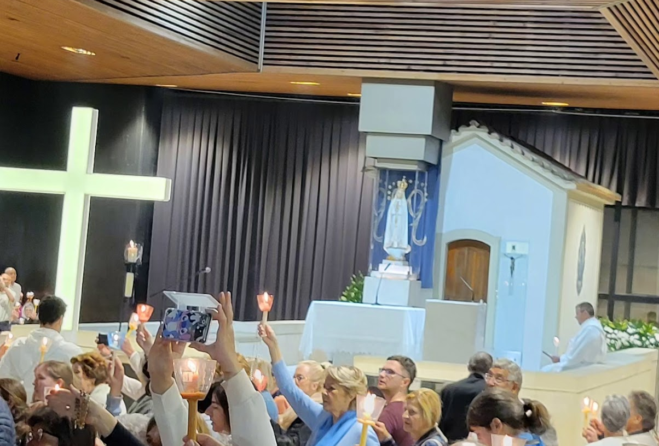
What is the difference between
a tourist
and a
religious pilgrim??

Slide 9

Pilgrims
do not
complain
We offer it up!

Slide 10
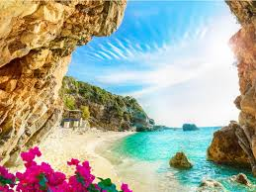
Meet your
fellow pilgrims!

Slide 11
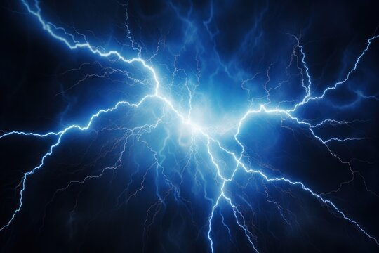
Electricity:
Europe’s electricity is 230 Volt 50hz.
Your electronics need a power adapter/converter
You will need a 2-prong adapter for your electronic items, which will fit into European outlets with two/three holes.

Slide 12

Plug adapters vs converters
The USA operates on 110 volts
Most of Europe operates on 220 volts
Adapters help the plugs fit into the outlet
Converters change the voltage of the electricity

Slide 13
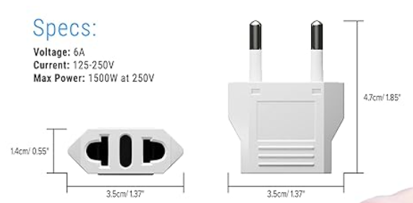
Adapter
https://www.amazon.com/s?k=european+travel+power+converter&i=tools&crid=1V2S2NQ5VG1CN&sprefix=european+travel+power+converter%2Ctools%2C82&ref=nb_sb_noss_1

Slide 14
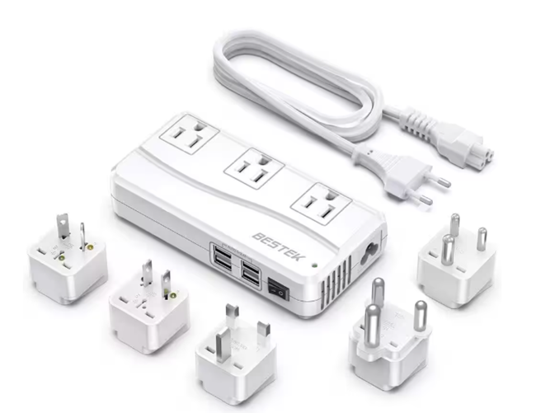
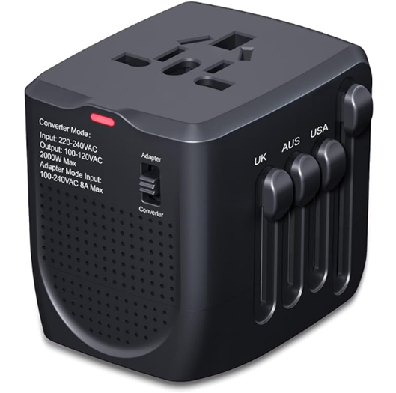


Slide 15
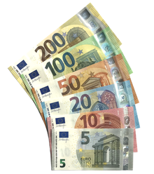
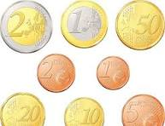
money
Europe’s currency is the euro (€). All major credit cards are widely accepted in Europe, though some establishments do not accept American Express and Diners.
You can purchase Euros (currency) through your bank

Slide 16
Exchange rate $1 =
Euros to US Dollars: exchange rates today
EUR | USD
1 EUR | 1.19 USD
10 EUR | 11.92 USD
20 EUR | 23.84 USD
50 EUR | 59.59 USD
0.84 Euro
Jan 29
It's a good idea to exchange currency before traveling to ensure you have some local currency on-hand when you arrive.

Slide 17

Things to check:
Cellular telephone coverage
Health insurance / coverage
Debit Cards – PIN issues
Credit Cards – say no to FOREIGN TRANSACTION FEES
How will you get to and from the airport?

Slide 18
TSA
What can I bring?
Liquids, Aerosols, and Gels Rule
Two-minute travel tips from Select International

Slide 19
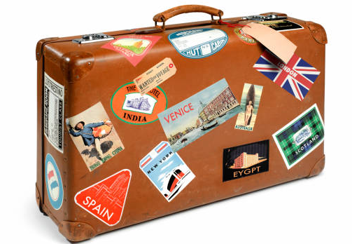
Luggage / baggage
Checked baggage – One single piece of baggage
  Not more 62 linear inches [height + width + length] in size, and 50 lbs. for Economy Class and 70 lbs. for Business Class.
One piece of cabin baggage per passenger
  not to exceed 21.7” x 13.8” x 9” in size and 26 lbs. in weight
One personal item per passenger
  not to exceed 40x30x15 inches in size and 9 lbs. in weight
Air France baggage American Airlines baggage

Slide 20
Weather late-April in Paris
Late April in Paris offers mild, pleasant spring weather, but it's famously unpredictable, with average highs around 15-17°C (59-62°F) and cooler nights around 7-9°C (45-48°F), so expect sunny days mixed with potential rain showers and chilly mornings/evenings, requiring layers and a light umbrella.

Slide 21
What to wear in France in April
While April temperatures begin to warm up, you’ll also want to bring warmer garb to layer up for cooler days and the chillier evenings, when temperatures slide.
For example, you might want to bring a fleece or a few pullovers. We also suggest bringing a light raincoat.

Slide 22
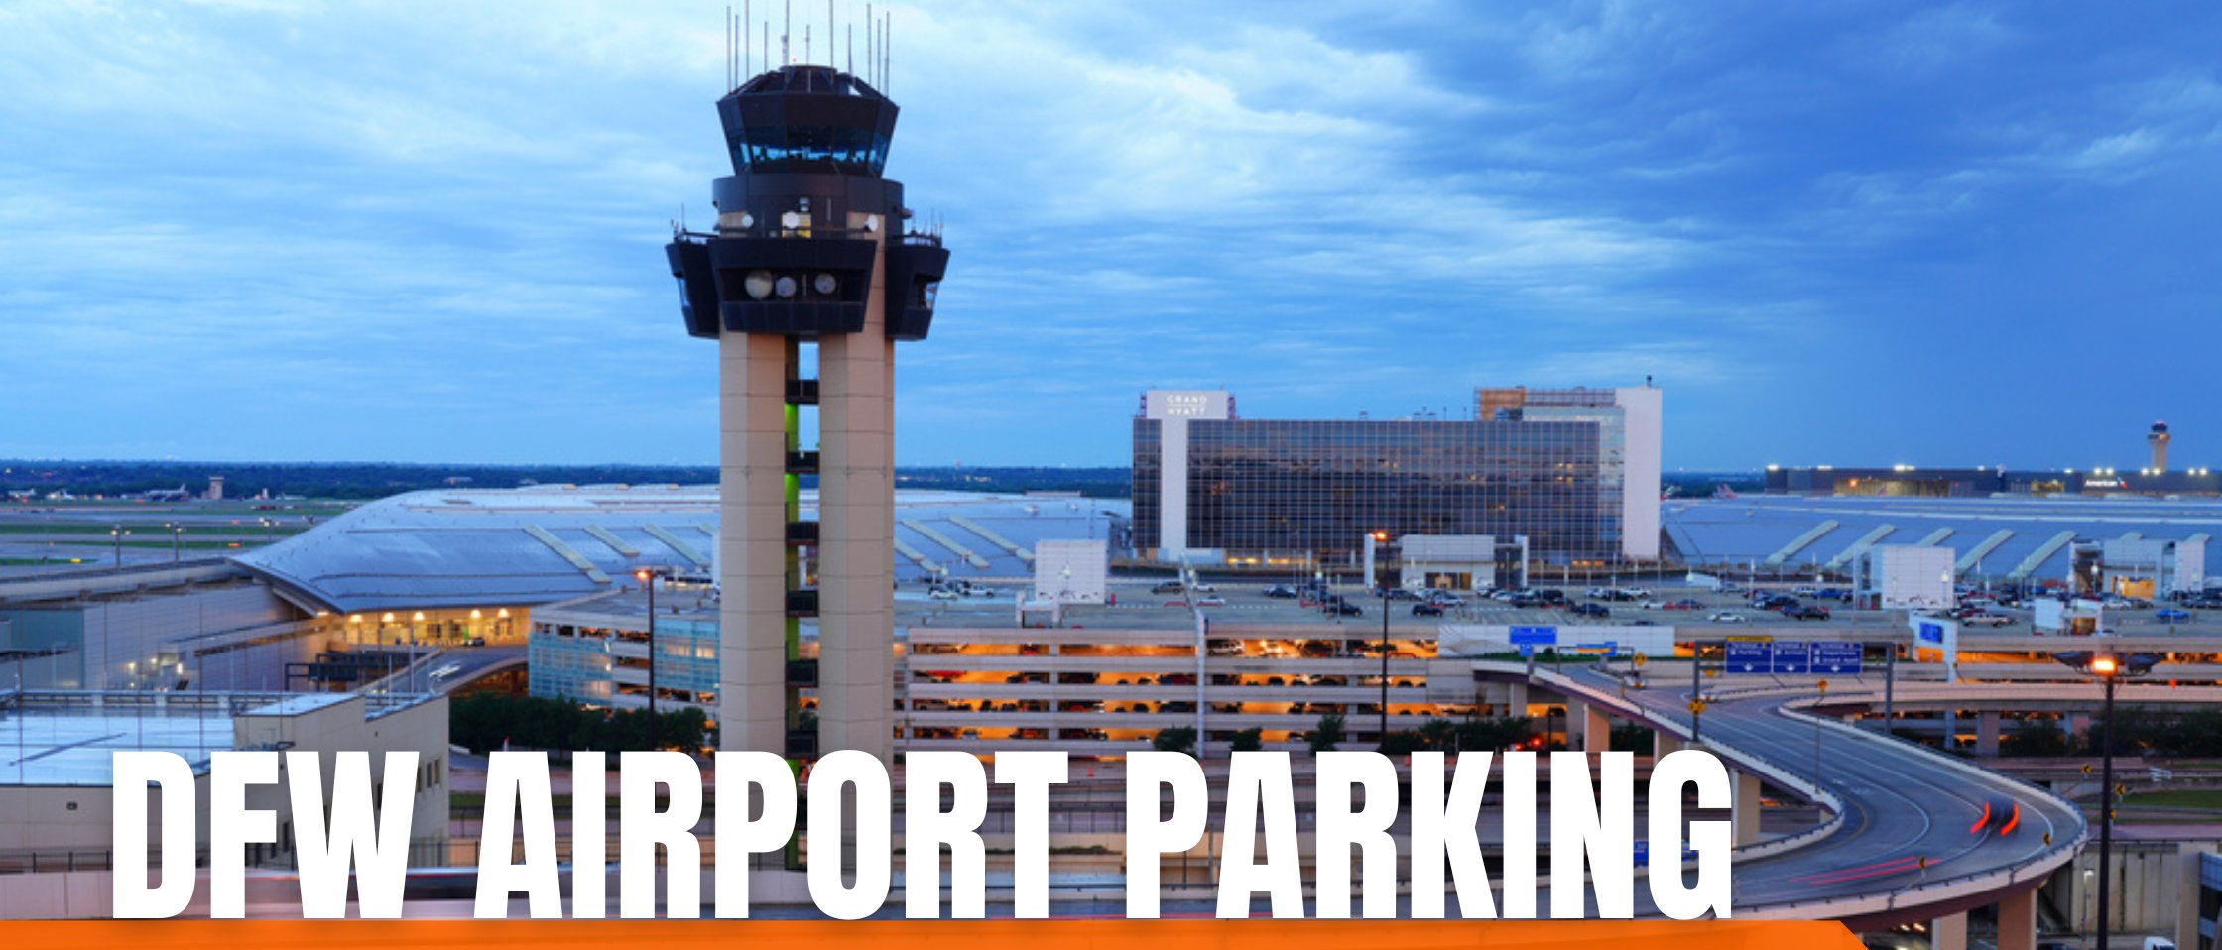
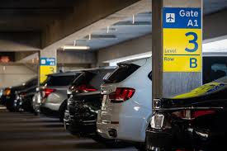

  Terminal Parking
  Valet options
  Express Parking - located on the north and south end of the airport
  Remote Parking - located north and south of the airport
  off-site long-term options.
Park at DFW

Slide 23
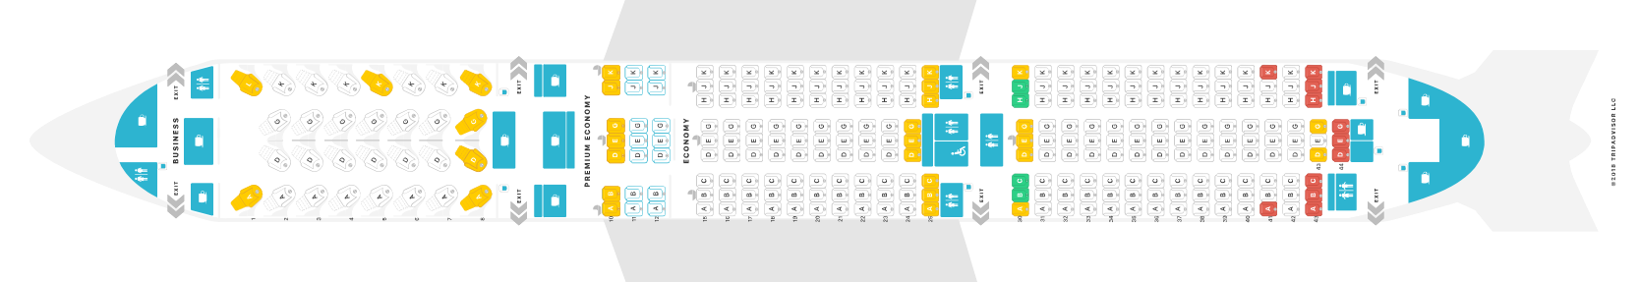
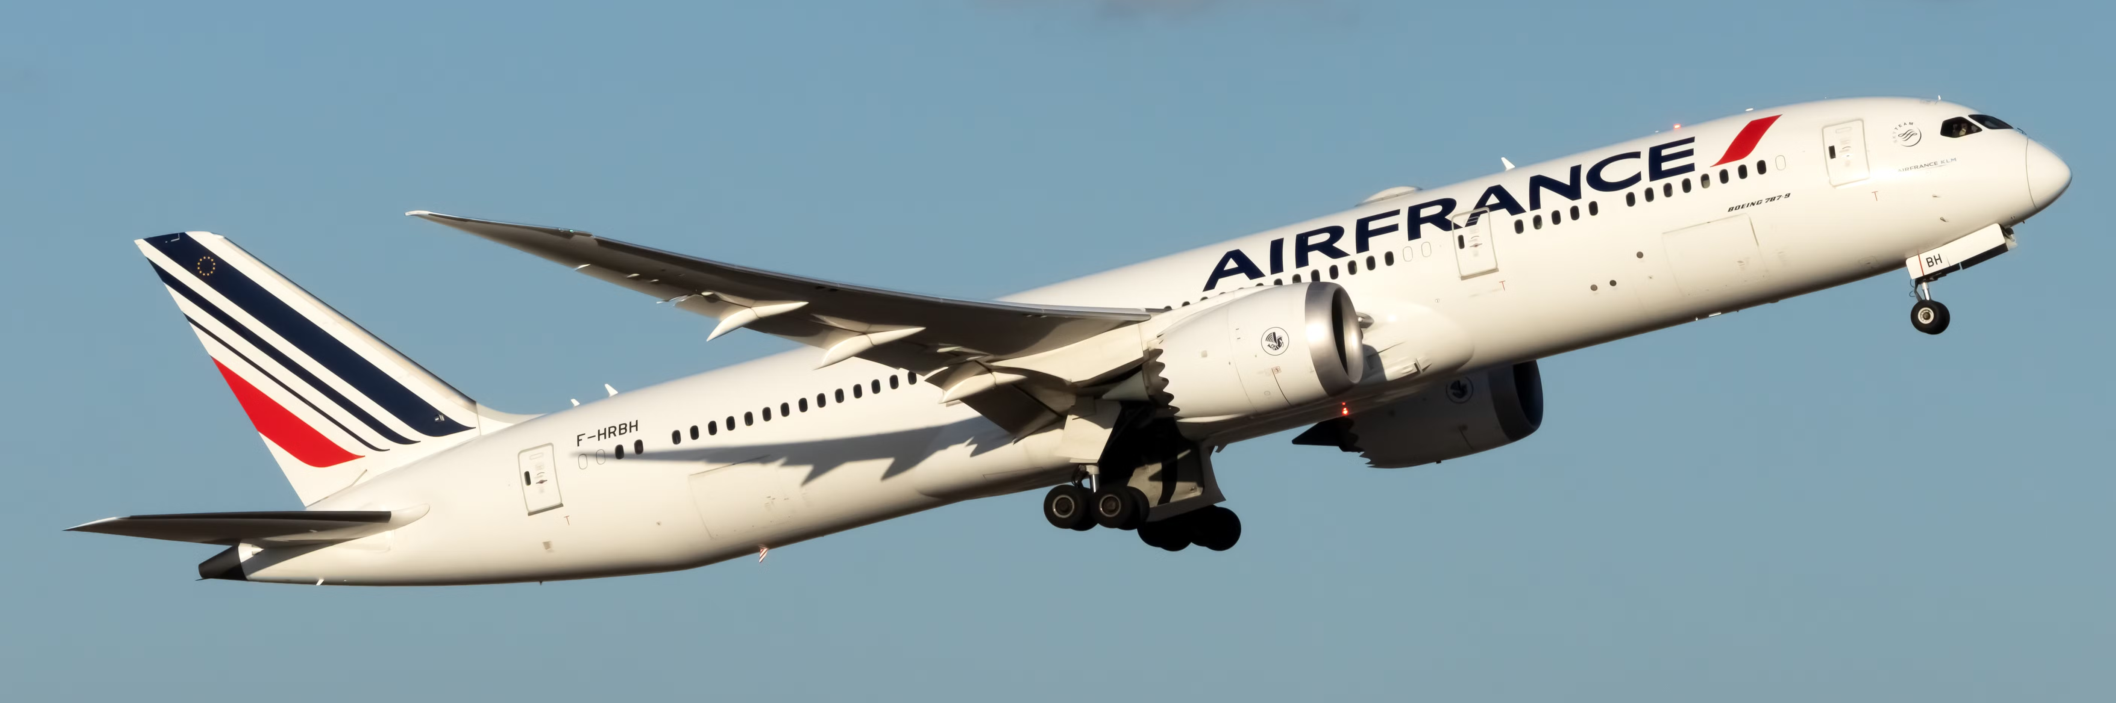
Day One
Air France
April 21, 2026
Dallas/ Fort Worth
3:50 pm
Evening departure from the United States (currently 3:50 pm)
Dinner and Breakfast served on the plane
Premium and business class upgrades available - work with the airline directly
https://www.seatguru.com/airlines/Air_France/Air_France_Boeing_787-9.php

Slide 24
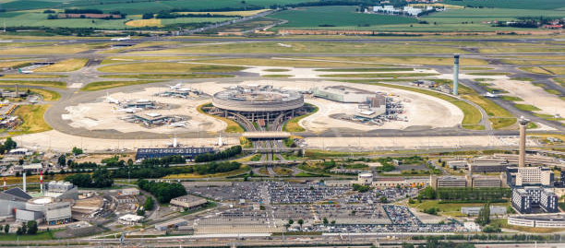
Arrive in Paris
April 22
Bienvenue à Paris, France
Welcome to Paris

Slide 25
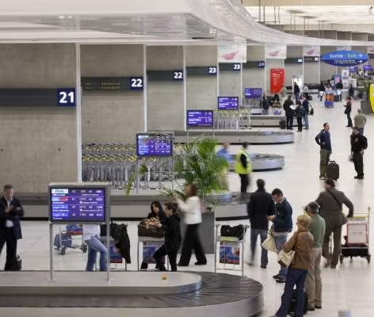
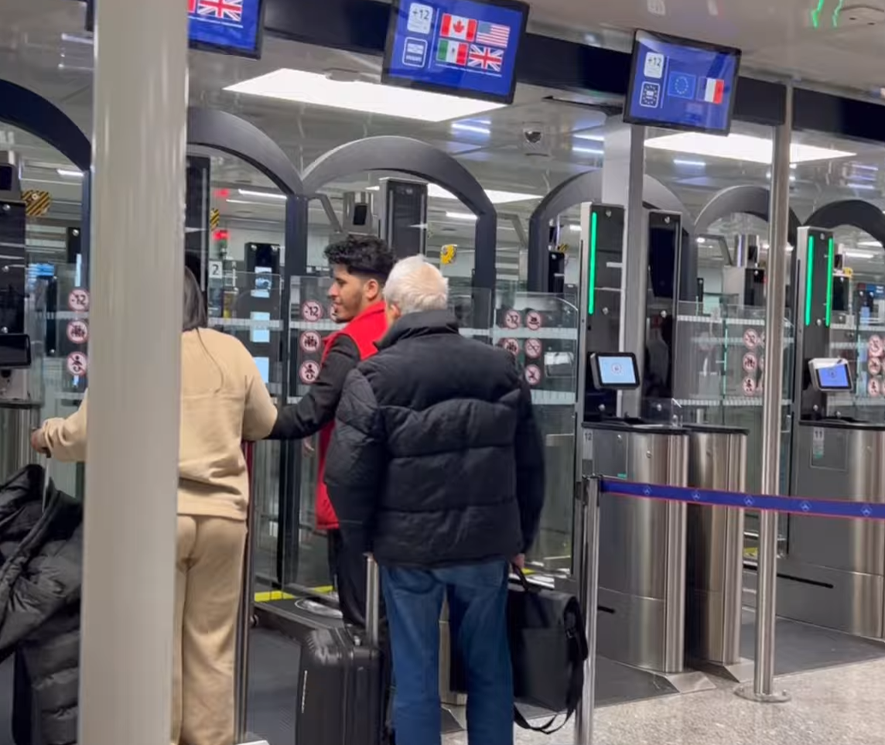
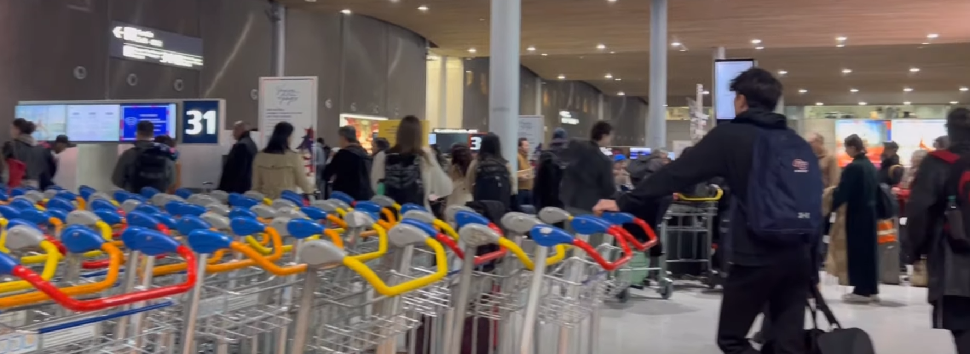
Arrive in at Charles de Gaulle Airport
Traveling with Jennifer Sparks Savoy

Slide 26
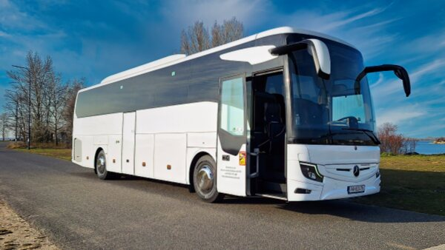
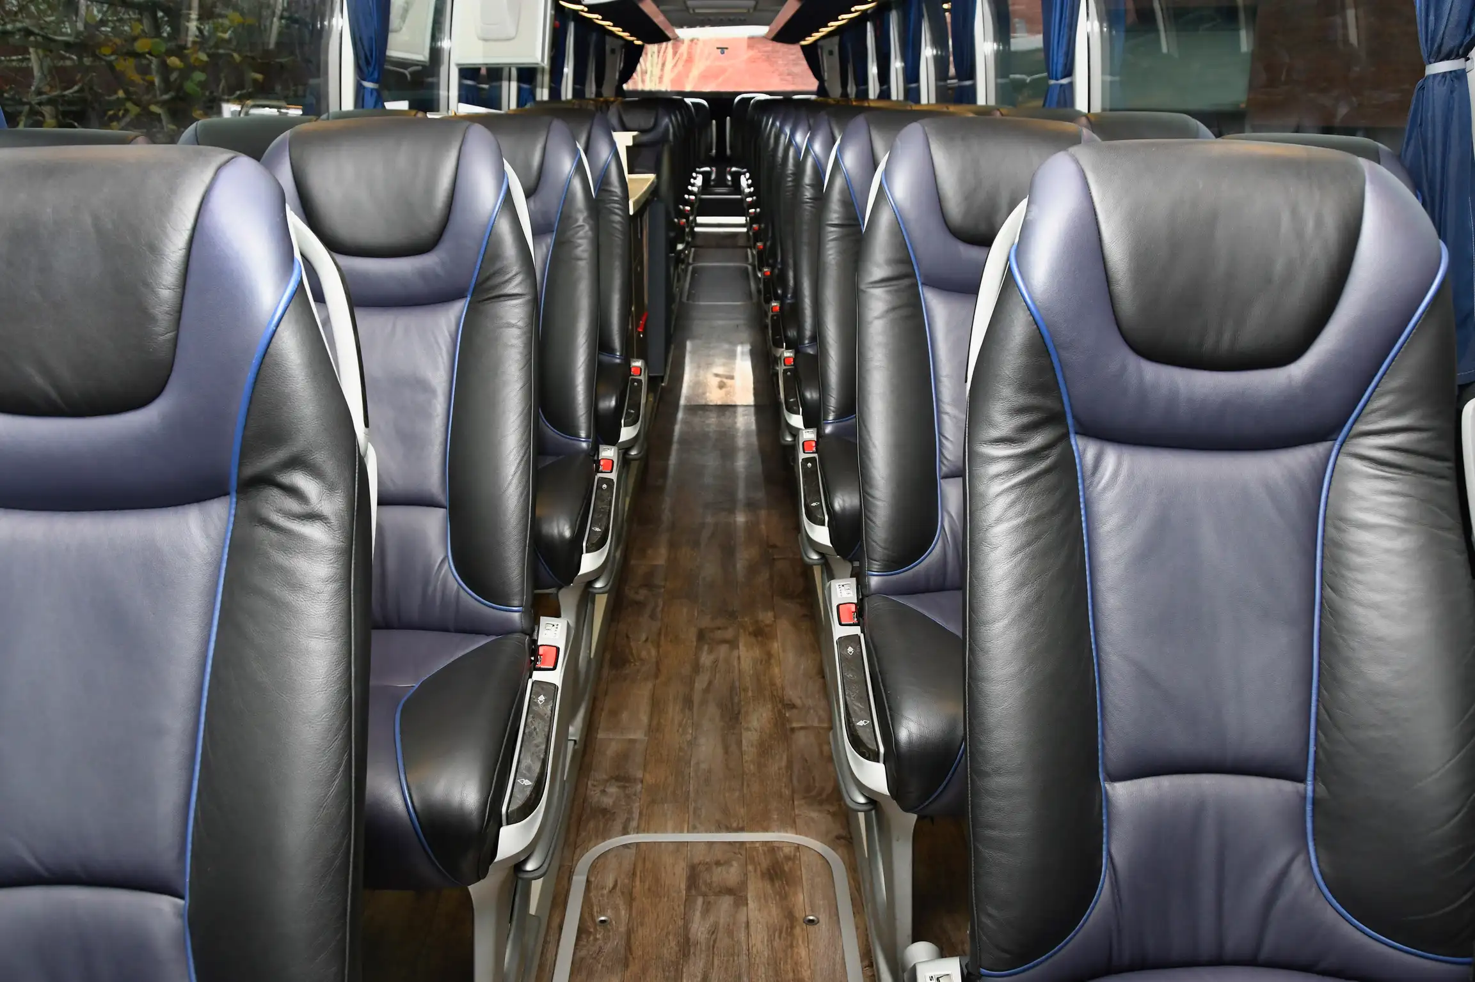
“Tour bus”

Slide 27
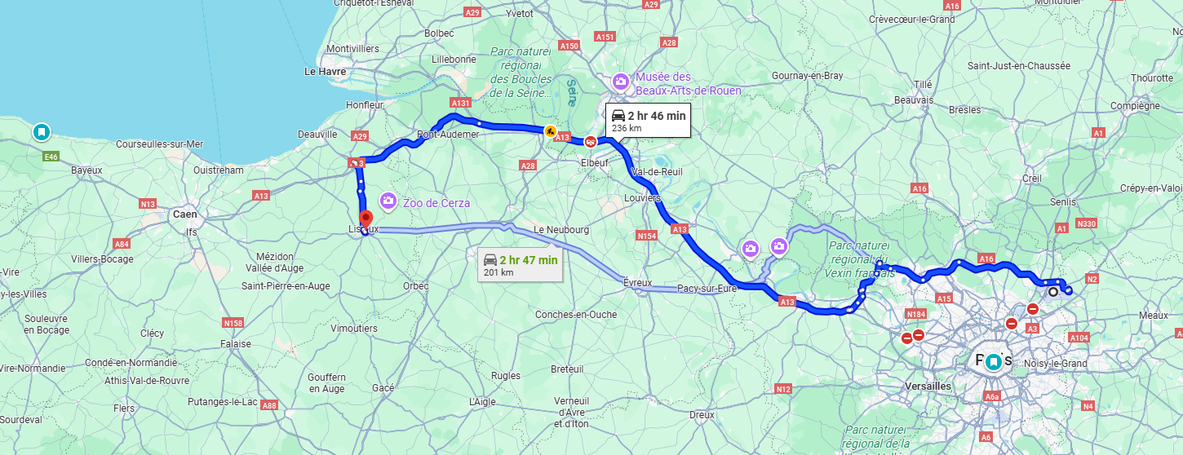
Route to Lisieux

Slide 28
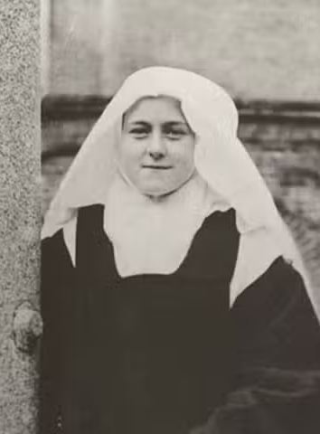
Saint Therese of Lisieux
I prefer the monotony of obscure sacrifice to all ecstasies. To pick up a pin for love can convert a soul.
The words of Thérèse of Lisieux, a Carmelite nun called the “Little Flower,” who lived a cloistered life of obscurity in the convent of Lisieux, France. Her preference for hidden sacrifice did indeed convert souls. Few saints of God are more popular than this young nun.
Her autobiography, The Story of a Soul, is read and loved throughout the world. Thérèse Martin entered the convent at the age of 15 and died in 1897 at the age of 24.

Slide 29
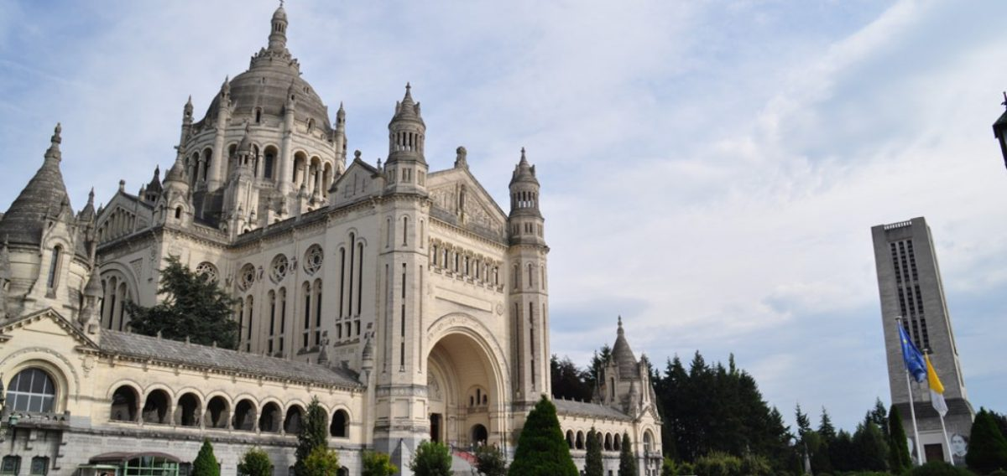
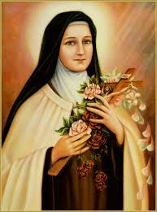
Lisieux, France overnight in Lisieux
Day 2
Basilica of St. Thérèse
Saint Thérèse of Lisieux
Doctor of the Church
https://www.littleflower.org/st-therese/
https://www.catholic.org/saints/saint.php?saint_id=105
https://www.therese-de-lisieux.catholique.fr/en/decouvrir-le-sanctuaire/la-basilique/
Bishop Barron on Saint Thérèse of Lisieux: https://www.youtube.com/watch?v=O7EJc94SfQg

Slide 30
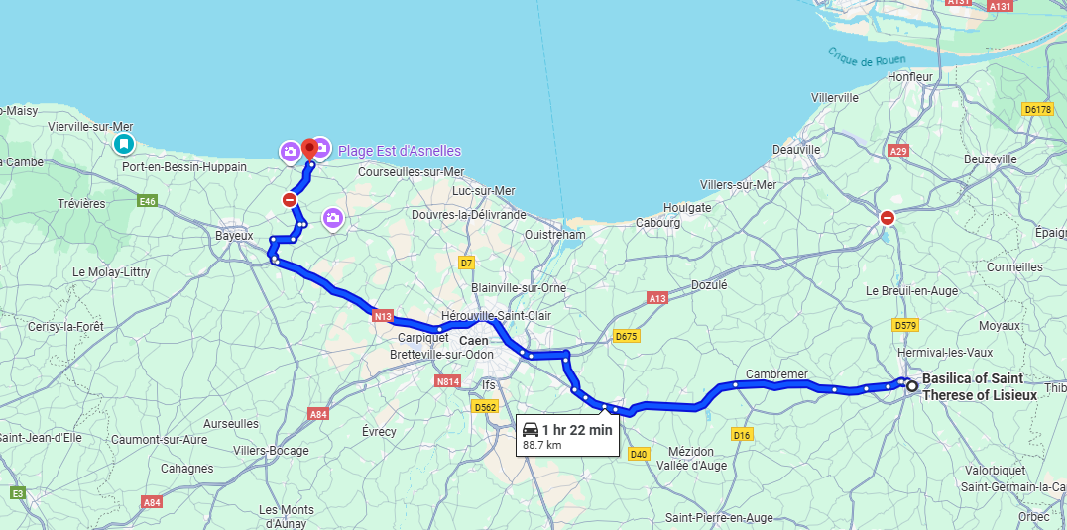
April 23 – Day 3 Lisieux to Normandy

Slide 31
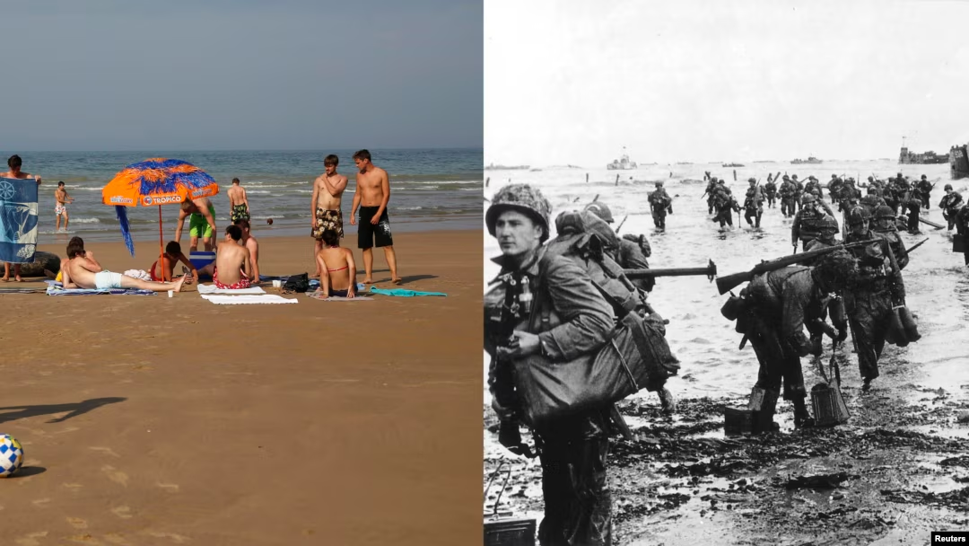
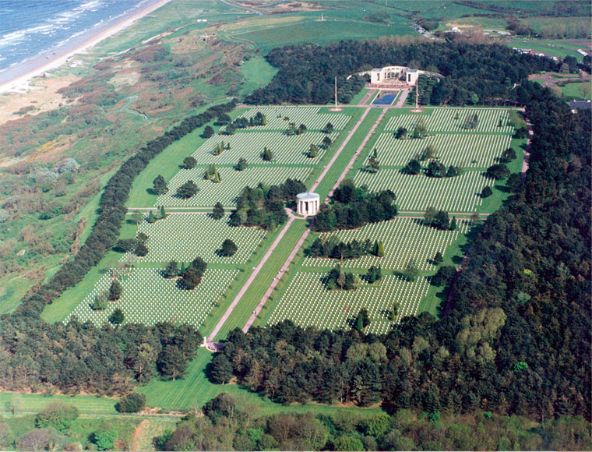

Beaches of Normandy
https://www.abmc.gov/cemeteries-memorials/about-normandy-american-cemetery/
D-Day
June 6, 1944
Day 3
Notes:
2500 Americans died / 4400 Allied soldiers died CEMETARY at Omaha Beach 9388 souls / 1557 MIA on the wall

Slide 32
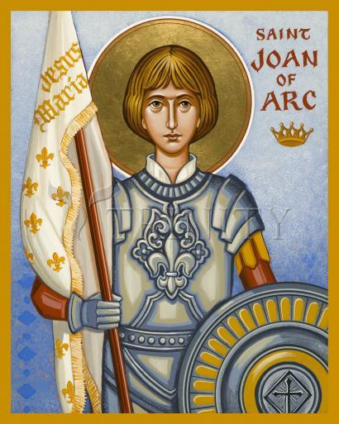
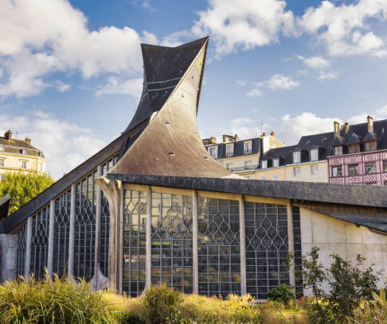
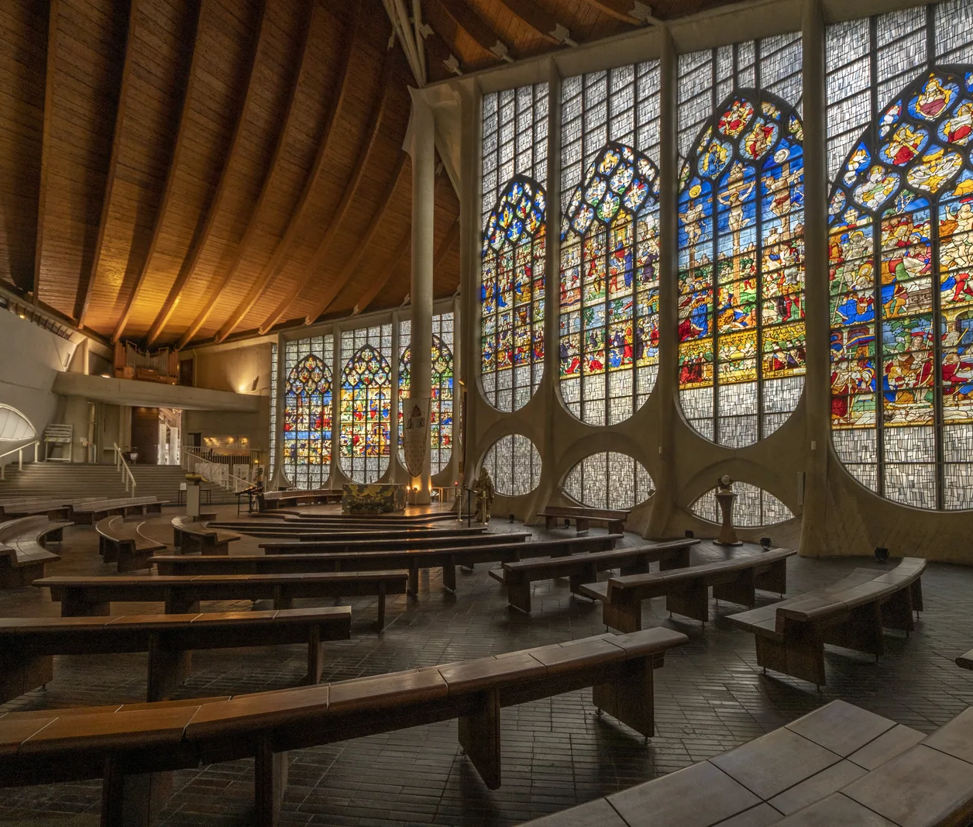
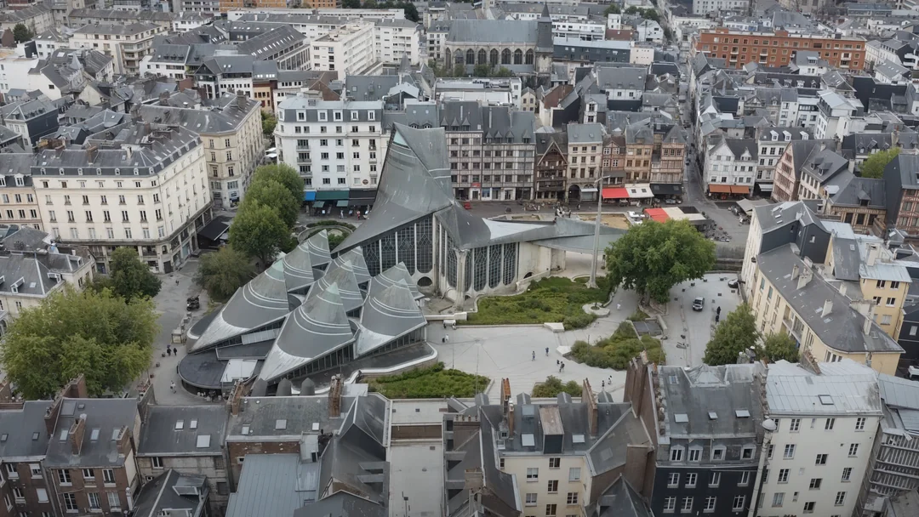
Rouen
City of Saint Joan of Arc
https://www.reddit.com/r/architecture/comments/1k3odxy/the_church_of_saint_joan_of_arc_rouen_france_1979/
Day 4

Slide 33
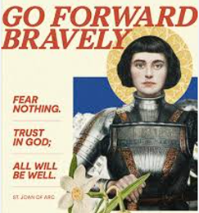
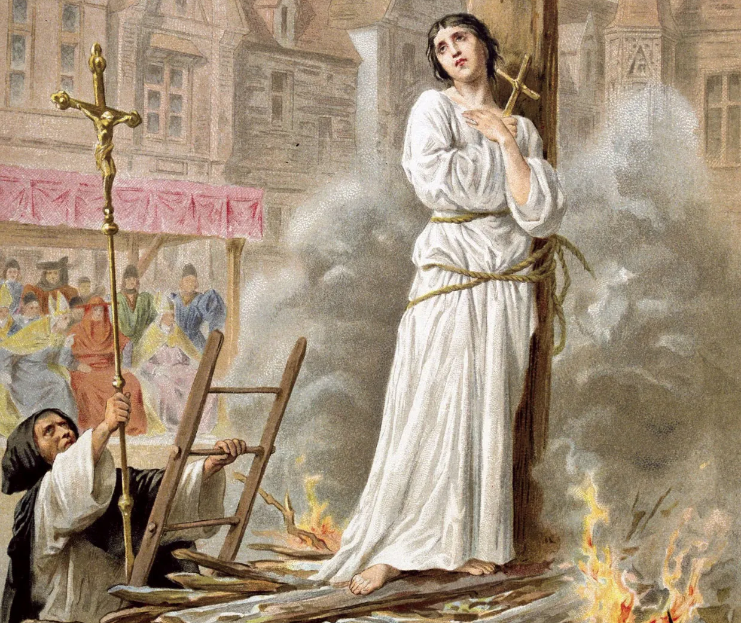
Saint Joan of Arc
St. Joan of Arc is a heroine of France and revered as a holy person for her faithfulness and courage, which she displayed in battle, but even more acutely in her trial and execution.
She was born Jeanne in 1412 on the feast of the Epiphany.
At the age of 14, she began hearing voices telling her she had a mission to save France during the Hundred Years’ War with England.
She marched into battle with a banner that proclaimed the names of Jesus and Mary.
Tortured and burned at the stake at age 19.
https://www.youtube.com/watch?v=bs9J-fuwRk0
https://www.youtube.com/watch?v=I5mVr2R5D-Y

Slide 34
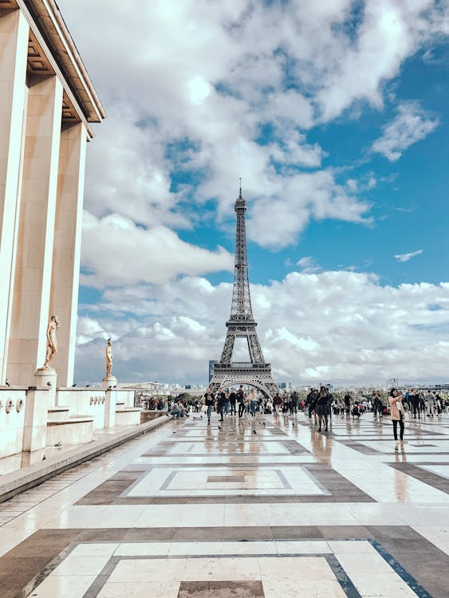
Saint Vincent de Paul
Day 5
morning
Visit Saint Vincent de Paul
“Quick” lunch
City tour of Paris
https://www.youtube.com/watch?v=WEarj49hFRg&list=PL58g24NgWPIzvBk2IQVES_xC4WTm6-CDI

Slide 35
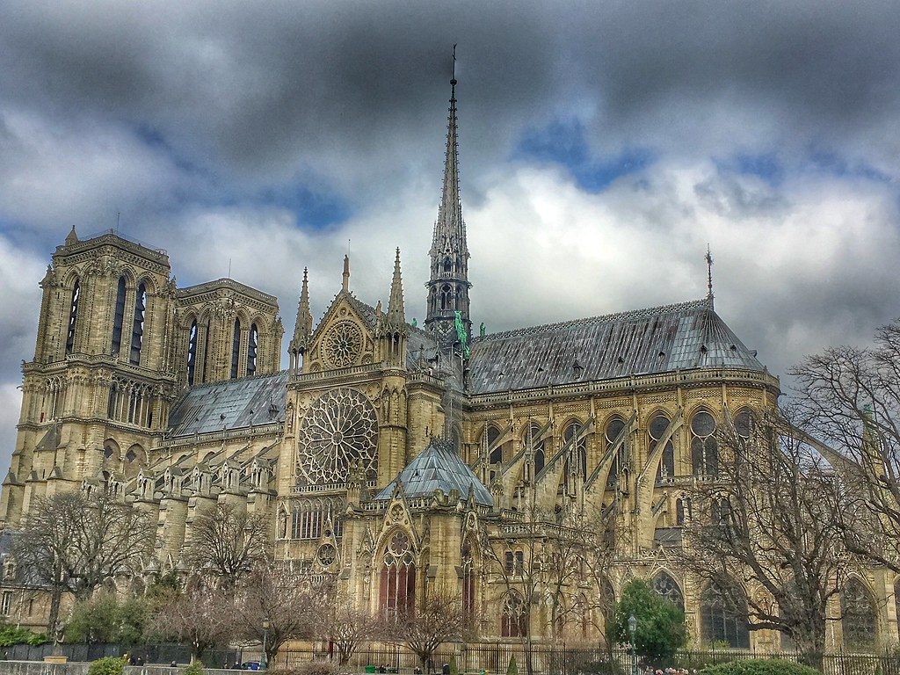
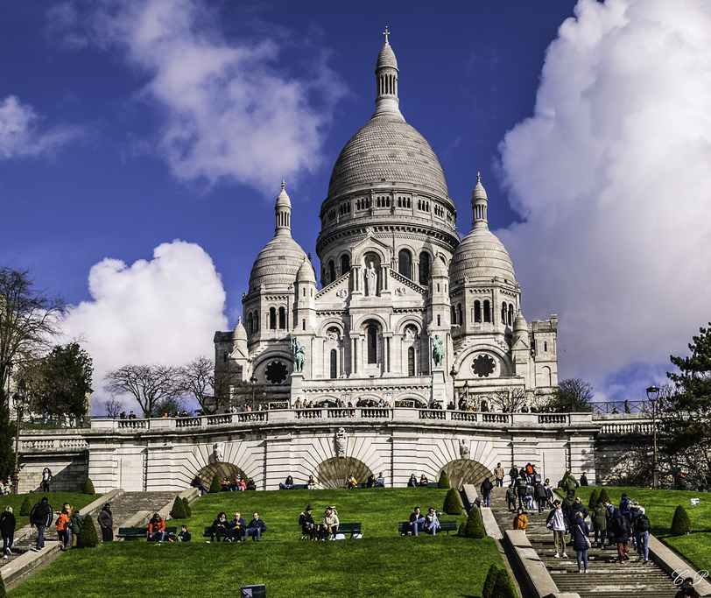
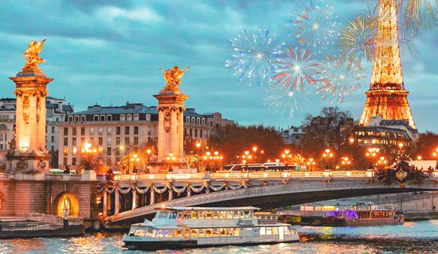
Tour of Notre Dame https://www.notredamedeparis.fr/en/
Visit Sacre Coeur
(Sacred Heart Basilica) https://www.sacre-coeur-montmartre.com/en/
Seine Dinner cruise with Eiffel Tower fireworks
Day 5

Slide 36
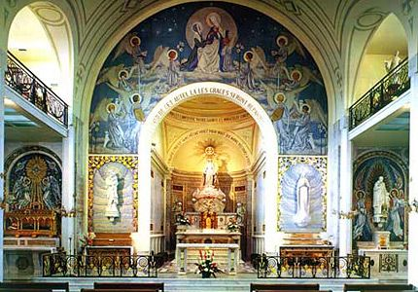
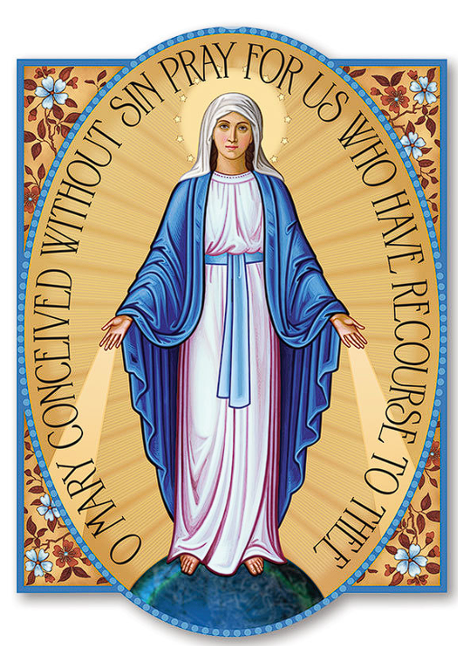
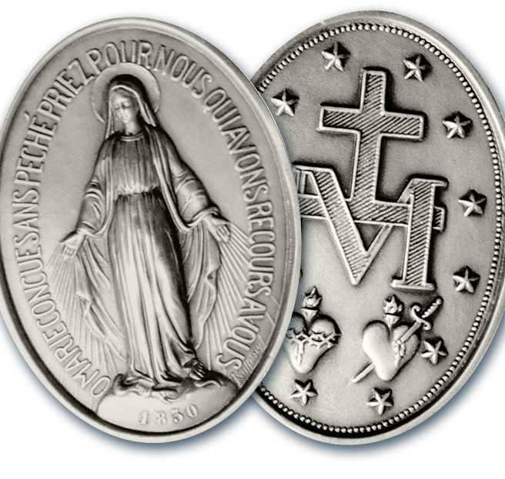
Day 6 Paris, France
Celebrate Mass at the
Chapel of the Miraculous Medal
https://youtu.be/aTnzelRultc

Slide 37
Day 6
After Mass - depart Montparnasse train station to travel to Lourdes, France
T G V Train
Train à Grande Vitesse
https://video.search.yahoo.com/search/video?fr=pk4afpq0b2f&ei=UTF-8&p=inoui+tgv&type=E210US714G91762#id=18&vid=9541541d71104a64925beae39ace16ce&action=view

Slide 38
Day 6
Lourdes, France
Walking tour of Lourdes and celebrate Mass. We will see the places associated with the apparition of the Blessed Mother and the life of little Bernadette. Overnight in Lourdes.
https://www.youtube.com/watch?v=IzeO0E36RJw
Opportunity to join the
Candlelight Procession

Slide 39
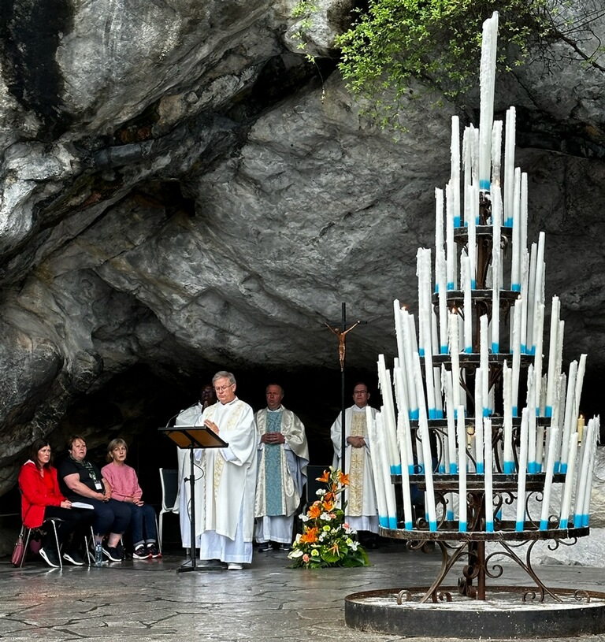
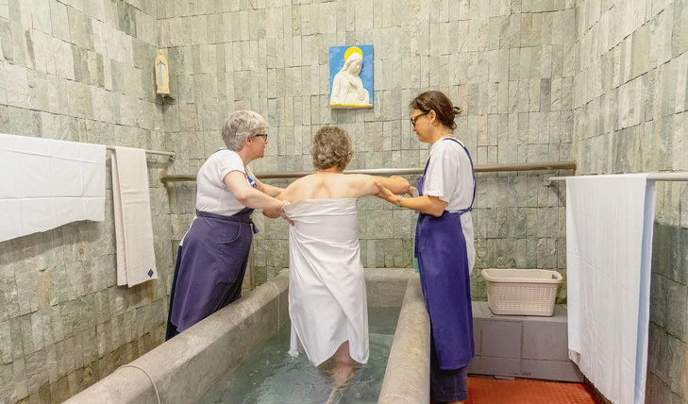
Lourdes
Days 7 & 8
Pilgrimage schedule includes comprehensive spiritual activities, candlelight procession, baths, and Stations of the Cross. Visit the birthplace of Saint Bernadette
Bathe in the baths at the grotto.
The baths of the Marian Shrine of Our Lady of Lourdes in France have completely reopened after four years. Pools for the Sick Reopen in the Shrine of Lourdes, Closed Since the Pandemic | ZENIT – English – Aug. 20, 2024
Mass at the Grotto

Slide 40
Lourdes –Avila, Spain
Day 9
Avila
The magnificent walled city dedicated to Saint Teresa of Avila - the first woman to be named a Doctor of the Church.
Visit the Crypt of La Encarnacion Convent where she became a nun.
See the Cathedral and the Cuatro Postes which commemorates Saint Teresa who at the age of seven convinced her brother to run away with her to die as martyrs.
Mass will be celebrated
Dinner and overnight in Avila

Slide 41
Avila-Fatima, Portugal
Day 10
Fatima
Journey through Spain toward Portugal.
Late in the afternoon, we will arrive in Fatima, one of the most visited pilgrimage sites in the world.
Well known for the story of the apparition of Our Lady to three shepherd children in 1917
Mass will be celebrated
Overnight in Fatima

Slide 42

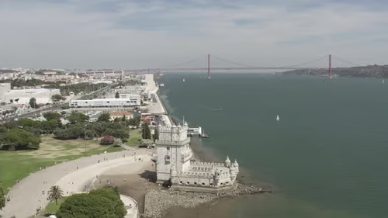
Santarem - Lisbon
Day 12
Belem Tower and the longest bridge in Europe
https://www.youtube.com/watch?v=6wa46iwpVso

Slide 43
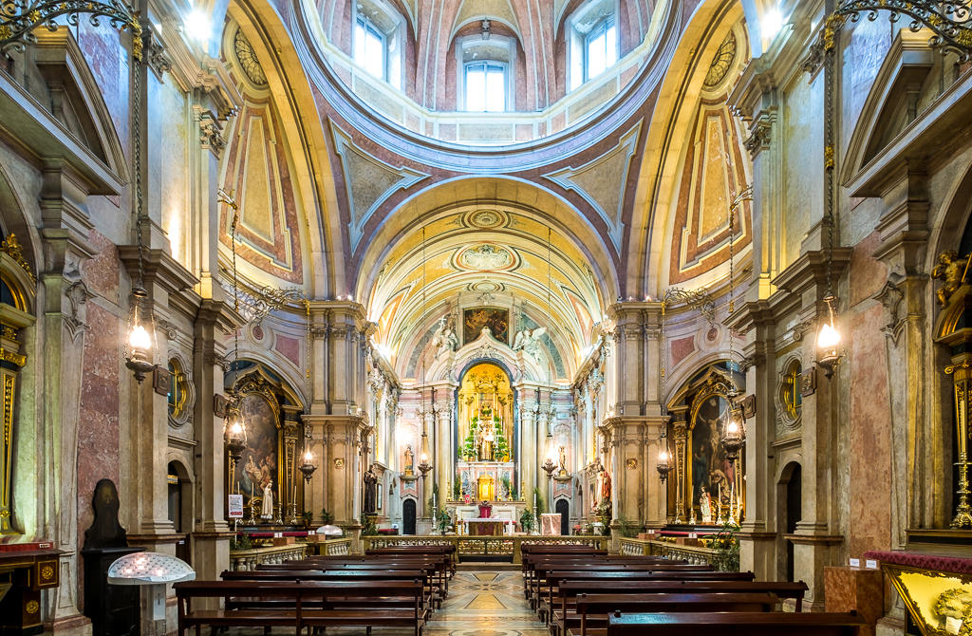

Lisbon
Day 12
Church of Saint Anthony
300’ Statue of Christ the King
The Feast of Saint Anthony will be celebrated

Slide 44

Day 13
5:40 am
departure to Charles de Gaulle
12:25 pm
departure to DFW
Adeus, Viagens Seguras!
Goodbye, Safe Travels!

